Slide 1
“Survive and Thrive: How to Overcome Adversity and Live the Life You Really Want”
By Darcy Keith

Slide 6
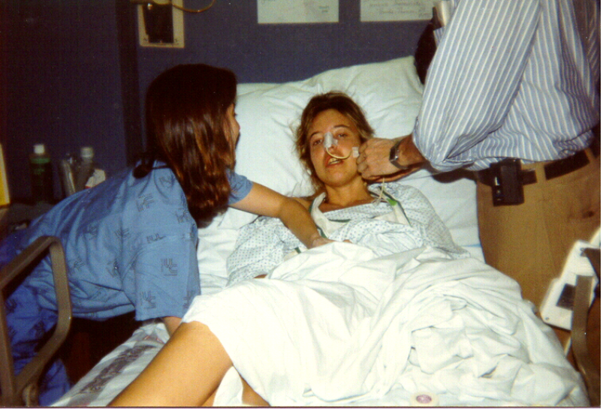

Slide 7
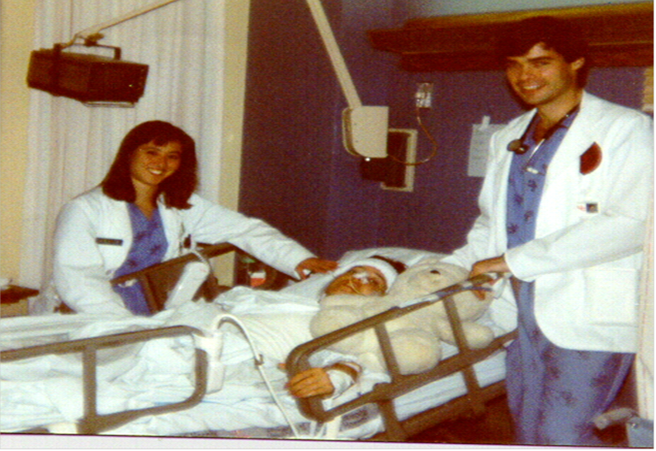

Slide 8
Three Types of Memory:

Slide 9
Three Types of Memory:
Retrospective – Ability to recall things that have happened in the past.

Slide 10
Three Types of Memory:
Retrospective – Ability to recall things that have happened in the past.
Prospective – Remembering to perform a planned act in the future.

Slide 11
Three Types of Memory:
Retrospective – Ability to recall things that have happened in the past.
Prospective – Remembering to perform a planned act in the future.
Habit – Completing habitual tasks without much thought.

Slide 12
STEPS to Survive and Thrive:

Slide 13


Brain Gym® Exercises
Relax, Focus, and Concentrate
Hook-ups – Part II
Hook-ups - Part II
Text and photos from the book Educate Your Brain by Kathy Brown, M.Ed. Chapter 13, “A Selection of Brain Gym Movements,” pages 144-145. ©Copyright 2012. www.EducateYourBrain.com. Brain Gym® is a registered trademark of Brain Gym® International. www.braingym.org

Slide 14
STEPS to Survive and Thrive:
Surrender - let go what you can’t control

Slide 15
STEPS to Survive and Thrive:
Surrender - let go what you can’t control
Try not to play the “victim” attitude

Slide 16
STEPS to Survive and Thrive:
Surrender - let go what you can’t control
Try not to play the “victim” attitude
Exemplify a positive attitude

Slide 17
A positive attitude:
Allows us to live longer, healthier lives
Helps to cope with life’s daily activities
Helps us manage and handle stress
Leads to happiness and success

Slide 18
STEPS to Survive and Thrive:
Surrender - let go what you can’t control
Try not to play the “victim” attitude
Exemplify a positive attitude
Persevere with fortitude and determination

Slide 19
STEPS to Survive and Thrive:
Surrender - let go what you can’t control
Try not to play the “victim” attitude
Exemplify a positive attitude
Persevere with fortitude and determination
Specifically ask for help, if needed.

