Slide 1
Caring for Combat Wounds
Presented by
Stephen Heck
M.Res., M.A.

Slide 2
Session Description
Working with veterans is not always equivalent to providing care to the general population. This session provides information for caregivers on understanding and overcoming barriers to providing care to veterans with traumatic brain injury.

Slide 3
Agenda
My background
Objectives
Seminar topics:
Military TBI
Veterans experience with TBI
TBI and substance abuse with veterans
Caregivers for TBI veterans survivors
Resources
References
Questions

Slide 4
Background
Prior Experience:
10 years as a U.S. Army Chemical, Biological, Radiological, and Nuclear (CBRN) officer (1x Afghanistan tour)
Defense and Veterans Brain Injury Center (DVBIC), Research Coordinator
Brain Injury Rehabilitation Services at Robin Hill Farm, Life Skills Facilitator
Research interest:
Traumatic brain injuries... improve quality of life
Military studies
Current research projects:
Art therapy mask intervention
College students’ experience with and knowledge of concussions
West Virginia Medicaid TBI claims data
Army Reserve and National Guard service members’ experience with balancing life requirements with their military requirements
PhD student at WVU School of Public Health in the social and behavioral sciences

Slide 5
Objectives
Identify important aspects of veterans experience with TBIs
Discuss the role of a caregiver in supporting veterans with TBIs

Slide 6
What is a TBI?
A direct blow or jolt to the head
A penetrating head injury, or
Exposure to external forces such as blast waves that disrupt the function of the brain
(DVBIC, 2010)

Slide 7
Military TBI

Slide 8
Military TBI
Combat concussion often co-exists with post-traumatic stress
Gender and age distributions differ from civilian populations
Military populations tend to be healthier
Less often subject to severe substance abuse
Mandated treatment programs
Requirements for deployable condition
(DVBIC, 2010)

Slide 9
Concerns with servicemembers reporting TBIs
Stigma
Concerns about being forced out of their unit or the Army
Do not want to let their ‘battle buddies’ down
Do not recognize symptoms

Slide 10
How Common is TBI in the military?
TBI is the leading injury among U.S. forces serving in Afghanistan and Iraq
Active duty and reserve service members are at increased risk for sustaining a TBI compared to their civilian peers.
In 2008, the Department of Defense (DoD) reported that:
Seven out of 10 TBI injuries were due to a blast
More than 1 in 10 were due to a fall
More than 1 in 20 were due to a vehicular incident
One in 20 were due to fragments
The rest were due to other causes.
The Army reported that 88 percent of TBIs among soldiers were mild. Six percent were moderate and another six percent were severe.
(DVBIC, 2010)

Slide 11
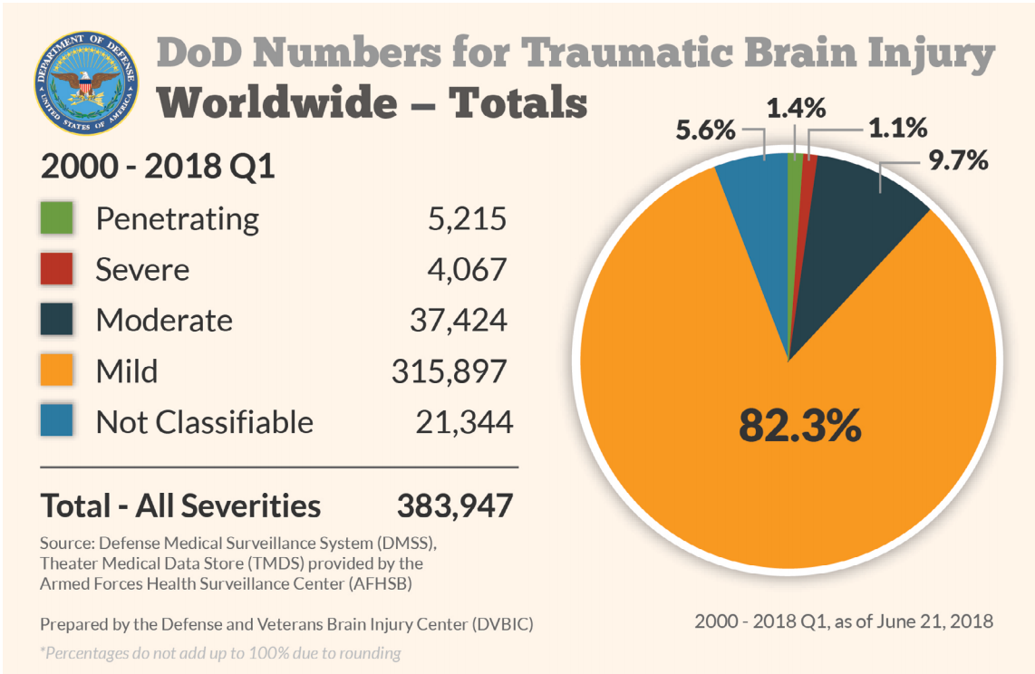
Department of Defense Numbers for TBIs

Slide 12
Veterans experience with TBI

Slide 13
Experience since injury
Experiencing reduced physical and mental function
Migraines, changes in memory, experiencing nerve damage, and sensitivity to light
Staying active, being physically active or going to school, as the most helpful
Lack of community support
Extensive amounts of time researching treatments for themselves
(Koehmsted et al., 2018)

Slide 14
Changes to health status
Concentration
Memory problems
Increased irritability
Changes in symptoms and new symptoms after many years pass
(Koehmsted et al., 2018)

Slide 15
TBI and substance abuse with veterans

Slide 16
Substances use after a TBI
Brain more sensitive to alcohol after TBI
Increases likelihood of another TBI
Increases seizure risk associated with moderate and severe TBI
Reduces gains in brain injury recovery
Exacerbates negative TBI effects on mental abilities
Headaches and hangovers
(Weil et al., 2016; Corrigan & Cole, 2008; DVBIC, 2017)

Slide 17
Recommendations
There is no ‘safe’ level of alcohol or recreational drug use after TBI
Six-month window of increased risk for dependence or another TBI
Alcohol use dangerously complicates medication interactions
Substance abuse significantly slows/prevents the healing of brain injuries.
Additional prescription medication risks in addicted and TBI populations
(Weil et al., 2016; Corrigan & Cole, 2008; DVBIC, 2017)

Slide 18
Substance use and effect on TBI recovery
Make it harder for the brain to heal
Interfere with thinking processes that are already slowed down
Increase aggressive and socially inappropriate behaviors
Increase balance problems
Promote other risky behaviors
Cause problems with friends and family
Worsen feelings of depression and anxiety
(Weil et al., 2016; Corrigan & Cole, 2008; DVBIC, 2017)

Slide 19
How to help veteran TBI survivors with substance abuse
Talk
Talk with them
Maximize
Maximize time with people who encourage not using substances
Avoid
Avoid high risk situations
Develop
Develop a plan
Explore
Explore new social circles or environments
Encourage
Encourage learning of new ways to deal with stress
Remove
Remove substances from the home

Slide 20
Caregivers for TBI servicemembers survivors

Slide 21
What is a caregiver?
Any family or support person(s) relied upon by the service member or veteran with traumatic brain injury (TBI) who assumes primary responsibility for ensuring the needed level of care and overall wellbeing of that service member or veteran.

Slide 22
Caregiver Role
Case manager
Advocate
Benefits coordinator
Health care provider

Slide 23
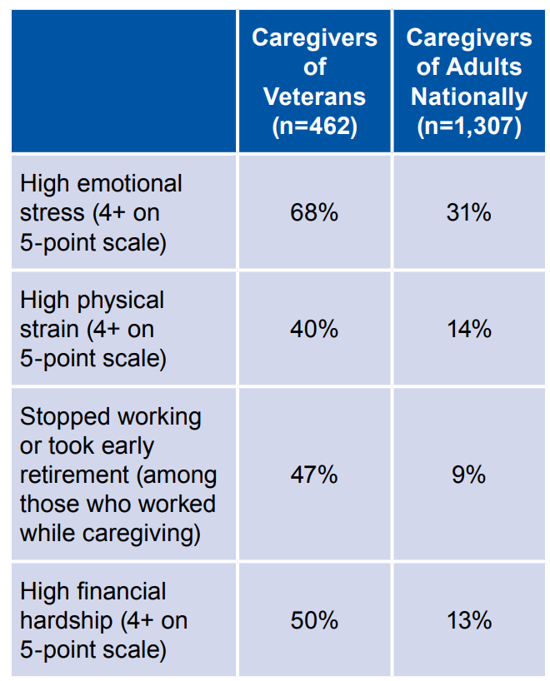
Caregivers of veterans
(National Alliance for Caregiving, 2010)

Slide 24
Uniqueness of caregivers to servicemembers
Compared to civilian populations:
Experience less family cohesion and nurturance
Greater emotional distress and mental health problems
Greater financial strain
Additional difficulties
Burdens related to deployment and reintegration
Servicemembers are more likely to experience repeat injuries as well as physical and psychological issues at the same time with their TBI
(Carlozzi et al., 2016)

Slide 25
Caregiver unmet needs after a TBI
Health information
Emotional support
Instrumental support
Professional support
Community support network
Involvement with care
(Brickell et al., 2019)

Slide 26
Experiences of caregivers
Many caregivers receive stipends that allow them to be paid for providing care for the veteran
General feeling of pride and respect for the sacrifices that their loved one had made for their country
Anger related to perceived lack of availability, accessibility, or ease of navigating the military or VA healthcare system
Appointments, and disruption of financial benefits were common complaints and significant sources of anger for many caregivers

Slide 27
Experiences of caregivers
A large proportion of caregivers report numerous unmet health care and social service needs
Many do not receive any training on how to navigate the VA/DoD benefits or medical system
Unaware of what to expect from their loved one and how to appropriately respond to their needs
Veteran’s impulsive spending habits that can affect family finances
(Carlozzi et al., 2016; Saban et al., 2016)

Slide 28
Impact on military TBI survivor caregivers
Social health
Emotional health
Physical/medical health
Cognitive health

Slide 29
Social health
Common concerns:
Trouble with finances
Giving up a career to serve as a caregiver for their servicemember (vocation)
Being a caregiver has changed their social roles
Affected other social systems (family and friend relationships)
Uncertain of how hard to push the servicemember
Changes in social roles:
Difficulty switching back and forth from spouse to caregiver
Having to manage another person who was previously independent
Family disruption
(Carlozzi et al., 2016)

Slide 30
Emotional health
Common concerns:
Caregiver strain/burden
Feelings of loss
Feelings of anger
Depression
Anxiety
Hypervigilant:
Constantly monitor their own behavior
Behavior of other individuals
Behavior of the servicemember
(Carlozzi et al., 2016)

Slide 31
Physical/medical health
Common concerns:
Not feeling as “sharp” as he or she used to be
Feeling like he or she had TBI via proxy
(Carlozzi et al., 2016)

Slide 32
Physical/medical health
Common concerns:
Lifestyle choices
Diet and exercise
Difficulties keeping up with their own medical care
Intimacy/sexual life with their partners
Fatigue and sleep difficulties
(Carlozzi et al., 2016)

Slide 33
Resources

Slide 34
Important resources
RealWarriors.net: 24/7 Live Chat: realwarriors.net/livechat
Military Crisis Line for crisis intervention: 800-273-8255, press 1
Psychological Health Resource Center: 866-966-1020
National Suicide Prevention Lifeline: at 1-800-273-8255 (TALK)

Slide 35
For more information
WVU Center for Excellence in Disabilities
Brain Injury Association of America
Defense and Veterans Brain Injury Center
National Association of State Head Injury Administrators
North American Brain Injury Society
Traumatic Brain Injury Technical Assistance Center
Department of Veterans Affairs
Wounded Warrior Project

Slide 36
References

Slide 37
Brickell, T. A., Lippa, S. M., French, L. M., Gartner, R. L., Driscoll, A. E., Wright, M. M., & Lange, R. T. (2019). Service needs and health outcomes among caregivers of service members and veterans following TBI. Rehabilitation Psychology, 64(1), 72-86. doi:10.1037/rep0000249
Carlozzi, N. E., Brickell, T. A., French, L. M., Sander, A., Kratz, A. L., Tulsky, D. S., . . . Lange, R. T. (2016). Caring for our wounded warriors: A qualitative examination of health-related quality of life in caregivers of individuals with military-related traumatic brain injury. Journal of Rehabilitation Research & Development, 53(6), 669-679.
Carlozzi, N. E., Kratz, A. L., Sander, A. M., Chiaravalloti, N. D., Brickell, T. A., Lange, R. T., . . . Tulsky, D. S. (2015). Health-related quality of life in caregivers of individuals with traumatic brain injury: development of a conceptual model. Archives of physical medicine and rehabilitation, 96(1), 105-113. doi:10.1016/j.apmr.2014.08.021
Carlozzi, N. E., Lange, R. T., French, L. M., Sander, A. M., Freedman, J., & Brickell, T. A. (2018). A Latent Content Analysis of Barriers and Supports to Healthcare: Perspectives From Caregivers of Service Members and Veterans With Military-Related Traumatic Brain Injury. Journal of Head Trauma Rehabilitation, 33(5), 342-353. doi:10.1097/HTR.0000000000000373
Corrigan, J., & Cole, T. (2008). Substance use disorders and clinical management of traumatic brain injury and posttraumatic stress disorder. Jama, 300(6), 720-1. doi:10.1001/jama.300.6.720 Defense and Veterans Brain Injury Center (2016). Addressing family needs. Falls Church, VA: A Defense Centers of Excellence for Psychological Health and Traumatic Brain Injury Center
Defense and Veterans Brain Injury Center. (2010). Traumatic brain injury: A guide for caregivers of service members and veterans (Curriculum). Retrieved from https://dvbic.dcoe.mil/caregivers-companion.
Defense and Veterans Brain Injury Center. (2017). TBI, Substance use: This is your injured brain on alcohol (PDF slides). Retrieved from http://dvbic.dcoe.mil/training/webinars/2017/tbi-substance-use-your-injured-brain-alcohol.

Slide 38
Griffin, J. M., Lee, M. K., Bangerter, L. R., Van Houtven, C. H., Friedemann-Sánchez, G., Phelan, S. M., . . . Meis, L. A. (2017). Burden and mental health among caregivers of veterans with traumatic brain injury/polytrauma. American Journal of Orthopsychiatry, 87(2), 139-148.
Koehmstedt, C., Lydick, S. E., Patel, D., Cai, X., Garfinkel, S., & Weinstein, A. A. (2018). Health status, difficulties, and desired health information and services for veterans with traumatic brain injuries and their caregivers: A qualitative investigation. PLoS ONE, 13(9), 1-19. doi:10.1371/journal.pone.0203804
National Alliance for Caregiving (2010). Caregivers of Veterans – Serving on the Homefront. In N. A. f. Caregiving (Ed.).
Saban, K. L. (2016). Perceived health, caregiver burden, and quality of life in women partners providing care to Veterans with traumatic brain injury. Journal of Rehabilitation Research & Development, 53(6), 681-691. doi:10.1682/JRRD.2015.07.0143
Trotter, B. B., Robinson, M. E., Milberg, W. P., McGlinchey, R. E., & Salat, D. H. (2015). Military blast exposure, ageing and white matter integrity. Brain: A Journal of Neurology, 138(8), 2278-2292. doi:10.1093/brain/awv139
Weil, Z., Corrigan, J., & Karelina, K. (2016). Alcohol abuse after traumatic brain injury: Experimental and clinical evidence. Neuroscience and Biobehavioral Reviews, 62, 89-99. doi:10.1016/j.neubiorev.2016.01.005

Slide 39
Questions

