Slide 1

Brain Injury and Behavioral Health:
The Complexities, Consequences, and Considerations
Judy Dettmer
Director
Judy.dettmer@state.co.us
303-866-4085
3/8/19

Slide 2


The Reality:
Brain Injury Belongs to no one entity but crosses all Systems
Notes:
There are a host of drastic life changes after BI.
Physical or cognitive limitation
Roles changing – previous breadwinner, now can’t work full time
Relationship changes with spouses
Friendships – networks – changes
Self-esteem issues

Slide 3
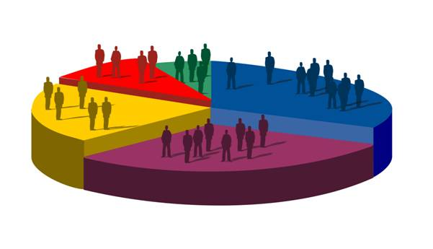
Special Populations
Notes:
Touch on research into special populations

Slide 4
Behavioral Health and Brain Injury
Almost half of adults with TBI who have no pre-injury history of mental health problems develop mental health problems after the TBI
(Gould, Ponsford, Johnston, & Schonberger, 2011. Psychological Medicine, 41, 2099-2109.)
1/3 of TBI survivors experience emotional problems between 6 months and a year post injury
Patients who reported:
  Hopelessness 35%
  Suicidal ideation 23%
  Suicide attempts 18%
85% of survivor families report that emotional or behavioral problems have an impact on their function
Suicidal ideation can be 7x higher in people with TBI than in those without
  Attempts of suicide post-TBI can be at rates close to 17%
  Increased suicide risk persists up to 15 years post-injury
  Fazel, et al. 2014. JAMA Psychiatry, 71(3), 326-33.; Mackelprang et al., 2014. Am J Public Health, 104(7), e100; Simpson & Tate, 2007. Brain Inj., 21(13-14), 1335-51.
Notes:
Lenny will discuss, a few highlights:
Behavioral health – work has happened and continues to happen to make sure ppl with co-occurring are served, not denied.
Not asking MHCs to treat the BI, asking them to treat the MI in the context of BI (eg. Anxiety)
Worth appealing, we can be a resource
Used to think it relates to adjustment to a TBI, now we understand can be lasting –15 years, especially during milestones and transitions in life
BI and grieving go hand in hand, re-occurring as ppl remember they are not what they used to be.
Mild – may have more depression because they have more awareness of what they’ve lost.

Slide 5
Justice Involved Individuals
According to jail and prison studies, 65% of inmates report having experienced a head injury or TBI as compared to 8.5% in a general population reporting a history of TBI.
Prisoners who have had head injuries may also experience mental health problems such as severe depression and anxiety, substance use disorders, difficulty controlling anger, or suicidal thoughts and/or attempts (CO study indicates 87% with co-occurring behavioral health problems
The U.S. Department of Justice has reported that 52% of female offenders and 41% of male offenders are under the influence of drugs and/or alcohol at the time of their arrest.
Notes:
CO – 54%
SA and BI – hand in hand issue.

Slide 6
Behavioral Health Symptoms in Kentucky Prisoners
(Walker, Hiller, Staton % Leukefeld, 2003)
Notes:
Blue – no hx of BI
Red – 1
Yellow – multiple
Ppl with more than one – risk for these issues raises.

Slide 7
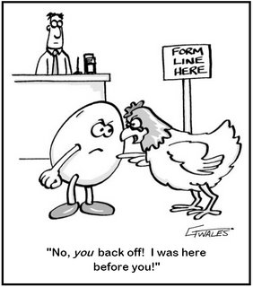
Substance Abuse and Brain Injury
Why would TBI be associated with substance abuse disorders?
Intoxication causes TBI
Early life TBI predispose to
substance abuse
Structural damage from TBI
changes behavioral control
Notes:
Study out of New Zealand – risk for SA much higher with early exposure to BI
Harder to treat.

Slide 8
Substance Abuse and Brain Injury
Natural History of TBI to Age 25 from the Christchurch Birth Cohort (McKinlay, et al., 2008)
Those hospitalized with 1st TBI before age 6
  3 times more likely to have a diagnosis of either alcohol or drug dependence by age 25
Those hospitalized with 1st TBI between ages 16 and 21
  3 times more likely to be diagnosed with drug dependence
TBI highly associated with likelihood of arrest

Slide 9
Homelessness and Brain Injury
In a study of over 2,000 individuals experiencing homelessness, 43% of respondents reported a history of TBI with the mean age of first injury being 15. Individuals with TBI become homeless at a younger age and are more likely to report mental health diagnoses, substance use, suicidality, victimization, and difficulties with activities of daily living. The majority of participants (51%) reported sustaining their first injury prior to becoming homeless or at the same age as their first homelessness episode. (Mackelprang, Harpin, Grubenhoff, & Rivara, 2014).
Out of 111 men, nearly half (45%) of the respondents had a positive screening result for traumatic brain injury. Of these, 73% reported experiencing their first injury before adulthood, and 87% reported a first injury before the onset of homelessness. Among those with a positive screening result, 66% reported sustaining at least one traumatic brain injury by assault. A positive screening result was significantly associated with a lifetime history of arrest or mental illness and a parental history of substance abuse. (Topolovec-Vranic et al 2014)
Notes:
1st example – Colorado
A lot of violence on streets – can sustain injuries while being homeless.
May not know about a BI, but because a client may be in a special population – consider the potential for BI.
BI happens after birth, some period of normal development. However, many of the strategies will apply, but perhaps some of the services will not.

Slide 10






Notes:
There are a host of drastic life changes after BI.
Physical or cognitive limitation
Roles changing – previous breadwinner, now can’t work full time
Relationship changes with spouses
Friendships – networks – changes
Self-esteem issues

Slide 11

Notes:
1st example – Colorado
A lot of violence on streets – can sustain injuries while being homeless.
May not know about a BI, but because a client may be in a special population – consider the potential for BI.
BI happens after birth, some period of normal development. However, many of the strategies will apply, but perhaps some of the services will not.

Slide 12
Brain Injury Framework for Support
We are NOT treating the brain injury, we ARE treating the behavioral health concern in the context of brain injury:
Empowers individuals with brain injury and families to advocate for appropriate supports
Demystifies brain injury for non-brain injury professionals
Notes:
1st example – Colorado
A lot of violence on streets – can sustain injuries while being homeless.
May not know about a BI, but because a client may be in a special population – consider the potential for BI.
BI happens after birth, some period of normal development. However, many of the strategies will apply, but perhaps some of the services will not.

Slide 13
Building Blocks of Brain Development
Overall
Functioning
Achievement/ Cognitive Ability/ Reasoning
Higher Order
Processes
Social Emotional Competency
Executive Functions
Complexities Increase with Maturation
Intermediate
Processes
Language Processes
Learning Processes
Visual-Spatial Processes
Fundamental
Processes
Memory
Processing Speed
Attention
Inhibition
Sensory-Motor
CO Brain Injury Steering Committee: Adapted from Miller, 2007; Reitan and Wolfson, 2004; Hale and Fiorello, 2004

Slide 14
Achievement/ Cognitive Ability/ Reasoning
Social Emotional Competency
Executive Functions
Language Processes
Learning Processes
Visual-Spatial Processes
Memory
Processing Speed
Attention
Inhibition
Sensory-Motor
CO Brain Injury Steering Committee: Adapted from Miller, 2007; Reitan and Wolfson, 2004; Hale and Fiorello, 2004

Slide 15
Attention
Achievement/ Cognitive Ability/ Reasoning
Social Emotional Competency
Executive Functions
Language Processes
Visual-Spatial Processes
Learning Processes
Memory
Processing Speed
Inhibition
Sensory-Motor
CO Brain Injury Steering Committee: Adapted from Miller, 2007; Reitan and Wolfson, 2004; Hale and Fiorello, 2004

Slide 16

Impaired Attention
What it looks like:
Fidgets, squirms in seat, can’t sit still
Interrupts conversation
Low frustration tolerance
Talks Excessively
Off topic
Impulsivity (inability
to inhibit)

Slide 17

Accommodations for Impaired Attention
Check to make sure there is good eye contact
Work on only one task at a time
Keep instructions brief, simple, & to the point
Have client participate in discussion & development of plan
Reduce distractions, meet in quiet environment
Use cue words to alert the client to pay attention (“look”, “listen”)
Establish nonverbal cueing system (eye contact, touch)

Slide 18

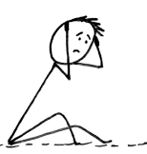
Delayed Processing Speed
What it looks like:
Slow to respond to questions
Appears to not be paying attention
Looks confused
Doesn’t follow instructions

Slide 19
Accommodations for Delayed Processing Speed
Provide additional time to review information
Speak slowly, making sure client understands – ask them to rephrase back to you what they heard
Offer assistance with completing forms
Utilize checklists and a written schedule of routines
Provide written cues for organizing (“first do this, then do this”)

Slide 20

Short Term Memory Loss
What it looks like:
Can’t remember more than one thing at a time
Can’t remember details
Appears disorganized
Appears to have an “attitude” problem
Appears
manipulative

Slide 21
Accommodations for Short Term Memory Loss
Repeat
Repeat information and summarize
Provide
Provide written summary – cue them to record important information (dates, action items)
Review
Review new information frequently
Teach
Teach client to use reminder system like planner
Teach
Teach “chunking” as a way to aid in retention
Stick
Stick to routine as much as possible
Keep
Keep information tangible and relevant
Practice & reinforce
Practice & reinforce strategies until they become automatic

Slide 22
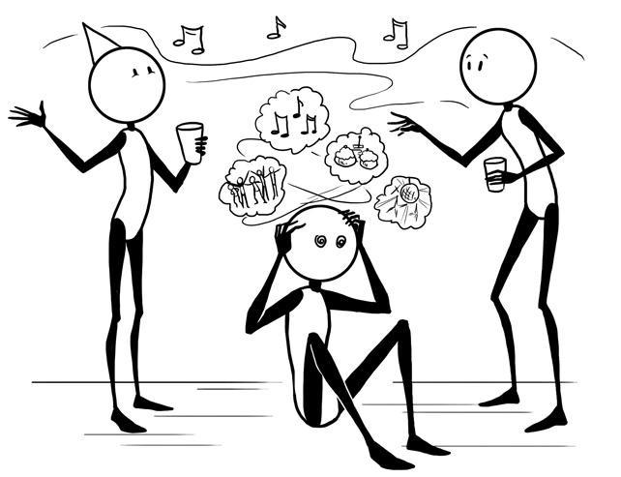
Impaired Sensory Motor Skills
What it looks like:
Appear overwhelmed
Emotionally melt down
Irritable, short fused
May appear oppositional
Shuts down

Slide 23


Accommodations for Impaired Sensory Motor
Keep environment quiet
Keep noise and lights to a minimum
Keep sessions short to minimize onset of headaches and fatigue
Schedule rest periods and breaks from planned activities

Slide 24
Language
What it looks like:
Social pragmatics
Do not interpret body language
Inappropriate eye contact
Personal bubble
Say too little or too much
Little awareness of inappropriate behavior
Receptive
Say “huh” frequently
Confused
Followers
Struggle with abstract language/sarcasm
May withdraw
Expressive
Poor grammar or immature speech
Difficult to follow in conversation
Difficulty staying on topic
Difficulties navigating
social rules
May withdraw
Notes:
Language (social pragmatics);
Help clients who are searching for words by offering “cues” or alternatives (do you mean this or that?)
To assist clients “stay on topic”, offer gentle redirection whenever the clients begin to wander off topic (e.g., you were talking about “x” before, but now you are discussing “y”…lets go back to “x” for a minute)
Encourage clients to prepare a written “agenda” of things to be discussed at planned meetings. This will help the client focus on topics at hand, and prevent memory loss.
Use of yes/no questions rather than open ended questions are most helpful for clients.
Never ask “what do you want to talk about?” You are asking them to… structure, organize their thoughts, and to remember what they wanted to say. Instead ask them to meet with you tomorrow at 2
Considerations/Interventions
Help individual stay on topic; redirect when necessary.
Ask individual to re-state aspects of a discussion to ensure comprehension.
Encourage individual to prepare an “agenda” in advance.
Avoid open-ended questions...use yes/no or structured formats where possible.
p.m. and ask them to write down when they think of something that they want to talk about.

Slide 25
Provide direct, structured and concrete feedback
Do not rely on body language to convey a message
Role play
Videotaping interactions
Accommodations for Social Pragmatics

Slide 26
Be direct
Avoid abstract humor, sarcasm, metaphors, colloquialisms, etc.
Allow wait time for person to process what has been said
Provide instructions/directions slowly and one at a time
Ask if it would be helpful to repeat or rephrase your message
Let the individual know that you value their input, thoughts, and feelings
Accommodations for Receptive Language

Slide 27

Accommodations for Expressive Language
Redirect if the individual is off topic
Provide opportunities to practice expression
Role play common real life conversations
Teach individual to rehearse silently before replying
Be patient and allow person time to respond

Slide 28

Initiation Deficits
What it looks like:
Appears lazy or spacey
Appears unmotivated
Follower
Needs constant cuing
Lags in independent living

Slide 29
Accommodations for Initiation Deficits
Encourage client to focus on one step at a time
Ask client to repeat instructions to ensure comprehension
Use underlining and highlighting for significant parts of directions. Checklists & calendars can help organize.
Break complex directions into simple steps and assign action items
Utilize color-coding
Help the person get started
Repeat instructions or interventions multiple times in different ways

Slide 30
Executive Functioning
What it looks like:
Initiation
Appears lazy or spacey
Appears unmotivated
Follower
Needs constant cuing
Lags in independent
living skills
Reasoning
Concrete thinkers
Can’t think of alternative solutions
Difficulties answering open ended
questions
Difficulties learning from experience, cause and effect
Mental Flexibility
Difficulties taking feedback
Perseverate
Resistant
Can appear stubborn or argumentative
May appear to
lack empathy
Notes:
Help clients who are searching for words by offering “cues” or alternatives (do you mean this or that?)
To assist clients “stay on topic”, offer gentle redirection whenever the clients begin to wander off topic (e.g., you were talking about “x” before, but now you are discussing “y”…lets go back to “x” for a minute)
Encourage clients to prepare a written “agenda” of things to be discussed at planned meetings. This will help the client focus on topics at hand, and prevent memory loss.
Use of yes/no questions rather than open ended questions are most helpful for clients.
Never ask “what do you want to talk about?” You are asking them to… structure, organize their thoughts, and to remember what they wanted to say. Instead ask them to meet with you tomorrow at 2
Considerations/Interventions
Help individual stay on topic; redirect when necessary.
Ask individual to re-state aspects of a discussion to ensure comprehension.
Encourage individual to prepare an “agenda” in advance.
Avoid open-ended questions...use yes/no or structured formats where possible.
p.m. and ask them to write down when they think of something that they want to talk about.

Slide 31
Accommodations for Reasoning Deficits
Point out possible consequences of decisions, short- & long-term (“Is this a good idea? What might happen? Is this consistent with your goals?”)
Teach step by step approach to problem solving
Avoid open-ended questions
Speak concretely
Be clear on expectations and consequences of risk taking behaviors
Be supportive and continually identify strengths

Slide 32

Accommodations for Mental Flexibility Deficits
Develop and practice routines & plan ahead for changes in routines
Prepare for transitions
Help develop alternative plans
Assist in prioritizing goals, breaking them down into smaller tangible tasks
Provide respectful feedback to potential or obvious problem areas

Slide 33
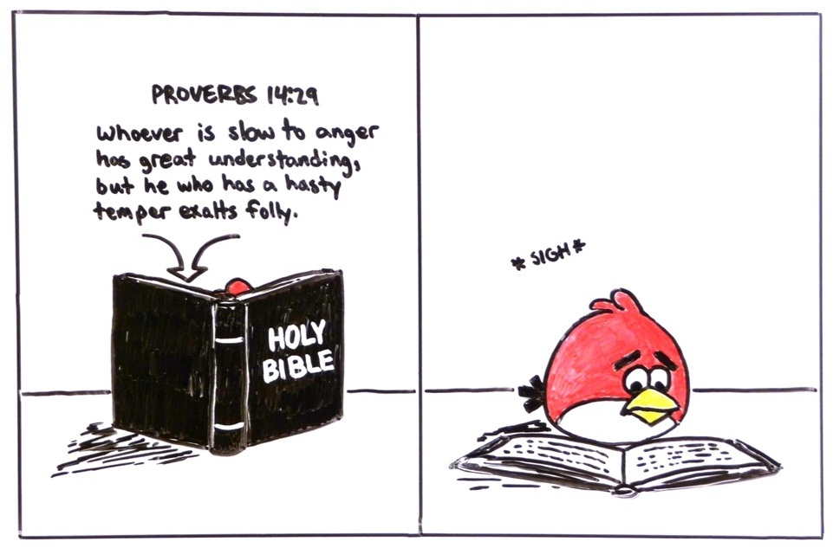
Emotional/Behavioral
What it looks like:
Over/under reaction
Difficulties with anger management
Melt down
Can appear emotionally “flat”
Difficulties making friends
Can appear
argumentative

Slide 34
Accommodations for Emotional/Behavioral Challenges
Minimize anxiety with reassurance, education, and structure.
Avoid focusing only on individual’s deficits
Promote self awareness by stopping and addressing undesired behavior immediately
Don’t interpret lack of emotion as a sign of lack of interest.
Suggest breaks if the individual becomes irritable or agitated.
  Mindfulness exercises to aid clients in accurately identify internal emotional states: progressive relaxation, body scans, deep breathing exercises
Practice positive social interactions. Provide alternative comments or choices that could have been made

Slide 35

Addressing Behavioral Concerns Following Brain Injury: A Framework

Slide 36
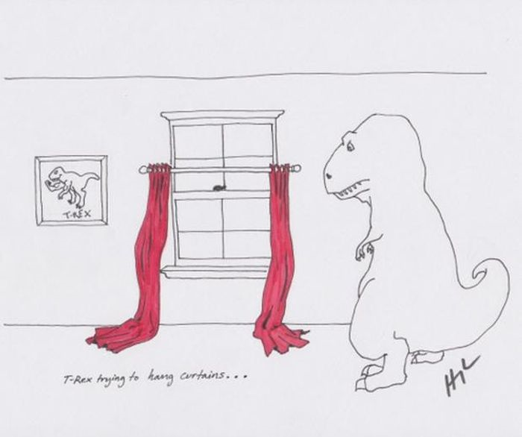
Skill vs. Will
Notes:
Skill vs. Will
If you think they have the skill but choose to not use it, likely to think punishment
If you think they don’t have the skill, less likely to think punishment, more likely to think of teaching the skill

Slide 37
Can’t
Won’t

Slide 38
Behavior Management
Behavior management techniques can be classified into two categories:
antecedent strategies, which are used before a behavior occurs in an effort to prevent or elicit a behavior, and
(2) consequent strategies, which are used after a behavior occurs in an effort to prevent the continuation and recurrence of a behavior or to reinforce a behavior.
Although both can be effective … in their own way, when applied at the right times.
Crisis Prevention instead of Crisis Management

Slide 39
Look For: The Function of the Behavior
Get $, get social status… We feel manipulated
Get away with something…
We feel manipulated
Notes:
Functional Behavior Hypothesis Statement
TBI checklist

Slide 40
Attention
Memory
Executive DYSFUNCTION:
Inability to delay gratification (wait)
Inability to manage time – no future thinking which results in poor planning, organization or initiation
Social INCOMPETENCE:
Inability to make better behavioral or social decisions.
Achievement/ Cognitive Ability/ Reasoning
Lack of attention to feedback in environment = poor MEMORY & poor LEARNING = repetitive mistakes
Social Emotional Competency
Executive Functions
Language Processes
Visual-Spatial Processes
Learning Processes
Processing Speed
Inhibition
Sensory-Motor
CO Brain Injury Steering Committee: Adapted from Miller, 2007; Reitan and Wolfson, 2004; Hale and Fiorello, 2004

Slide 41
Skill Vs. Will
If think they have the skill but choose to not use it, likely to think punishment
If think they don’t have the skill, less likely to think punishment, more likely to think of teaching the skill
Notes:
Majority of injuries are “mild”

Slide 42
Function of the Behavior
Is off-task while reviewing expectations:
Attention
Doesn't feel rules are fair and expresses feelings inappropriately Expressive /Pragmatic
Language
Can’t remember expectations:
Memory
Behavior:
Non-compliance
Doesn't read visual cues:
Visual-Spatial
Doesn't understand expectations: Receptive Language
No problem-solving skills:
Executive Dysfunction
Community
And what about the setting events? = Internal Interferences
Home
Work/school

Slide 43
Function of the Behavior I
Make sure you have attention before reviewing expectations
Teach appropriate ways to express verbal discontent
Is off-task while reviewing expectations:
Attention
Doesn't feel rules are fair and expresses feelings inappropriately Expressive /Pragmatic
Language
Write out/draw out steps to compensate for memory
Can’t remember expectations:
Memory
Review expectations in visual, multi-modal fashion
Behavior:
Non-compliance
May need to teach facial cues, non-verbal cues
Doesn't read visual cues:
Visual-Spatial
Doesn't understand expectations: Receptive Language
How pervasive?
What’s your Body of Evidence?
No problem-solving skills:
Executive Dysfunction
May need to teach Cog. Beh. Therapy skills CBT
Community
And what about the setting events? = Internal Interferences
Home
School/work
Be mindful of Rx interactions, family stress, financial stressors, medical/neurological factors

Slide 44
FBA – Function of the Behavior?
Performance
Deficit
Generalization Skill
Generalize the skill to other environments
Acquisition Skill
Identify the skill deficit – teach the skill
Environmental
What are the environmental factors affecting the behavior? Can the environment be changed?
Antecedent Management
Break the skill down to reasonable “chunks” for more impressive acquisition
Practice in various settings and under various circumstances
Notes:
Most like to start here – Performance / Will
Why? It is easier if a typical kid learns by osmosis. Then if they don’t do, it’s because they don’t want to do. Consequence 1 time – they never do wrong behavior again – and off we go.

Slide 45
Skill versus Will
Behavior of Concern
Outcome:
Did it have the desired effect on the behavior of concern?
Skill Deficit?
Teach to the skill deficit – to which ever deficit you determine to be underlying the behavior
(treatment)
Can but choosing not to?
Testing the limits –
Apply an appropriate limit (consequence)
Caveat: If you do not get the desired change in behavior, go back to the question of a skill acquisition problem or a skill generalization problem.

Slide 46
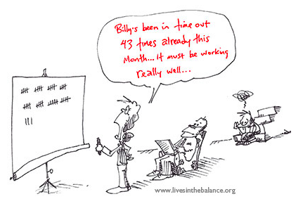

Slide 47

Specific Considerations: Brain Injury and Behavioral Health Treatment

Slide 48
Psycho-Social & Behavioral Health Challenges after TBI
    Neurological changes
      Awareness, cognition, communication, emotional regulation, cognitive fatigue, hypersensitivity, executive functioning, neuro-chemical changes
    Adjustment to injury & subsequent social changes
      Role changes, job loss, isolation, loneliness,, financial stress, lost sense of purpose, decreased self-esteem, grief, decreased coping skills
      Pre-injury mental health, personality issues

Slide 49

Changes in Social Behavior: 1 of the most challenging for families
Not responding to social cues
Becoming emotional during social interactions
Flat affect
Lack of social initiation – “I don’t know what to say”
Tangential – talking on and on
Repeating information – telling the same story over and over
Interrupting – turn taking
Speaking off topic
Crossing social boundaries
Body language – no eye contact, turning away, etc.
Difficulty following group conversation

Slide 50
Clinical Response to MTBI
Thorough neuropsychological & physical exam is valuable
Information and support for the person, family, employers
Reassurance that symptoms should subside
Address anxiety and “shaken sense of self”
Stress-reduction and gradual return to activity
Address other psychiatric issues
Silverberg, N., et al 2013

Slide 51
Clinical response to Mod/Severe TBI
Start with a thorough holistic assessment
  Pre-injury: roles, functioning, mental health, coping style
  Injury: review records, involve family
  Adjustment: social, financial, familial, vocational
  Provide education for client & family
Enhance self-awareness
Provide supports, repetition, and consistent feedback
Develop clear, short-term, realistic goals together
Provide compensatory strategies
Foster a sense of realistic hope and meaning
(Prigatano, 1986; Klonoff, 2010; Ruff & Chester, 2014)

Slide 52
Strategies for Success
  Consistency & Repetition
  Give a consistent message/expectations
  Talk in a low-stim environment
  Take a break if needed
  Break information into small pieces
  Repeat information and summarize
  Write things down
  Feedback and Reinforcement
  Provide immediate positive feedback, verbal and non-verbal
  Model calm, attentive interactions
  Calmly return to the topic – stay goal oriented
  Use active listening techniques – demonstrate, reflect, verify
      Assists with memory, self-esteem, problem solving

Slide 53

De-escalating Emotional Interactions
Watch for signs – be pre-emptive
Model calm – sit back, breath
Take a break if appropriate
Make sure the person is oriented
Use active listening – demonstrate, reflect, verify
Remove sunglasses, have eye contact
Speak slowly but normally, respectful of age
Take turns talking and listening
Decrease unnecessary light, noise and people
Re-direct, change the subject or the action
Notes:
Signs of irritation, disorientation, confusion

Slide 54

Individuals with TBI can benefit from psychotherapeutic interventions Block & West (2013):
Familiar Treatment Strategies…
Therapeutic alliance/engagement
Insight/self awareness
Cognitive behavioral strategies
Mindfulness and relaxation
Goal setting
Existential meaning in life
…Can be adapted for TBI

Slide 55
Evidence-based Psychotherapy for TBI: Individual, Group, & Family I
INDIVIDUAL THERAPY:
1. Cognitive Behavioral Therapy
  Provides a structured approach
  Homework and written materials help with memory
  Concrete behavioral goals – give structure
  Focus on problem solving – common deficit area
  Evidence for use of CBT with depression, anxiety, anger, social competence, problem solving, self-efficacy post-TBI
  M. Hsieh, J. Ponsford, et al (2012); M Hsieh, J Ponsford, et al (2012); K. Raina, et al 2016.

Slide 56
Evidence-based Psychotherapy for TBI: Individual, Group, & Family II
2. Behavioral Therapy
Redirection, behavioral contracts, cueing/prompting, reinforcement, feedback
Provide in a manner that is respectful of the individuals age and past and that allows choices for the individual
Target environmental cues/aids – checklists, calendars, smartphones, alarms
Evidence for use with anger, apathy/lack of initiation, extinguishing behaviors that are problematic
K. Slifer, M. Cataldo, P. Kurtz. (1995); M. Becker, E. Vakil (2009)

Slide 57
Evidence-based Psychotherapy for TBI: Individual, Group, & Family III
3. Supportive Psychotherapy
Loss, grief, depression, adjustment
Estential realignment of goals, expectations
Pilot feasibility shown for brief positive psychotherapy addressing psychological well-being
When CBT and supportive psychotherapy were compared for treatment of depression post-TBI – those treated with CBT reported sig improvement in sadness, loss of interest, while those treated with SPT reported sig improvement in agitation and irritability.
T. Ashman, et al 2014; B. Cullen, et al. 2016; E. D’Antonio, et al 2013

Slide 58
Group Therapy
Psycho-Educational Groups
Structured Cognitive-Behavioral Groups
  Coping Skills
  Problem Solving
  Social Competence
Set curriculum with visual/memory aids
Weekly review
Measureable, functional client goals
Feedback
Scheduled breaks
Small group size
  L. Hawley and J. Newman 2010; L. Hawley, J. Newman 2015; S. Backhaus, 2010; Delmonico, et al. 1998

Slide 59
Family Therapy
Multi-family support groups
Family education and awareness
Family therapy
Common Issues faced by families:
Need for resources and advocacy
Realignment of roles, responsibilities
Responding to behavior & personality changes
Grief and loss

Slide 60
TBI Toolkit
Cokids with Brain Injury
Accommodations the Symptoms of TBI Booklet
Helpful Tools

Slide 61

TBI Toolkit
http://www.mirecc.va.gov/visn19/tbi_toolkit/

Slide 62
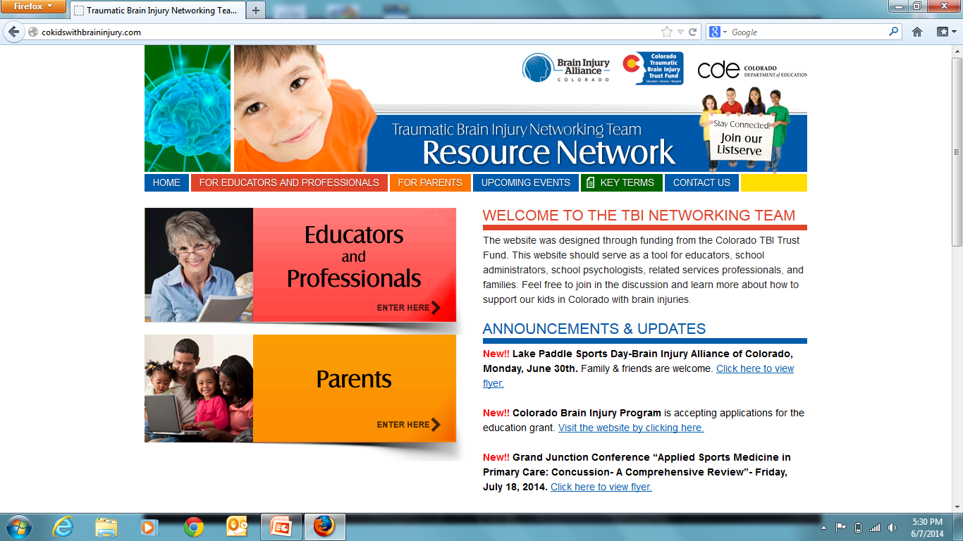
Cokids with Brain Injury www.cokidswithbraininjury.com

Slide 63
Accommodating the Symptoms of TBI http://ohiovalley.org/informationeducation/accommodatingtbi/
Presented by:
Ohio Valley Center for Brain Injury Prevention and Rehabilitation
With contributions from Minnesota Department of Human Services State Operated Services
  Developed in part with support of a grant from the US Department of Health and Human Services, Health Resources and Services Administration (HRSA) to Ohio Rehabilitation Services Commission and The Ohio State University

Slide 64

Thank you for your time!

