Slide 1
Pediatric TBI and Memory Loss
Bryce Meredith D.O.
Marshall Primary Care Sports Medicine Fellow

Slide 2
Financial Disclosures
I have no financial interests or relationships to disclose

Slide 3
About me

Slide 4
About me

Slide 5
TBI and Memory
What is memory? What are the different types of memory?
What is TBI?
How does a TBI impact memory?
Causes?
Symptoms?
Treatment?
Long term sequelae?

Slide 6
Memory
“Memory is the scribe of the soul”- Aristotle

Slide 7
Memory
“If you will give the matter a moment’s thought, you’ll see that memory is the highest faculty of the human”- Joseph Pulitzer

Slide 8
Concussions/TBI and memory
Photo: Elsa, Getty Images
Photo: Tony Avelar, AP
Notes:
Sports medicine focus → involvement with TBI/memory relates to concussions

Slide 9
Memory and TBI
“Blank spots”- Larry Johnson, former Penn State and Chiefs running back said in an interview with the Chicago Tribune in 2017 regarding his memory
Photo: Dave Kaup, REUTERS
Notes:
Photo :
RUETERS Dave Kaup
https://www.reuters.com/article/us-nfl-bengals-johnson/bengals-acquire-controversial-running-back-johnson-idUSTRE5AH09B20091118

Slide 10
Memory and TBI
Brett Favre recently stated an interview he is experiencing short term memory problems and may have experienced “thousands of concussions”
Photo: Bruce Kluckhohn, USA TODAY Sports

Slide 11
Memory
What is memory?
Ability to store, retain, and recall information
“Process of organizing and storing representations of events and recalling these representations to consciousness at a later date”
Savage and Wolcott-An Educator's Manual: What Educators Need to Know about Students with Brain Injury.

Slide 12
Types of memory
Sensory
Brief- usually only seconds
Autonomic perception from senses
Notes:
Vision/smell/auditory

Slide 13
Short term memory
Temporary storage
Must use to retain
Limited capacity
Graphic: bebrainfit.com

Slide 14
Long term memory
Storage of information that is important to you
Encoding
Storage
Retrieval

Slide 15
Three steps in memory acquisition
Acquisition
Consolidation
Retrieval
Recognition and recall

Slide 16
Anatomy and physiology of the brain
Synapse-conjunction or connection in which neurons communicate or influence neurons
There are chemical and electrical synapses
Notes:
Neuron junction

Slide 17
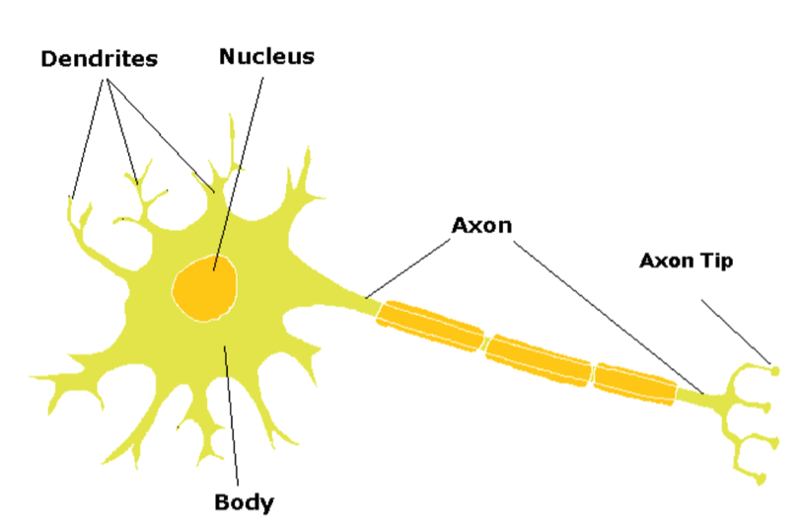
Anatomy and physiology of the brain
Due to the consistent polarity of synapses, the transmission of the action potential travels from the axon from one neuron to a dendrite of another
Notes:
Axon to dendrite
Brainleadersandlearners.com

Slide 18
Anatomy and physiology of the brain
When a membrane potential of a presynaptic neurite is reversed by the arrival of an action potential, calcium channels are opened and calcium ions diffuse in the cell because they are presents at a much higher concentration in the extracellular fluid than in the cytoplasm
The entry of calcium triggers the fusion of synaptic vesicles to the terminal plasma membrane, which releases the neurotransmitters and neuromodulators into the synaptic cleft

Slide 19
Anatomy and physiology of the brain
Once the neurotransmitter molecules have crossed the synaptic cleft, they combine with receptors on the postsynaptic cell
If the neurotransmitter-receptor interaction is one that results in excitation, nonspecific cation channels are opened, which allow entry of sodium, calcium, and the efflux of potassium at postsynaptic sites

Slide 20
Temporal lobe
Plays a role in emotions but is also responsible for
Smelling
Tasting
Perception
Memory
Notes:
http://www.richardsonthebrain.com/temporal-lobes

Slide 21
Limbic system
Consists of a ring on the medial surface of the cerebral hemisphere
Components
Subcallosal area
Cingulate gyrus with its isthmus
Parahippocampal
Mostly involved with learning, memory, and emotional responses

Slide 22
Frontal Lobe
Involved with higher cognitive function including
Problem solving
Memory
Language
Motivation
Judgement
Notes:
http://www.richardsonthebrain.com/neuroanatomy

Slide 23
Prefrontal Cortex
Involved with intellect, complex learning, and personality
Notes:
https://www.psychologytoday.com/us/blog/make-your-brain-smarter/201301/go-full-frontal-be-smart

Slide 24
Occipital lobe
Visual information
Notes:
http://www.richardsonthebrain.com/occipital-lobes

Slide 25
Traumatic brain injury
Traumatic brain injury- an insult to the brain caused by an external physical force
Notes:
https://www.mayfieldclinic.com/PE-TBI.htm

Slide 26
Coup-Contra Coup
Impact and bruising occur at 2 places in the brain
When the head is struck, the impact causes the brain to bump the opposite side of the skull, resulting in damage at both sites
Braininjury.com
Notes:
Rebounding

Slide 27
Diffuse axonal
Brain injury that does not require a direct head impact.
Rapid acceleration of the head and some parts of the brain move in different directions
Shearing or rotational force
Notes:
Shearing/rotational

Slide 28
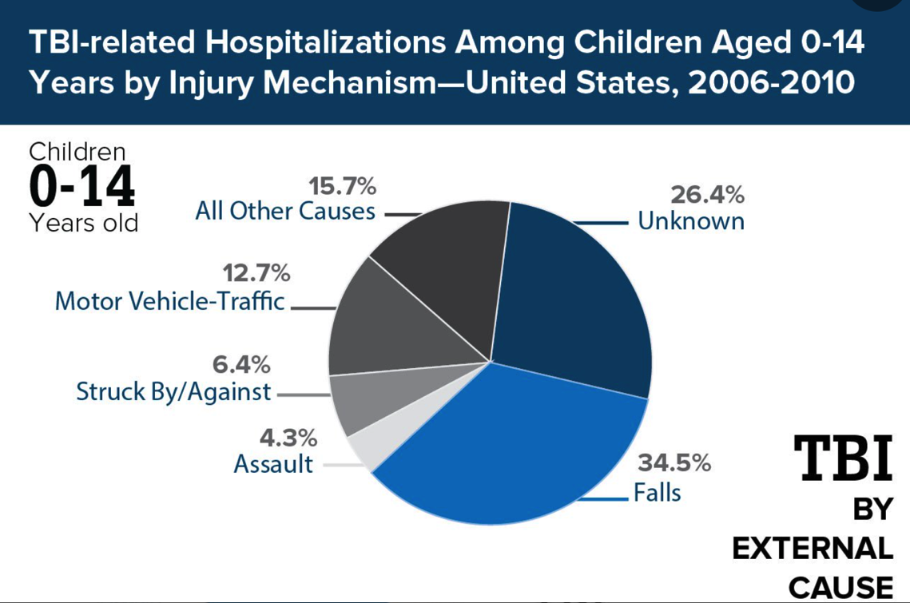
Causes of TBI
Notes:
Medscape, adapted from information from CDC

Slide 29
Epidemiology
In 2013, (Among Children 0-14) there were approximately:
640,000 TBI-related emergency department (ED) visits
18,000 TBI-related hospitalizations
1,500 TBI-related deaths
CDC Report to Congress, Management of TBI in Children. 2018

Slide 30
TBIs in Children
More than 61% of children with moderate-to-severe TBI experience some level of disability
A TBI of any severity can affect a child’s future ability to learn and perform
Children with moderate-to-severe TBI earn worse grades, show higher rates of grade retention, and receive more special education services than their uninjured peers
In a large study following children younger than 18 years of age, 14% of children who experienced a mild TBI needed educational support services at school 12 months later.
http://www.universityobserver.ie/sport/head-in-the-game-concussion-in-sport/
Notes:
Rivara FP, Koepsell TD, Wang J, et al. Incidence of Disability Among Children 12 Months After Traumatic Brain Injury. American Journal of Public Health. 2012/11/01 2012;102(11):2074-2079.
Donders J. Academic placement after traumatic brain injury. J Sch Psychol. 1994;32(1):53–65.
31. Ewing-Cobbs L, Fletcher JM, Levin HS, Iovino I, Miner ME. Academic achievement and academic placement following traumatic brain injury in children and adolescents: A two-year longitudinal study. J Clin Exp Neuropsychol. 1998;20(6):769-781.
32. Kinsella GJ, Prior M, Sawyer M, et al. Predictors and indicators of academic outcome in children 2 years following traumatic brain injury. Journal Of The International Neuropsychological Society: JINS. 1997;3(6):608-616.

Slide 31
TBIs in children
There is limited understanding of how childhood TBI impacts attainment of adult milestones (e.g., high school graduation, employment, or enrollment in post­ secondary education).
Studies of adults who sustained a childhood brain injury suggest common pathways to social difficulties, such as lower educational attainment and incarceration.
CDC Report to Congress: The Management of TBI in Children. Executive Summary. 2018.

Slide 32
Underreported TBI
Uncounted injuries
On the playground
On playing fields/youth sports
Falls in the home
Assaults
Domestic violence
Notes:
Kids playing sports

Slide 33
Concussion
Concussion is a traumatic brain injury induced by biomechanical forces.
70-90% of pediatric TBI-related ED visits are considered Mild-TBIs or concussions
Photo: AJ Mast, AP
Notes:
Austin Collie

Slide 34
Sports related concussion
Sports related concussion may be caused either by:
A direct blow to the head, face, neck
Blow elsewhere on the body with an impulsive force transmitted to the head.
Photo: Jayne Kamin-Oncea/ Getty Images
Notes:
Make 2 slides
Pics of concussions

Slide 35
Sports related concussion
SRC typically results in the rapid onset of short-lived impairment of neurological function that resolves spontaneously.
In some cases, signs and symptoms evolve over a number of minutes to hours.
Photo: mlb.com/cubs

Slide 36
Sports related concussion
SRC may result in neuropathological changes, but the acute clinical signs and symptoms largely reflect a functional disturbance rather than a structural injury
No abnormality is seen on standard structural neuroimaging studies.

Slide 37
Sports related concussion
SRC results in a range of clinical signs and symptoms that may or may not involve loss of consciousness.
Resolution of the clinical and cognitive features typically follows a sequential course.
In some cases symptoms may be prolonged.

Slide 38
Concussion
Signs and symptoms cannot be explained by drug, alcohol, or medication use, other injuries or other comorbidities
Photo: Andrej Isakovic Getty Images

Slide 39
Evaluating memory after TBI
SCAT-5
ImPACT test
C3 Logix
MACE- Military Acute Concussion Evaluation
ACE- Acute Concussion Evaluation

Slide 40
SCAT-5
Maddocks questions
What venue are we at today?
Which half is it right now?
Who scored last?
What team did you play last?
Did your team win the last game?

Slide 41
SCAT 5
Orientation/Remote Memory
What month is it?
What is today’s date?
What is the day of the week?
What year is it?
What time is it?
Notes:
Scat questionnaire

Slide 42
SCAT 5
Immediate Recall
3 trials of 5-10 words
Monkey
Tree
Watermelon
Firetruck
Car-Wash
Alligator
Ball
Penny
River
Lemon

Slide 43
SCAT 5
Delayed Recall- 5 minutes after immediate recall, ask the patient to recall the 5-10 words
Notes:
Stopwatch

Slide 44
ImPACT
Notes:
Memory
Impact test

Slide 45
C3 Logix

Slide 46
Memory tests
Mini COG test
Mini Mental Status Exam
MoCA (Montreal Cognitive Assessment)

Slide 47
Clinical presentation
Confusion
Anterograde amnesia
Retrograde amnesia
“Feeling in a fog”
“Zoned out”
Inability to focus
Delayed verbal and motor responses
Photo: Monsters, INC. : Disney Pixar

Slide 48
Clinical presentation
Frustrated
Inattentiveness
Difficulty with immediate recall and delayed recall
Difficulty maintaining information
Change in mood

Slide 49
Memory specific deficits
Difficulty retaining information(particularly for a quiz or test)
Asking the same question again
Difficulty following classroom routine and classroom rules
Remembering school supplies, books, completing assignments

Slide 50
Special interest populations
ADHD
Depression/anxiety
Learning disabilities
Family stressors
Substance abuse

Slide 51
Repeated Concussions
Athletes with multiple concussions were more likely to have confusion and anterograde amnesia - Collins et al
Athletes with a history of 2+ concussions had a longer period of impaired verbal memory- studied by Covassin et al

Slide 52
Subconcussive blows
Subconcussive blows appear to be a primary cause of cognitive dysfunction in boxers
Jordan et al concluded that repetitive subconcussive blows to the head may contribute to cognitive deterioration of brain function
Photo: Isaac Brekken/ AP

Slide 53
Treatment Plan
Initial cognitive rest
Return to learn
Slowly integrating back in to school
Providing with school accommodations
Notes:
Picture of return to learn protocol

Slide 54
Treatment Plan to help with memory
Academic accommodations
Adjust school attendance and class activity

Slide 55
Treatment Plan
Use mnemonics
Provide with external aides
Diaries
Notebooks
Lists
Alarm clocks
Watches
Wall Charts
Calendars
Tape recorders

Slide 56
Treatment Plan
Minimize external stimuli
Allow student to wear sunglasses or hat in school
Allow for pre-printed notes
Limit computer/tv screen/phone/bright screen time
Reduce brightness on monitors and screens

Slide 57
Treatment Plan
Lunch in a quiet place with a friend
Avoid music or shop classes if symptomatic
Allow to wear ear plugs as needed
Allow transitions before the bell

Slide 58
Treatment Plan
School accommodations
Reducing makeup work, classwork and homework
Prorating workload when possible
Reduce amount of homework each given night
Notes:
Homework

Slide 59
Treatment Plan
Allow for frequent breaks
Allow student to go to nurse’s office
Allow student to go home if symptoms do not subside

Slide 60
Treatment Plan
Allow extra time to complete tests
No more than 1 test in a day
No standardized testing
Allow for a scribe
Oral response and oral delivery of testing

Slide 61
Treatment Plan
Memory games and exercises
Physical activity

Slide 62
Treatment Plan
Multi-disciplinary approach
Physical therapy
Occupational therapy
Speech therapy
Athletic trainers
Teachers/school administrators
Psychologist/counselors

Slide 63
Post Concussive Syndrome
Persistence of physical, cognitive, emotional, and sleep symptoms beyond the usual recovery
Comorbidities?
Medications?
Sleep?
https://www.sports-health.com/sports-injuries/head-and-neck-injuries/concussion-and-risk-blood-clot

Slide 64
Additional Resources
https://www.cdc.gov/traumaticbraininjury/pdf/reportstocongress/managementoftbiinchildren/TBI-ReporttoCongress-508.pdf
https://www.cdc.gov/traumaticbraininjury/pdf/reportstocongress/managementoftbiinchildren/TBIRTCExecutiveSummary.pdf
https://www.cdc.gov/traumaticbraininjury/pdf/reportstocongress/managementoftbiinchildren/factsheets/TBIRTCFS-Healthcare-Providers-508.pdf
https://www.cdc.gov/traumaticbraininjury/pdf/reportstocongress/managementoftbiinchildren/factsheets/TBIRTCFS-Parents-508.pdf
https://www.cdc.gov/traumaticbraininjury/pdf/reportstocongress/managementoftbiinchildren/factsheets/TBIRTCFS-Schools-508.pdf
https://www.cdc.gov/traumaticbraininjury/pdf/reportstocongress/managementoftbiinchildren/factsheets/TBIRTCFS-Partners-508.pdf
https://www.cdc.gov/headsup/resources/custom.html

Slide 65
Thank you!

