Slide 1

Positive Behavior Support for Challenging Behavior in the Classroom relating to TBI
Anastasia Riley, MBA CBIS
Behavior Specialist
The PBS Project is funded through a grant with the West Virginia Bureau for Behavioral Health and Health Facilities.

Slide 2

A part of West Virginia University & WVU Health Sciences Center
Notes:
Key Talking Points: Recommendation is to start out explaining that your program is a part of CED, then lead into program information and training topic
-CED is a unit within West Virginia University (WVU), Health Sciences, and because of the placement within the University, has access and alignment within the Schools of Pharmacy, Public Health, Nursing, Medicine and Dentistry.

Slide 3
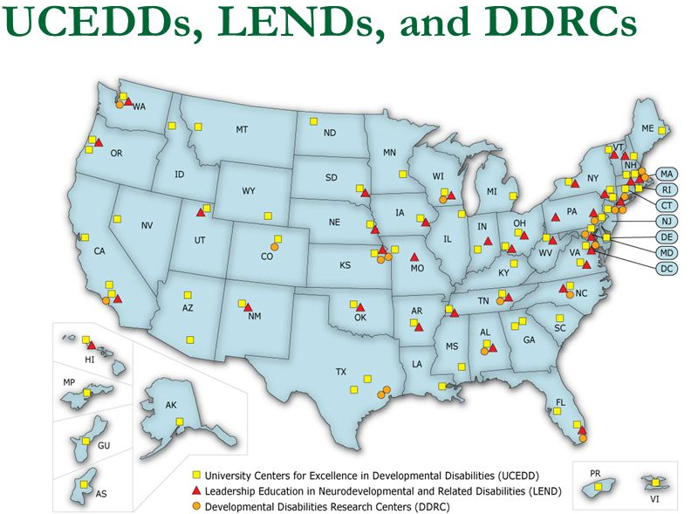

Part of a National Network
Notes:
Key Talking Points:
-The CED is a University Center for Excellence in Developmental Disabilities Education, Research and Service (UCEDD) designated and funded by the U.S. Department of Health and Human Services, Administration for Community Living, Administration on Intellectual Disabilities.
-UCEDDs were created in 1963 by the federal government with the enactment of Public Law 88-164 to serve people with intellectual disabilities.
-Today, there are sixty-seven (67) Centers across the country, authorized under the Developmental Disabilities Assistance and Bill of Rights Act of 2000 (PL-106-402), to serve as resources for Americans with a wide range of disabilities. The sixty-seven (67) Centers, at least one in every state and territory is affiliated with a major research University and serves as a resource for people of all ages.

Slide 4
WVU CED’s Role:
Education and training to University students in multiple disciplines to prepare a workforce that is able and willing to serve persons with disabilities
Technical assistance to individuals with disabilities and direct care providers who serve them to enhance their skillset and improve service quality
Gap filling direct services and supports in an effort to improve availability and acceptability of services for West Virginians
Dissemination of information about the status of disabilities services in West Virginia and the nation
Research activities conducted in collaboration with partners, to improve services and policies related to individuals with disabilities and their families.

Slide 5
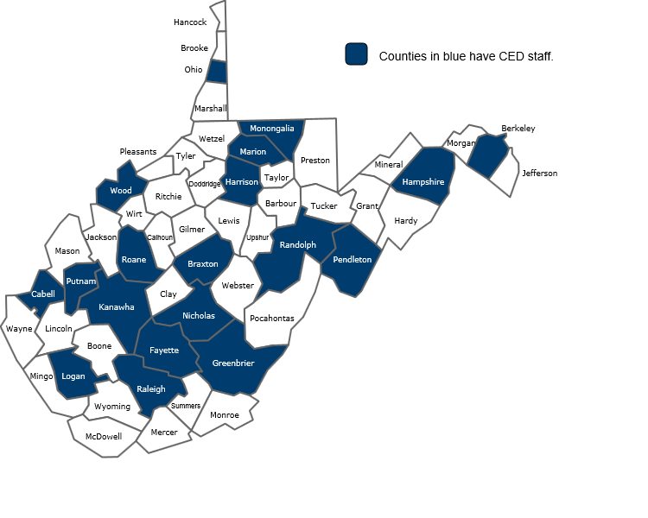
About WVU CED
Serves individuals with disabilities across the life span in all 55 counties
7 Programs
4 Clinics
Approx. 90 Staff
Multiple state and federal partners
Notes:
Taking Points:
Staff are hosted by partner agencies and located across the state
Partners include:
WV Dept of Health & Human Resources (DHHR)
WV Division of Rehabilitation Services (DRS)
WV Dept of Education (DOE)
WV Developmental Disabilities Council (DDC)
WV Advocates (WVA)
Maternal and Child Health Bureau (MCHB) /Health Resources and Services Administration (HRSA)
Administration for Community Living (ACL) / US Dept. of Health and Human Services

Slide 6
Become an Affiliate
Looking for a way to be more connected to CED? Individuals can now sign up to be an Affiliate of the CED. Affiliates will:
Receive updates on CED news and events
Have opportunities to provide input regarding programs, services and research projects
http://www.cedwvu.org/about-ced/become-an-affiliate/

Slide 7
Session Goal
Increase awareness of how to utilize positive behavior support to help decrease challenging behavior in a positive proactive way in addition to utilizing person centered calming techniques.

Slide 8
Session Objectives
Defines PBS and identifies its characteristics
Explain how to gather functional behavior assessment information and find a good replacement behavior
Describe sensory integration techniques

Slide 9

What is Positive Behavior Support?
Evidence based
Person-centered
Positive
Proactive
Data-driven

Slide 10

Positive Behavior Support is…
  Teaching in a strength-based way
  Finding the purpose or function of a maladaptive or dangerous behavior
  Finding replacement behaviors to serve that same function
    Reinforcing replacement behaviors
  Improving quality of life
    Supporting the individual and helping them reach their full potential

Slide 11

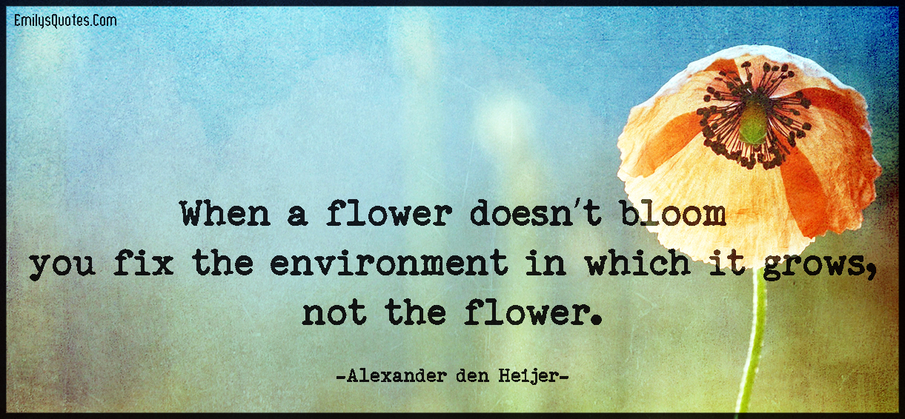

Slide 12
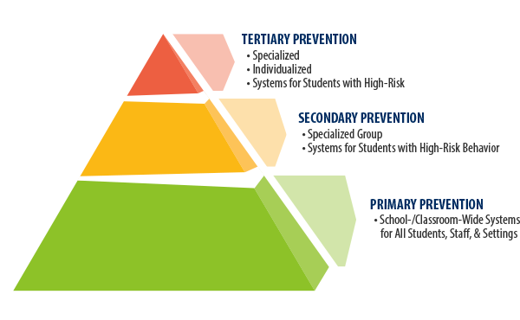
School wide PBS

Slide 13


ABCs of Behavior
A – Antecedent (Triggers)
Before the target behavior
B – Behavior (Target)
What we want to focus on
C – Consequence (Function)
What do they get or get out of

Slide 14
ABCs of Behavior
A – Antecedent (Triggers)
B – Behavior (Target)
C – Consequence (Function)

Slide 15

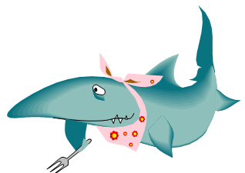
Antecedents
Events that occur before a behavior
Slow Triggers - Things that create the beginnings of a “bad day”
Fast Triggers - The straw that breaks the camel’s back; the immediate things that set off the behavior
Feeling sick
Being hungry
Feeling tired
Burst of anxiety
Difficult task
Being told “No” / Being denied a favorite item or activity
Personal space violated
Someone taking your toy or destroying your block tower

Slide 16
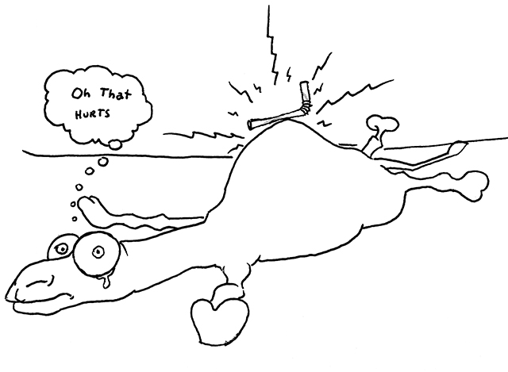
Activity: Triggers
Please fill out activity form 1
Please list 3 of your usual triggers and at least 3 triggers of a child
Notes:
Knowing your triggers is great, but knowing the triggers of someone you are working with is even more important because you will get a better idea of how to interact with them so they will not be faced with a behavior in the future.

Slide 17

Proactive Strategies
Changes the antecedent to prevent problem behavior from occurring
  Environmental Strategies
    Changes in settings
  Look for the precursor behaviors
    What is the usual start to the behavioral episode?
Teach the client to utilize these strategies when they are calm.
Very important!
  Focus on proactive strategies to prevent a problem before it starts

Slide 18
Clear Expectations
Rules posted in pictures and objective (easy to understand)
Clear schedule of what is going to happen next
  Knowing what to expect, re-assurance – reduces anxiety
Visual Prompts (Queuing in line)
Social Pressure
Explaining consequences of choice
Notes:
Some kids get more anxious before Christmas or things they are excited about, or just nervousness

Slide 19
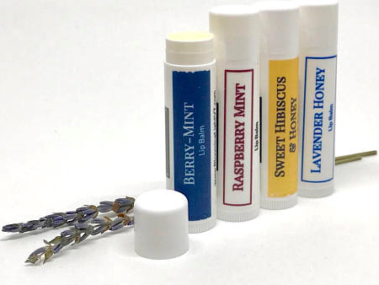
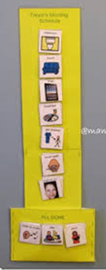
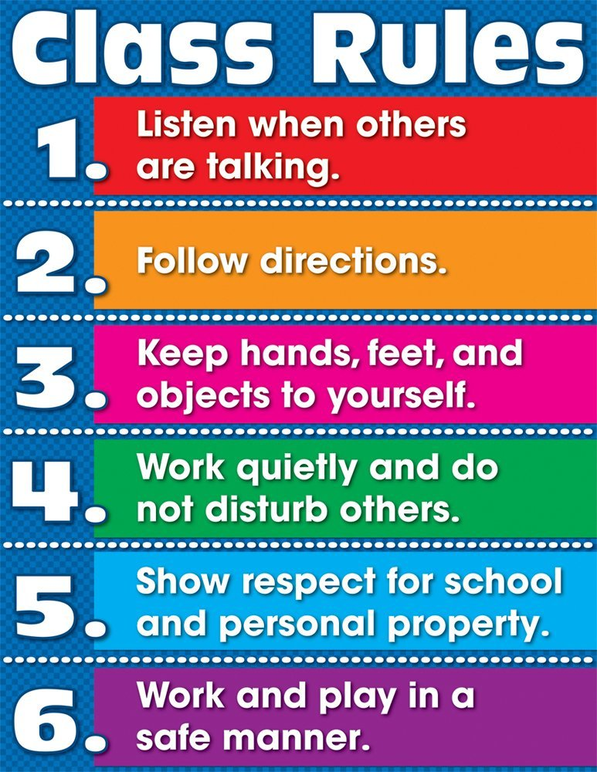
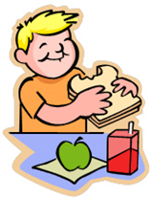
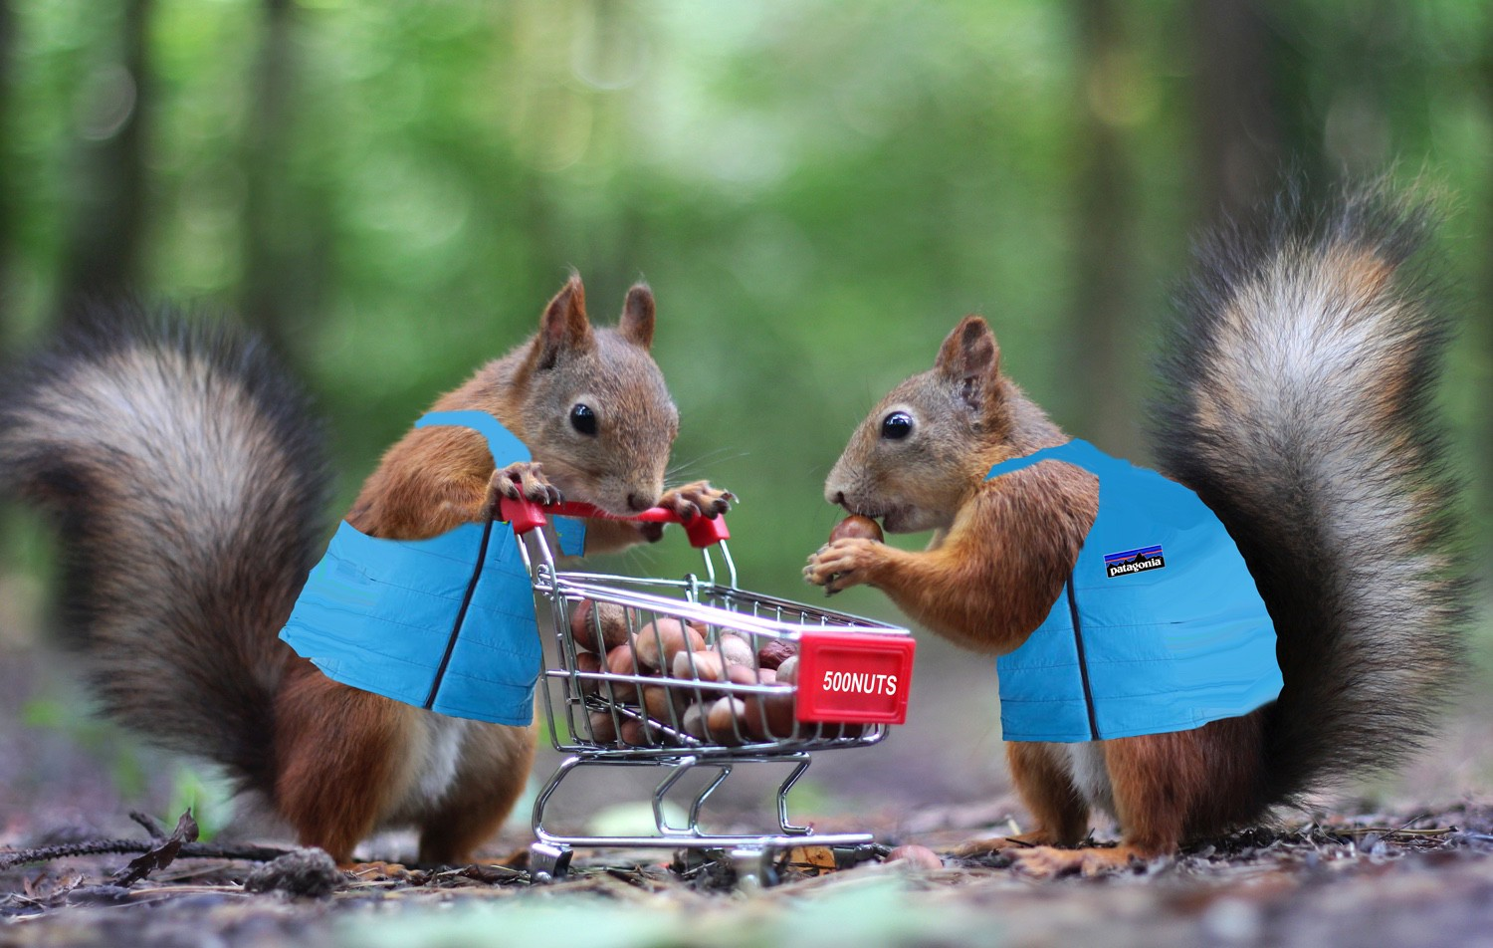
Examples: Proactive Strategies
A Velcro picture schedule for someone who has trouble with transitions
Using a different tone of voice or asking a question in another way
Providing snacks or exercise before an activity
A funny signal word
Very Clear Expectations

Slide 20

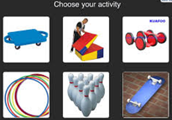
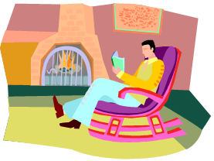

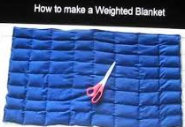
Examples: Proactive Strategies
Social Stories
A choice board
A quiet relaxing space to go to calm down
Teaching relaxation methods
Sensory integration techniques

Slide 21
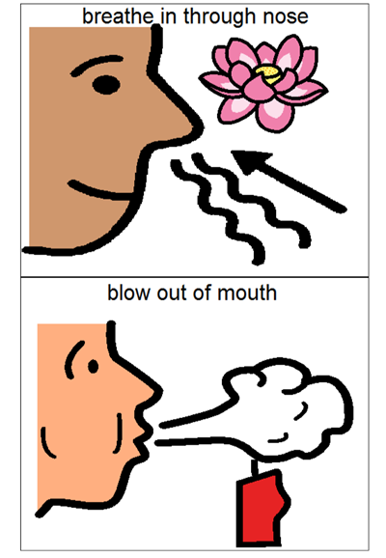
Activity: Flower / Candle
Or you can use a preferred item to sniff and blow
Notes:
Knowing your triggers is great, but knowing the triggers of someone you are working with is even more important because you will get a better idea of how to interact with them so they will not be faced with a behavior in the future.

Slide 22
ABCs of Behavior
A – Antecedent (Triggers)
B – Behavior (Target)
C – Consequence (Function)

Slide 23

Behavior
Behavior is anything and everything someone does
  All behavior serves a purpose
Target behaviors - are behaviors we want to decrease and replace with more appropriate behaviors
Replacement behaviors - are behaviors that we teach the client to engage in, rather than the problem behavior in order to meet the same function

Slide 24

Defining the Behavior
Operational Definitions:
  Observable
  Measureable
  Pass the Dead Man’s Test (something a dead man can’t do)
Define:
  Target Behavior
    Physical Aggression: Hitting, kicking, spitting at another person
  Replacement Behavior
    Hit Pillow: Take a pillow and punch it
So everybody sees it the same way

Slide 25
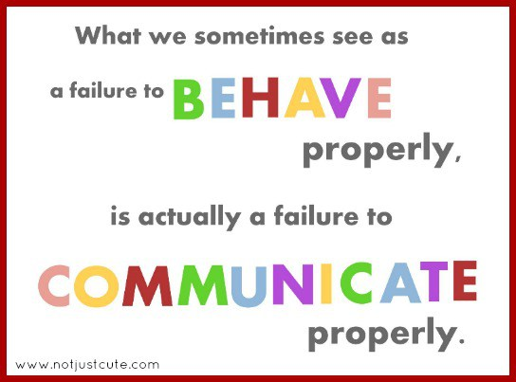
Behavior as Communication
What is the behavior telling us?
All problem behaviors are communicating something.
  Does the child want attention?
  Does the child want a break?
  Does the child want an item/activity?
  Does the child want sensory stimulation?

Slide 26
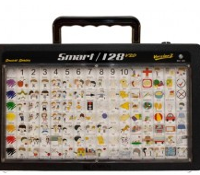
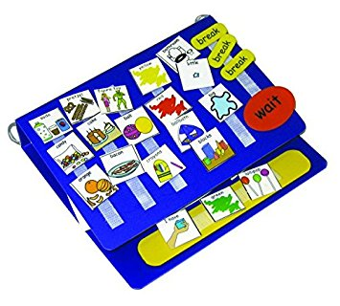
Increasing Communication Outlets
Assistive Technology Communication Devices
American Sign Language (ASL)
Picture Exchange Communication System (PECS)
Communication Boards / Picture Books
Gestures Pointing and Body Language
Notes:
Will Using an Alternative Means of Communication Prevent a Child from Speaking?
After reviewing all of the current research on augmentative and alternative communication (AAC) in 2006, Millar, D. C., Light, J. C., et al. made the following statement about using AAC:
“The present research review provides important preliminary evidence that augmentative and alternative communication interventions do not inhibit speech production; instead, AAC may also support speech production”
PECS is actually a formal certification with 3 distinct tiers (antiquated with technology but does allow for learning to pair the picture with the item)

Slide 27
ABCs of Behavior
A – Antecedent (Triggers)
B – Behavior (Target)
C – Consequence (Function)

Slide 28
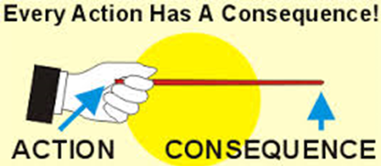
Consequences
What happens immediately after the target behavior.
What does a child get or get away from by performing a behavior?

Slide 29
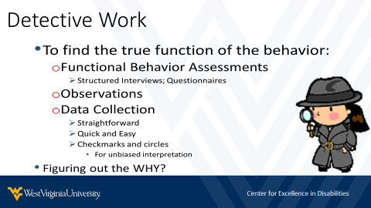
Detective Work
To find the true function of the behavior:
  Functional Behavior Assessments
    Structured Interviews; Questionnaires
  Observations
  Data Collection
    Straightforward
    Quick and Easy
    Checkmarks and circles
      For unbiased interpretation
Figuring out the WHY?

Slide 30

Functions of Behavior
4 Main Categories:
Sensory
Escape
Attention
Tangible
Remember… SEAT

Slide 31
Activity:
Shout out - What is the likely Function?
A child throws a temper tantrum in the store to get a candy bar.
A girl wipes all the items off a table to see the reaction of her classmates
A boy bites another child to get put in a separate room.
A preschooler takes off his clothes because they are itchy.
Notes:
Knowing your triggers is great, but knowing the triggers of someone you are working with is even more important because you will get a better idea of how to interact with them so they will not be faced with a behavior in the future.

Slide 32
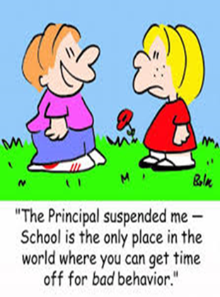
Functions of Behavior
What is the purpose of the behavior?
Can another more socially appropriate behavior serve the same function?
    We need to make the replacement behavior easy and accessible
    We need to teach the person to use the replacement behavior

Slide 33
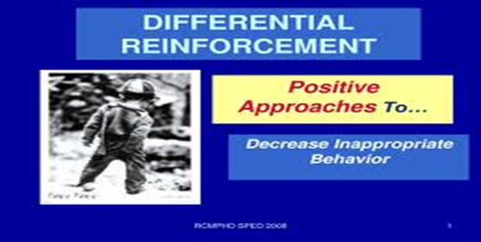
Catch them being good
Often behaviors that receive the most attention are the behaviors that will be strengthened.
  Look for opportunities to pay attention to the person in positive ways.
  Focus on what is right, not what is wrong.
    Praise them for these as much as possible

Slide 34
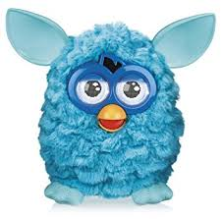
Replacement Behaviors (FERBs) Need to…
Incorporate what the child likes and their strengths
Be taught when calm
Be easier than the problem behavior
Be reinforced more than the problem behavior
Fit the relevant context of the person’s life
  It is also helpful to make old target behaviors irrelevant (not reinforced anymore - extinction) although sometimes this is impossible.

Slide 35
Replacement Behavior Examples
Target Behavior | Function | FERB
Picking at skin / sores | Sensory stimulation | Peeling elmer’s glue or picking off nail polish
Throwing items | Escape from an undesired task | Presenting a break card or switching to a different task
Yelling, screaming and kicking tantrum | Social attention | Performing a song and dance - flash mob style
Stealing another child’s toy | Obtained a preferred item | Asking for a turn to play with the toy

Slide 36
Teaching Replacement Behaviors
Teach when calm and happy
Social Stories are great
Remind them of their rewards for the FERB
Give them a way to feel empowered to do the FERB
  Internally motivated to go to it.
Start with errorless learning – immediate success
Have prompts and cues ready in trigger situations
Response Shaping – Reinforce small steps to the overall goal

Slide 37
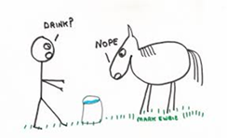
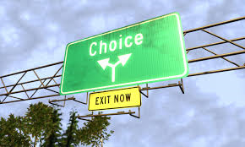

Increasing Choice
Increase opportunities for choice – Ask the child what they want
  Build autonomy / Use Preferences
Help with decision-making – Helping a child weigh out the pros and cons of their options.
  Limiting choice between acceptable options
Respect choice – We need to give the child as much control over their own lives as possible.

Slide 38
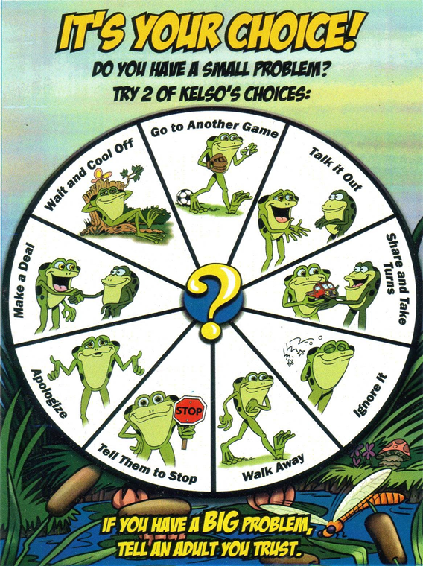
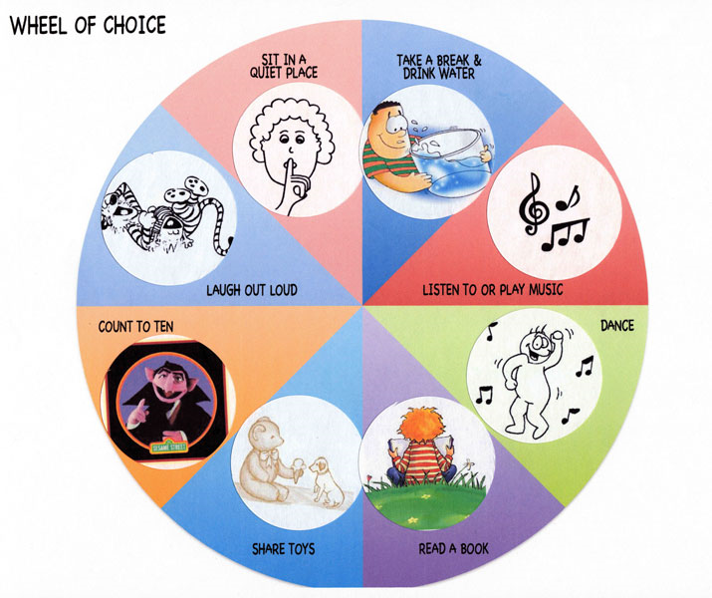
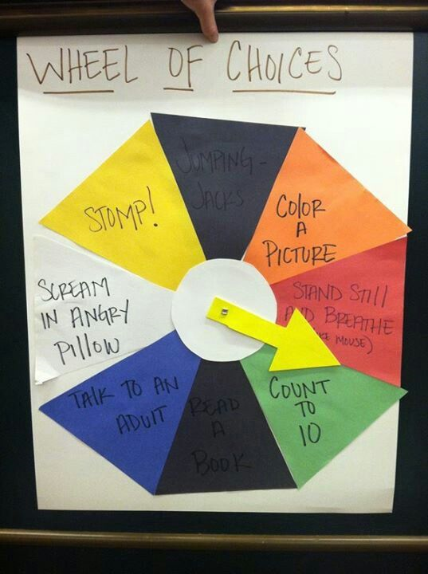
Encouraging Good Choices
Photo Credit:
(Efoza, 2018) (Katie, 2012) (Discovery Primary School)
Notes:
Photo Credit:
http://www.efoza.com/post_choice-charts-for-students_395164/
http://www.psrideaweb.com/2012/10/wheel-of-choices.html
http://discovery.fifeschools.com/resources/kelso-s-choices
Discovery Primary School. (n.d.). Retrieved from Kelso's Choices: http://discovery.fifeschools.com/resources/kelso-s-choices
efoza. (2018). Retrieved from 6 Best Images of Choice Charts For Students: http://www.efoza.com/post_choice-charts-for-students_395164/
Katie, S. (2012, October 22). Retrieved from Behavioral Interventions-For Kids: http://www.psrideaweb.com/2012/10/wheel-of-choices.html

Slide 39
Building Strengths
ID what a child is good at AND/OR what they enjoy
  Vision boards – interesting choices
Remind them of their positive attributes
Find ways for them to utilize these daily
  Interested in horses – present on horse breeds, what would a horse do situations
Praise the uniqueness of their talents / attributes

Slide 40
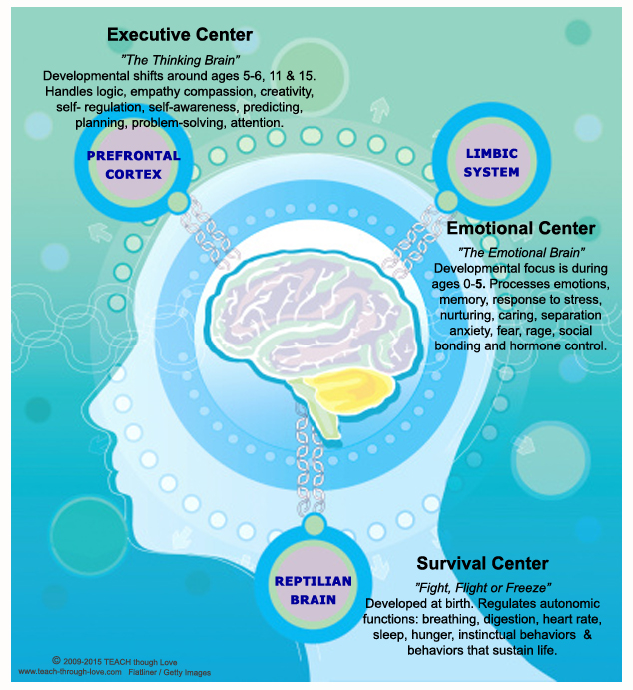
(Temucin, 2016)
Notes:
https://www.linkedin.com/pulse/neurochildren-dummies-emel-temu%C3%A7in
The Neocortex is the new brain, which has been developed through ages, by human race get older. It is 3-4 million years old. The main characteristics of the neocortex is that it is the rational part of our brain.
The limbic system is the store where our emotions are stored.
The Reptilian is the old brain, 500 million years old. It exists since the beginning of the life of mammals appeared on earths. The main characteristics of the reptilian is that it is our unconscious and is the center of our decision making system.

Slide 41
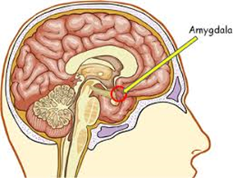
Overexerting Amygdala
Amygdala is responsible for the fear response
  Fight/Flight/Freeze
Sends Stress Response Hormones
When overexerted neuropathways go to the fear response instead of developing other areas.
Smaller hippocampus (working memory)

Slide 42

Resiliency
The ability to bounce back after aversive experiences.

Slide 43
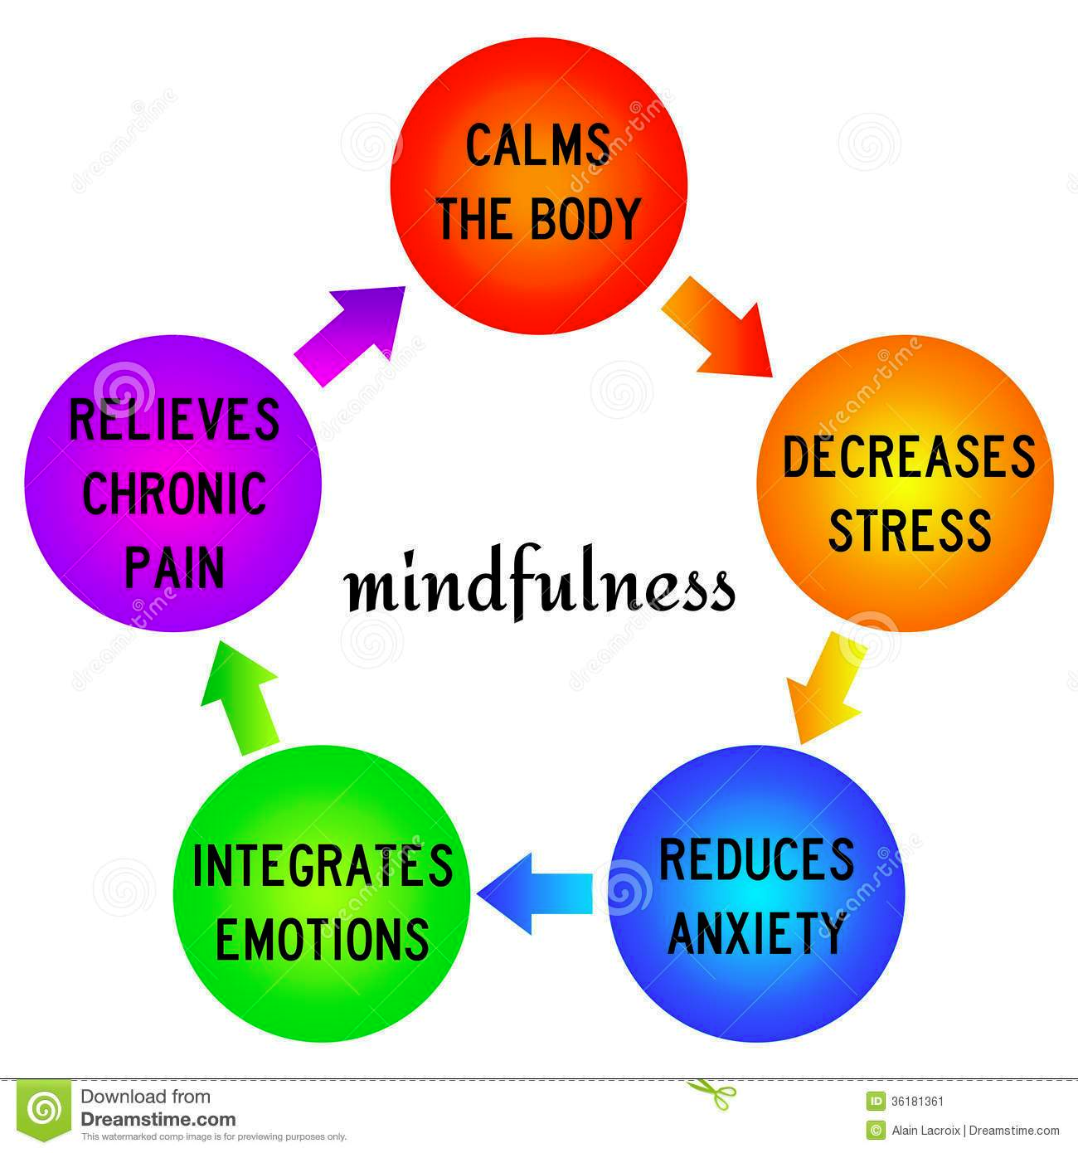
What Mindfulness can do…
(Lacroix, 2015)

Slide 44

Benefits of Legs Up the Wall Yoga Posture
It reduces edema in the legs and feet
It relieves tired leg muscles
It gives you all the benefits of inversion, without the effort
It is super calming for the nervous system
It helps quiet the mind
(Washington, 2018)
Notes:
1. It reduces edema in the legs and feet.
By reversing the effects of gravity on your legs and feet, you can really help to move any stuck or stagnant fluids that may build up there if you have low blood pressure, or spend a lot of time on your feet during your day. In this posture, you will be using gravity to your advantage.
2. It relieves tired leg muscles.
Hanging out with your legs up the wall is one of the best ways to help drain tension from the legs, feet, and even the hips if you have them elevated on blocks.
If you have a strap around your legs, and have given yourself an extended period of time to allow your body to fully relax into the posture, you will find that tired, sore legs will feel a whole lot better once you come out of your posture.
3. It gives you all the benefits of inversion, without the effort.
You most likely know how good inversions are for you at this point—they can help to reverse the effects of gravity on the whole system, help regulate blood pressure, help move stuck fluids, and even help to improve your digestion.
However, sometimes the energetic expressions of inversions like Handstand are too much. We all have times in our lives when we need something that is just fully nourishing, and that is where Legs Up the Wall comes in.
You will still be getting many of the benefits of practicing an active inversion, while also fully resting and surrendering.
4. It is super calming for the nervous system.
This posture is really intended to be a deeply relaxing pose. When you combine a longer hold of Legs Up the Wall with slow, rhythmic breathing, you will be tapping into your "rest and digest" nervous response.
In this state, your body will be actively digesting anything you have eaten, as well as working to heal and repair your body. When you do poses like Legs Up the Wall consistently for a period of time, you may notice that your body feels healthier overall, and that you are better able to find a calm state of mind.
5. It helps quiet the mind.
As mentioned in the point above, this posture may help you cultivate a quiet mind if you practice it for a period of time. By fully releasing and relaxing your body and by focusing on deep breathing, you will evoke a meditative state.
Having the body feel safe and supported is one of the tools that we as yogis use to help reach this peaceful state. As you breathe, surrender and let go, you may find yourself slipping into bliss!

Slide 45
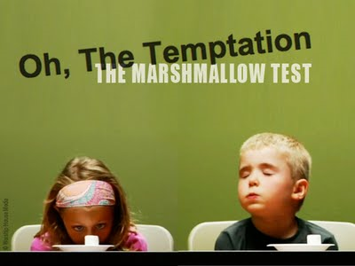
Teaching Self Regulation
A prefrontal cortex skill that can be trained
Delayed Gratification
Recognize a bigger goal to help control an impulse
Make decisions for themselves
Opportunities for the child to plan ahead
Practice!!!
(Dewar, 2015)

Slide 46

Teaching Relaxation Methods
(Sesame Street, 2012)
Notes:
https://www.youtube.com/watch?v=_mZbzDOpylA

Slide 47
“Time-out” vs. Calming Space
  “Time Out”
Instructed to go to a designated room/place based on their behavior
Loss of access to preferred activities (e.g., cancelling a trip into community or loss of privileges to iPad or TV)
Calming Space
Focus person chooses to go to space on their own
Never told to go there, but can be reminded that it is available
Focus person chooses the space and is involved in the decorating/setup
Focus Person is in proactive control

Slide 48
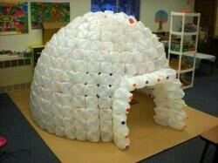
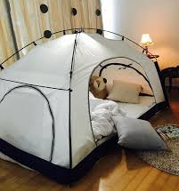
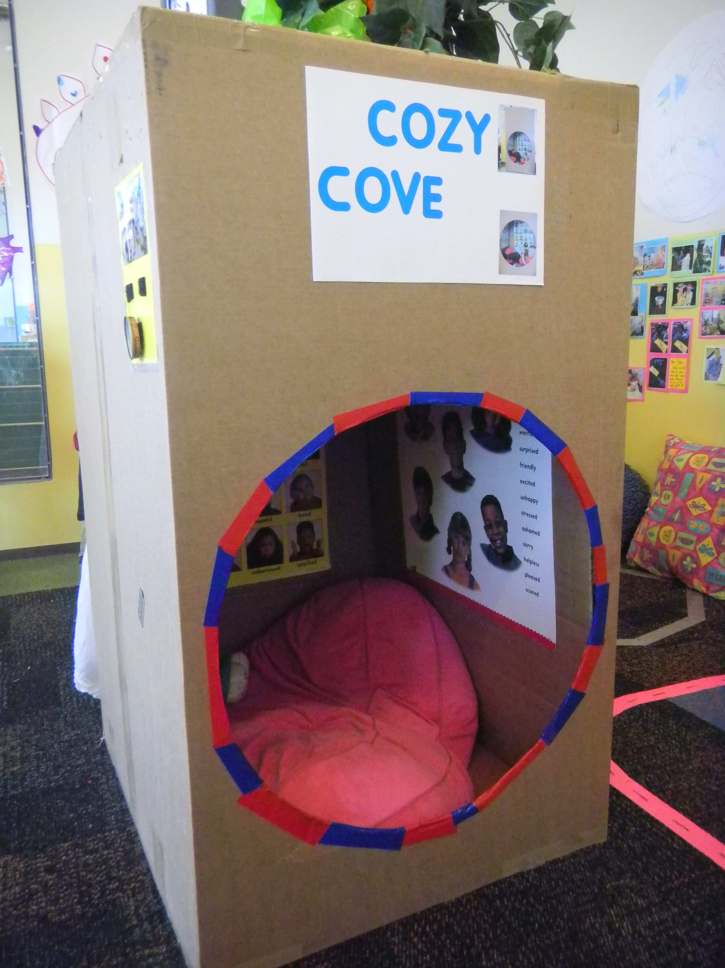
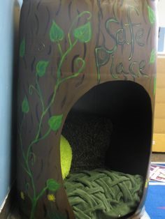
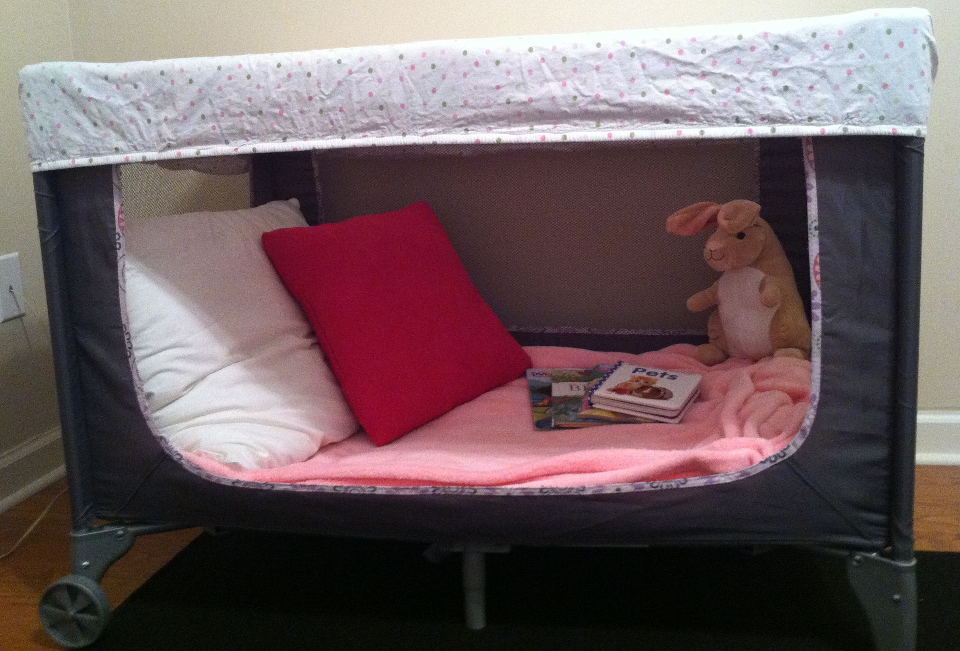
Calming Space Ideas
Photo Credit:
Tent = (morningculture.co, 2017)
Cozy Cove & Safe Place = Pinterest
Igloo = (Warren, 2017)
Notes:
Photo Credit:
http://morningculture.co/tent-for-bedroom/tent-for-bedroom-room-in-room-a-cozy-bed-tent-tent-bedroom-ideas/
https://www.pinterest.com/pin/252834966558149277/?lp=true
Photo Credit:
https://hubpages.com/education/milk-jug-igloo
https://www.pinterest.com/pin/102105116535109590/?lp=true

Slide 49
References
Behavior & Communication (2015). https://communicatepa.wikispaces.com/Behavior+%26+Communication?responseToken=4010f7db139100b918cbfbb388abc146
Clements, D. (2012). Raising Little Rhodies. http://raisinglittlerhodies.blogspot.com/
Dewar, G. (2015, 11). Parenting Science. Retrieved from Teaching self-control: Evidence-based tips: https://www.parentingscience.com/teaching-self-control.html
Discovery Primary School. (n.d.). Retrieved from Kelso's Choices: http://discovery.fifeschools.com/resources/kelso-s-choices
Efoza. (2018). Retrieved from 6 Best Images of Choice Charts For Students: http://www.efoza.com/post_choice-charts-for-students_395164/
Notes:
Research should be up-to-date and the newest available
References should be used on the slides and in listing at back if materials come directly from a particular source.
References should be listed at back if materials use the source in an indirect way.
If you are using someone’s exact words/wording, you must use quotations and in-text citation or else it is considered plagiarized.
Follow American Psychological Association standards for references.
https://owl.english.purdue.edu/owl/section/2/10/

Slide 50
References
Enright, T. (2015, September 30). Child Development Institute. Retrieved from Eight Ways to Encourage Self-Motivation in Your Child: https://childdevelopmentinfo.com/development/eight-ways-to-encourage-self-motivation-in-your-child/#.WrlaEtqosdU
Evans, J. (2016, November 12). “The children who need love the most will always ask for it in the most unloving ways” so stop shaming them! Retrieved from Jane Evans: http://www.thejaneevans.com/the-children-who-need-love-the-most-will-always-ask-for-it-in-the-most-unloving-ways-so-stop-shaming-them/
Hinerman, M. (2017). Positive Behavior Support Training Videos for Parents and Professionals. Practiced Routines. Iris Education Media.
Katie, S. (2012, October 22). Retrieved from Behavioral Interventions-For Kids: http://www.psrideaweb.com/2012/10/wheel-of-choices.html
Notes:
Research should be up-to-date and the newest available
References should be used on the slides and in listing at back if materials come directly from a particular source.
References should be listed at back if materials use the source in an indirect way.
If you are using someone’s exact words/wording, you must use quotations and in-text citation or else it is considered plagiarized.
Follow American Psychological Association standards for references.
https://owl.english.purdue.edu/owl/section/2/10/

Slide 51
References
Lacroix, A. (2015, September 13). Caring Mindfulness: Thoughts on The Day of Mindfulness – Pulse. Retrieved from Depression Treatments: https://yourdepressiontreatments.wordpress.com/2015/09/13/caring-mindfulness-thoughts-on-the-day-of-mindfulness-pulse/
Lebowitz, S. (2014). 40 Ways to Relax in 5 Minutes or Less. http://greatist.com/happiness/40-ways-relax-5-minutes-or-less
Lindsey B.; Peske, N.; Grandin, T. (n.d.). Raising a Sensory Smart Child. Retrieved from https://www.sensorysmarts.com/sensory_diet_activities.html
Lovett, H. (1996). Learning to Listen: Positive Approaches and People with Difficult Behavior. Brookes Publishing.
Minahan, J. (2013). Teaching Self-Calming Skills. Responsive Classroom. https://www.responsiveclassroom.org/blog/teaching-self-calming-skills
Notes:
Research should be up-to-date and the newest available
References should be used on the slides and in listing at back if materials come directly from a particular source.
References should be listed at back if materials use the source in an indirect way.
If you are using someone’s exact words/wording, you must use quotations and in-text citation or else it is considered plagiarized.
Follow American Psychological Association standards for references.
https://owl.english.purdue.edu/owl/section/2/10/

Slide 52
References
Morningculture.co. (2017, Nov 21). Tent For Bedroom Room In Room A Cozy Bed Tent Tent Bedroom Ideas. Retrieved from http://morningculture.co/tent-for-bedroom/tent-for-bedroom-room-in-room-a-cozy-bed-tent-tent-bedroom-ideas/
Sdorow, L. M. (1993). Psychology. Brown and Benchmark Publishers.
Sesame Street. (2012, Oct 19). Retrieved from Common and Colbie Caillat Belly Breath: https://www.youtube.com/watch?v=_mZbzDOpylA
Stephens, C. (2015, December 7). How to Calm Young Children Down in Minutes . Retrieved from https://www.youtube.com/watch?v=yRKpNaVaP84
Temucin, E. (2016, February 27). Nuerochildren for dummies. Retrieved from Linkedin: https://www.linkedin.com/pulse/neurochildren-dummies-emel-temu%C3%A7in
Notes:
Research should be up-to-date and the newest available
References should be used on the slides and in listing at back if materials come directly from a particular source.
References should be listed at back if materials use the source in an indirect way.
If you are using someone’s exact words/wording, you must use quotations and in-text citation or else it is considered plagiarized.
Follow American Psychological Association standards for references.
https://owl.english.purdue.edu/owl/section/2/10/

Slide 53
References
Views from a Stepstool. 8 ways kids can calm down anywhere. http://viewsfromastepstool.com/tips-calming-angry-child-plus-8-calming-tools-anywhere/ Retrieved 1-4-18.
Warren, J. (2017, Aug 23). How to Build a Milk Jug Igloo. Retrieved from Hub Pages: https://hubpages.com/education/milk-jug-igloo
Washington, A. (2018). 5 Health Benefits of Legs Up the Wall Posture. Retrieved from Do You Yoga: https://www.doyouyoga.com/5-health-benefits-legs-wall-posture/
Notes:
Research should be up-to-date and the newest available
References should be used on the slides and in listing at back if materials come directly from a particular source.
References should be listed at back if materials use the source in an indirect way.
If you are using someone’s exact words/wording, you must use quotations and in-text citation or else it is considered plagiarized.
Follow American Psychological Association standards for references.
https://owl.english.purdue.edu/owl/section/2/10/

Slide 54
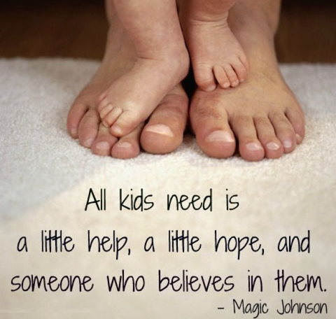
Thank You!!!
aheasley@hsc.wvu.edu
304-290-6229

Slide 55


For more Information
304-293-4692 www.cedwvu.org
Notes:
Key Talking Points:
How to contact the program, Center, make a referral, etc.

