Slide 1
CBD, Medical Marijuana & Traumatic Brain Injury
Martin A. Lee
Director, Project CBD
2018 TBI Conference, West Virginia University
May 10, 20128

Slide 2
Post-Stroke

Slide 3
CBD and THC are neuroprotective antioxidants

Slide 4
U.S. government patent on cannabinoids for neuroprotection
“Cannabinoids have been found to have antioxidant properties [and] are found to have particular application as neuroprotectants, for example in limiting neurological damage following ischemic insults, such as stroke and trauma, or in the treatment of neuro-degenerative diseases, such as Alzheimer’s disease, Parkinson’s disease and HIV dementia.”
—From 2003 U.S Department of Health and Human Services patent titled Cannabinoids as antioxidants and neuroprotectants

Slide 5
Marijuana use “is associated with decreased mortality in adult patients sustaining TBI”

Slide 6
WHY CANNABIS WORKS
Phytocannabinoids mimic & augment the effects of endogenous cannabinoids.
Endogenous CBs are part of the endocannabinoid system.

Slide 7
The Endocannabinoid System
ECS
Eat
Sleep
Relax
Protect
Forget
A healthy ECS plays a major role in neural signaling, immune activity & cellular homeostasis (balance)

Slide 8
CANNABInoidS V. DEMENTIA
“Cannabinoids as regulators of mitochondrial activity. . . protect neurons on the molecular level . . . Neuroinflammatory processes contributing to the progression of normal brain ageing and to the pathogenesis of neurodegenerative diseases are suppressed by cannabinoids, suggesting that they may also influence the ageing process on the system level.”
—The endocannabinoid system in normal and pathological brain aging, Philosophical Transactions of the Royal Society, Feb. 21, 2016

Slide 9
EMPEROR SHÊN-NUNG, 2700 BCE
“Ma Fen is acrid and balanced. Taking much of it may make one behold ghosts and frenetically run about. Protracted taking may enable one to communicate with the spirit light and make the body light. It mainly supplements the center and boosts the qi. Protracted taking may make one fat, strong, and never senile.”
Shou-zhong, Y. 1997. The Divine Farmer's Materia Medica: A Translation of the Shen Nong Ben Cao Jing. Boulder, CO: Blue Poppy Press.

Slide 10
THE MASTER REGULATOR
Regulates brain activity, blood pressure, bone density, immune function, glucose metabolism, pain perception, neuroplasticity, immune function . . .
Facilitates cell repair, cell death, and neurogenesis
Neuroprotective
Stress adaptation

Slide 11
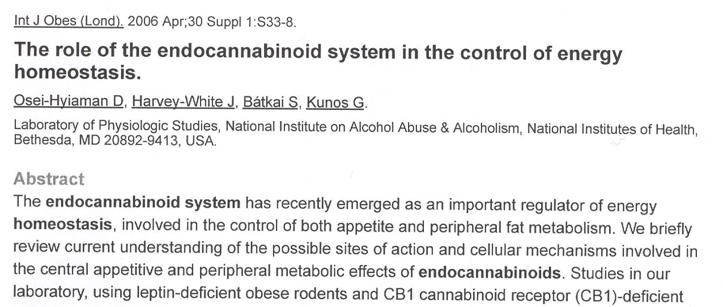
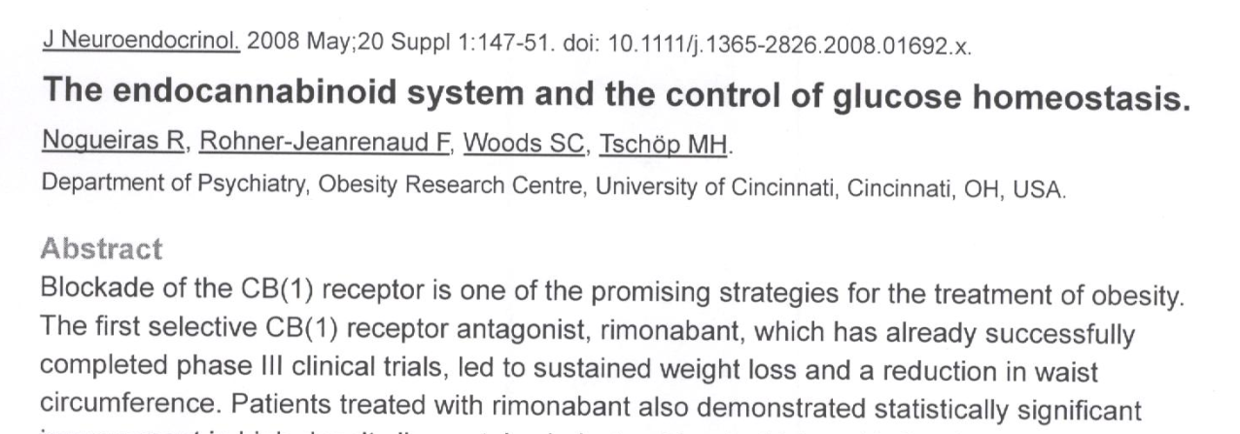
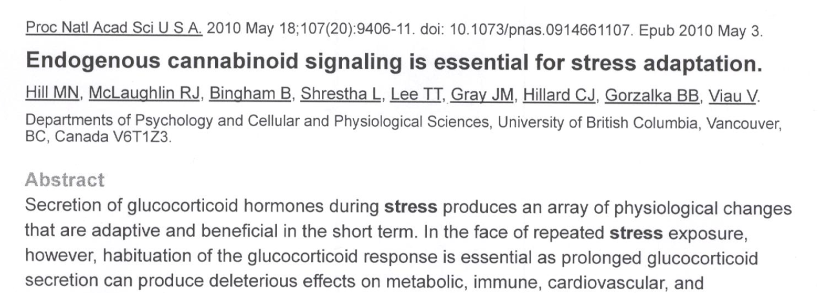

Slide 12
THE ECS IS DYSREGULATED IN NEARLY ALL DISEASE STATES
Cancer
Diabetes
Alzheimer’s
Pain
ECS
Sleep Disorders
TBI/Stroke

Slide 13
Endocannabinoid system – receptors
Cannabinoid Receptors: CB1 & CB2.
CB1- Concentrated in the brain and CNS; mediates psychoactivity when activated by THC. Also present in some peripheral organs.
No fatal cannabis overdose because there are few CB1 receptors in brain stem.
CB2 - Concentrated in peripheral nervous system, immune cells, metabolic tissue; regulates inflammation, immune function, glucose metabolism.
THC binds directly to CB1 and CB2.

Slide 14
Endogenous cannabinoids
Major eCBs: Anandamide and 2AG.
Metabolic Enzymes: FAAH, MAGL and other proteins involved in the biosynthesis and breakdown of endocannabinoids.
Transport Molecules: Fatty acid binding proteins carry eCBs through cell membrane and facilitate reuptake.
By targeting metabolic enzymes and transport molecules, scientists are able to increase or decrease eCB levels in animal models.

Slide 15
TBI: ECS & secondary injury cascade
GLUTAMATE OVERLOAD, EXCITOTOXICITY
Inhibits glutamate receptor transmission
INFLAMMATION
Anti-inflammatory
REACTIVE OXYGEN SPECIES
Antioxidant
BLOOD-BRAIN BARRIER DYSREGULATION
Restores integrity of BBB
MICROVASCULAR DAMAGE
Regulates vasodilation, cerebral blood flow
ION IMBALANCE, CALCIUM INFLUX & ACCUMULATION
Regulates mitochondrial activity
BRAIN TISSUE SWELLING, EDEMA
Limits infarct size
CELL SURVIVAL, CELL DEATH
Regulates autophagy and apoptosis

Slide 16
eCB levels in brain increase in response to TBI & mediate neuroprotection

Slide 17
CB1 activation beneficial after TBI

Slide 18
CB1 and CB2 mediate neuroprotection after TBI

Slide 19
CB2 & microvascular injury during ischemia/reperfusion

Slide 20
CB2 & neuroinflammation

Slide 21
CB2 & neurogenesis

Slide 22
Cannabidiol: A promiscuous compound
CBD does not bind directly to CB receptors like THC does.
CBD is not psychoactive like THC.
CBD’s neuroprotective properties are mediated by non-CB receptors and receptor-independent channels.
CBD is an eCB reuptake inhibitor, thereby increasing eCB levels in the brain and body.

Slide 23
CBD protects blood-brain barrier via serotonin and PPAR (nuclear) receptors

Slide 24
CBD normalizes irregular heartbeat and reduces brain damage after ischemia

Slide 25
From preclinical models to clinical uses
Multifunctional drugs are need for head injuries.
CBD is a multifunctional compound and should be considered as a first-line TBI treatment.
CBD-rich cannabis may be more efficacious for TBI than single molecule CBD.

Slide 26
Preclincal study: CBD-rich cannabis oil better than single molecule CBD
“A lot of research has been made to isolate and characterize isolated single constituents of traditional herbal medicine to find their rationale for therapeutic uses. However, our data together with those of others provide legitimation to introduce a new generation of phytopharmaceuticals to treat diseases that have hitherto been treated using synthetic drugs alone. The therapeutic synergy observed with plant extracts results in the requirement for a lower amount of active components, with consequent reduced adverse effects.”
—“Overcoming the Bell-Shaped Dose-Response of Cannabidiol by Using Cannabis Extract Enriched in Cannabidiol,” Ruth Gallily, Zhannah Yekhtin, and Lumír Hanus (Pharmacology & Pharmacy, February 2015)

Slide 27
PHARMACEUTICAL CBD
Single-molecule THC (Marinol, Naboline) is a FDA-approved pharmaceutical.
CBD will soon be approved as a single-molecule pharmaceutical (Epidiolex).
“Pure CBD” products lack critical medicinal terpenes and minor cannabinoids that interact with CBD and THC to enhance therapeutic benefits.
Preclinical research shows whole plant CBD-rich oil is effective at lower doses & has a wider therapeutic window than CBD isolates.
Drug interactions more likely with CBD isolates.

Slide 28
PATIENTS SHOULDN’T FORGO OTHER MEDICATIONS
Cannabis and CBD can work synergistically with conventional medications, but patients need to be aware of potential side effects.
CHEMOTHERAPY
OPIATES
WARFARIN
EPILEPSY DRUGS

Slide 29
CBD & THC: Power Couple
Cannabidol (CBD) & tetrahydrocannabinol (THC) both have significant medicinal attributes.
CBD & THC work synergistically for therapeutic benefit.
CBD and THC work better in combination than as isolates.

Slide 30
CBD magnifies THC’s inhibitory effect on brain cancer

Slide 31
Cannabis therapeutics for TBI
One doesn’t have to smoke marijuana or get high to experience the plant’s medical benefits.
Measurable doses of CBD-rich cannabis remedies are available in various non-smokable forms.
CBD-rich products can be taken sublingually, orally or applied topically.

Slide 32
Managing psychoactivity
Medical use of cannabis depends on managing its psychoactive properties.
CBD can lessen or neutralize the THC high depending on how much of each is in a given product.
A greater ratio of CBD:THC means less of a high.
The goal is to administer consistent, measurable doses of a CBD-rich remedy with as much THC as a person is comfortable with

Slide 33
Acknowledgements

Slide 34
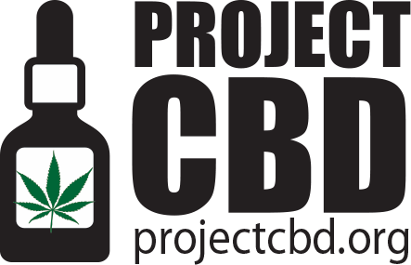
For More Information

