Slide 1

Music Therapy and traumatic brain injury
Katie Martin, MT-BC, NMT
Neurologic Music Therapist
Notes:
Talking Points
UCEDDs were created in 1963 by the federal government with the enactment of Public Law 88-164 to serve people with intellectual disabilities.
Today, there are sixty-seven (67) Centers across the country, authorized under the Developmental Disabilities Assistance and Bill of Rights Act of 2000 (PL-106-402), to serve as resources for Americans with a wide range of disabilities.
The sixty-seven (67) Centers, at least one in every state and territory is affiliated with a major research University and serves as a resource for people of all ages.
The West Virginia Center is a unit within West Virginia University (WVU), Health Sciences, and because of the placement within the University, has access and alignment with the Schools of Pharmacy, Public Health, Nursing, Medicine and Dentistry. Reporting authority with WVU tacitly supports the opportunity for collaboration, education and training needed to support and strengthen the state’s capacity to meet the needs of persons with disabilities.
CEDs role is to provide education and training to University students in multiple disciplines; educate direct care providers who serve persons with disabilities; and provide policy makers with objective information about the status of disabilities services in West Virginia.
West Virginia's Center also provides gap filling direct services and supports in an effort to improve availability and acceptability of services.
On average, over the past five years, the national network of UCEDDs
Provided professional preparation for working in the disability field to over 2,000 students annually.
Provided technical assistance and training each year to over one million health, education, mental health, and policy-making professionals, as well as people with disabilities and their families.
Provided direct (clinical or other) services to more than 700,000 individuals with developmental disabilities and/or their families annually.
Conducted nearly 3,000 research projects each year whose results may benefit people with disabilities.
Developed and disseminated over 7,000 different publications annually to bring the most current information to professionals and the community.
Federal appropriations for Centers are not intended to support all facets of operations.
There is an expectation that federal resources will be leveraged to secure additional monies from state and local agencies, to address issues specific to each state.
West Virginia's Center for Excellence in Disabilities in partnership with the Developmental Disabilities Council (DDC) and the State Protection and Advocacy agency, West Virginia Advocates, is engaged in capacity building, advocacy and system change that promote the integration and inclusion of people with disabilities in community life.

Slide 2
It’s time for music today,
Get ready here we go!
It’s time for music today,
Are you ready? Show me so!
We’ve got some instruments to play and
Songs to sing today, don’t you know?
Say hello to _________. Hey, how are you?
Wave, hello to _________. Hey, how are you?
We’ve got some instruments to play and
Songs to sing today, don’t you know?

Slide 3
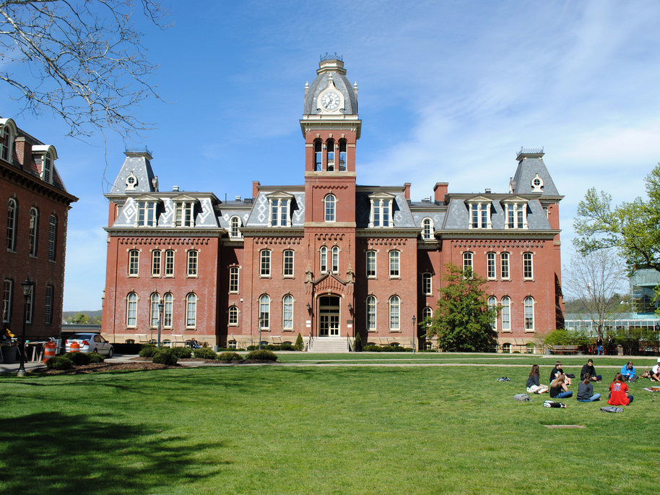
A part of West Virginia University
& WVU Health Sciences Center
Center for Excellence in Disabilities
Notes:
Key Talking Points: Recommendation is to start out explaining that your program is a part of CED, then lead into program information and training topic
-CED is a unit within West Virginia University (WVU), Health Sciences, and because of the placement within the University, has access and alignment within the Schools of Pharmacy, Public Health, Nursing, Medicine and Dentistry.

Slide 4

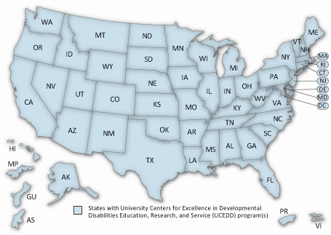
Part
of a National Network
Center for Excellence in Disabilities
Notes:
Key Talking Points:
-The CED is a University Center for Excellence in Developmental Disabilities Education, Research and Service (UCEDD) designated and funded by the U.S. Department of Health and Human Services, Administration for Community Living, Administration on Intellectual Disabilities.
-UCEDDs were created in 1963 by the federal government with the enactment of Public Law 88-164 to serve people with intellectual disabilities.
-Today, there are sixty-seven (67) Centers across the country, authorized under the Developmental Disabilities Assistance and Bill of Rights Act of 2000 (PL-106-402), to serve as resources for Americans with a wide range of disabilities. The sixty-seven (67) Centers, at least one in every state and territory is affiliated with a major research University and serves as a resource for people of all ages.

Slide 5
CED’s role:
    Education and training to University students in multiple disciplines to prepare a workforce that is able and willing to serve persons with disabilities
    Technical assistance to individuals with disabilities and direct care providers who serve them to enhance their skillset and improve service quality
    Gap filling direct services and supports in an effort to improve availability and acceptability of services for West Virginians
    Dissemination of information about the status of disabilities services in West Virginia and the nation
    Research activities conducted in collaboration with partners, to improve services and policies related to individuals with disabilities and their families.
Center for Excellence in Disabilities

Slide 6
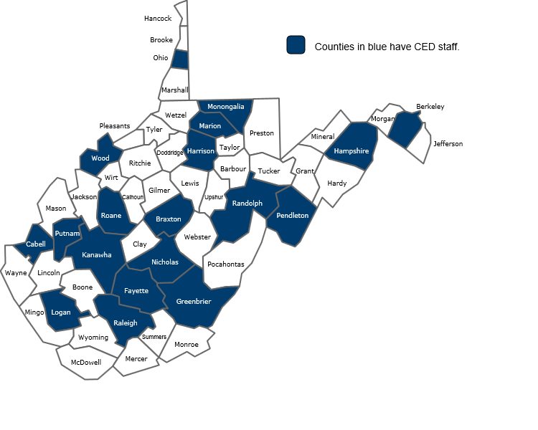
About CED
Serves individuals with disabilities across the life span in all 55 counties
13 Programs
3 Clinics
Approx. 90 Staff
Multiple state and federal partners
Center for Excellence in Disabilities
Notes:
Taking Points:
Staff are hosted by partner agencies and located across the state
Partners include:
WV Dept of Health & Human Resources (DHHR)
WV Division of Rehabilitation Services (DRS)
WV Dept of Education (DOE)
WV Developmental Disabilities Council (DDC)
WV Advocates (WVA)
Maternal and Child Health Bureau (MCHB) /Health Resources and Services Administration (HRSA)
Administration for Community Living (ACL) / US Dept. of Health and Human Services

Slide 8
Becoming an MT-BC:
Graduate from a nationally accredited university with a bachelors or masters degree in music therapy.
Complete at least 1200 clinical hours at an approved internship under the supervision of an MT-BC.
Pass the Boards and become an MT-BC (Music Therapist Board Certified)
Maintain Certification every five years by completing continuing education.

Slide 9
Facilities a MT might work at?
Hospitals
School Districts
Psychiatric Facilities
Hospice
VA Centers
Rehab Facilities
Doctors Offices
Assisted Living
Prisons
Private Practice

Slide 11
Goal of Music Therapy Treatment...
Transfer into functional, nonmusical, real world applications

Slide 12
How is music, and its specific elements, different?
Music activates and accesses parts of the brain bilaterally, therefore enabling the brain to more effectively compensate for itself during therapy, thus facilitating neuroplasticity.

Slide 13
Referral
Assessment
Treatment Plan
Goal/Objective
Intervention
Implementation
Evaluation & Documentation
Discharge

Slide 14
Therapeutic Functions of Music (TFM):
The direct relationship between the treatment goal and the explicit characteristics of the musical elements informed by a theoretical framework and/or philosophical paradigm in the context of the targeted client(s).

Slide 15
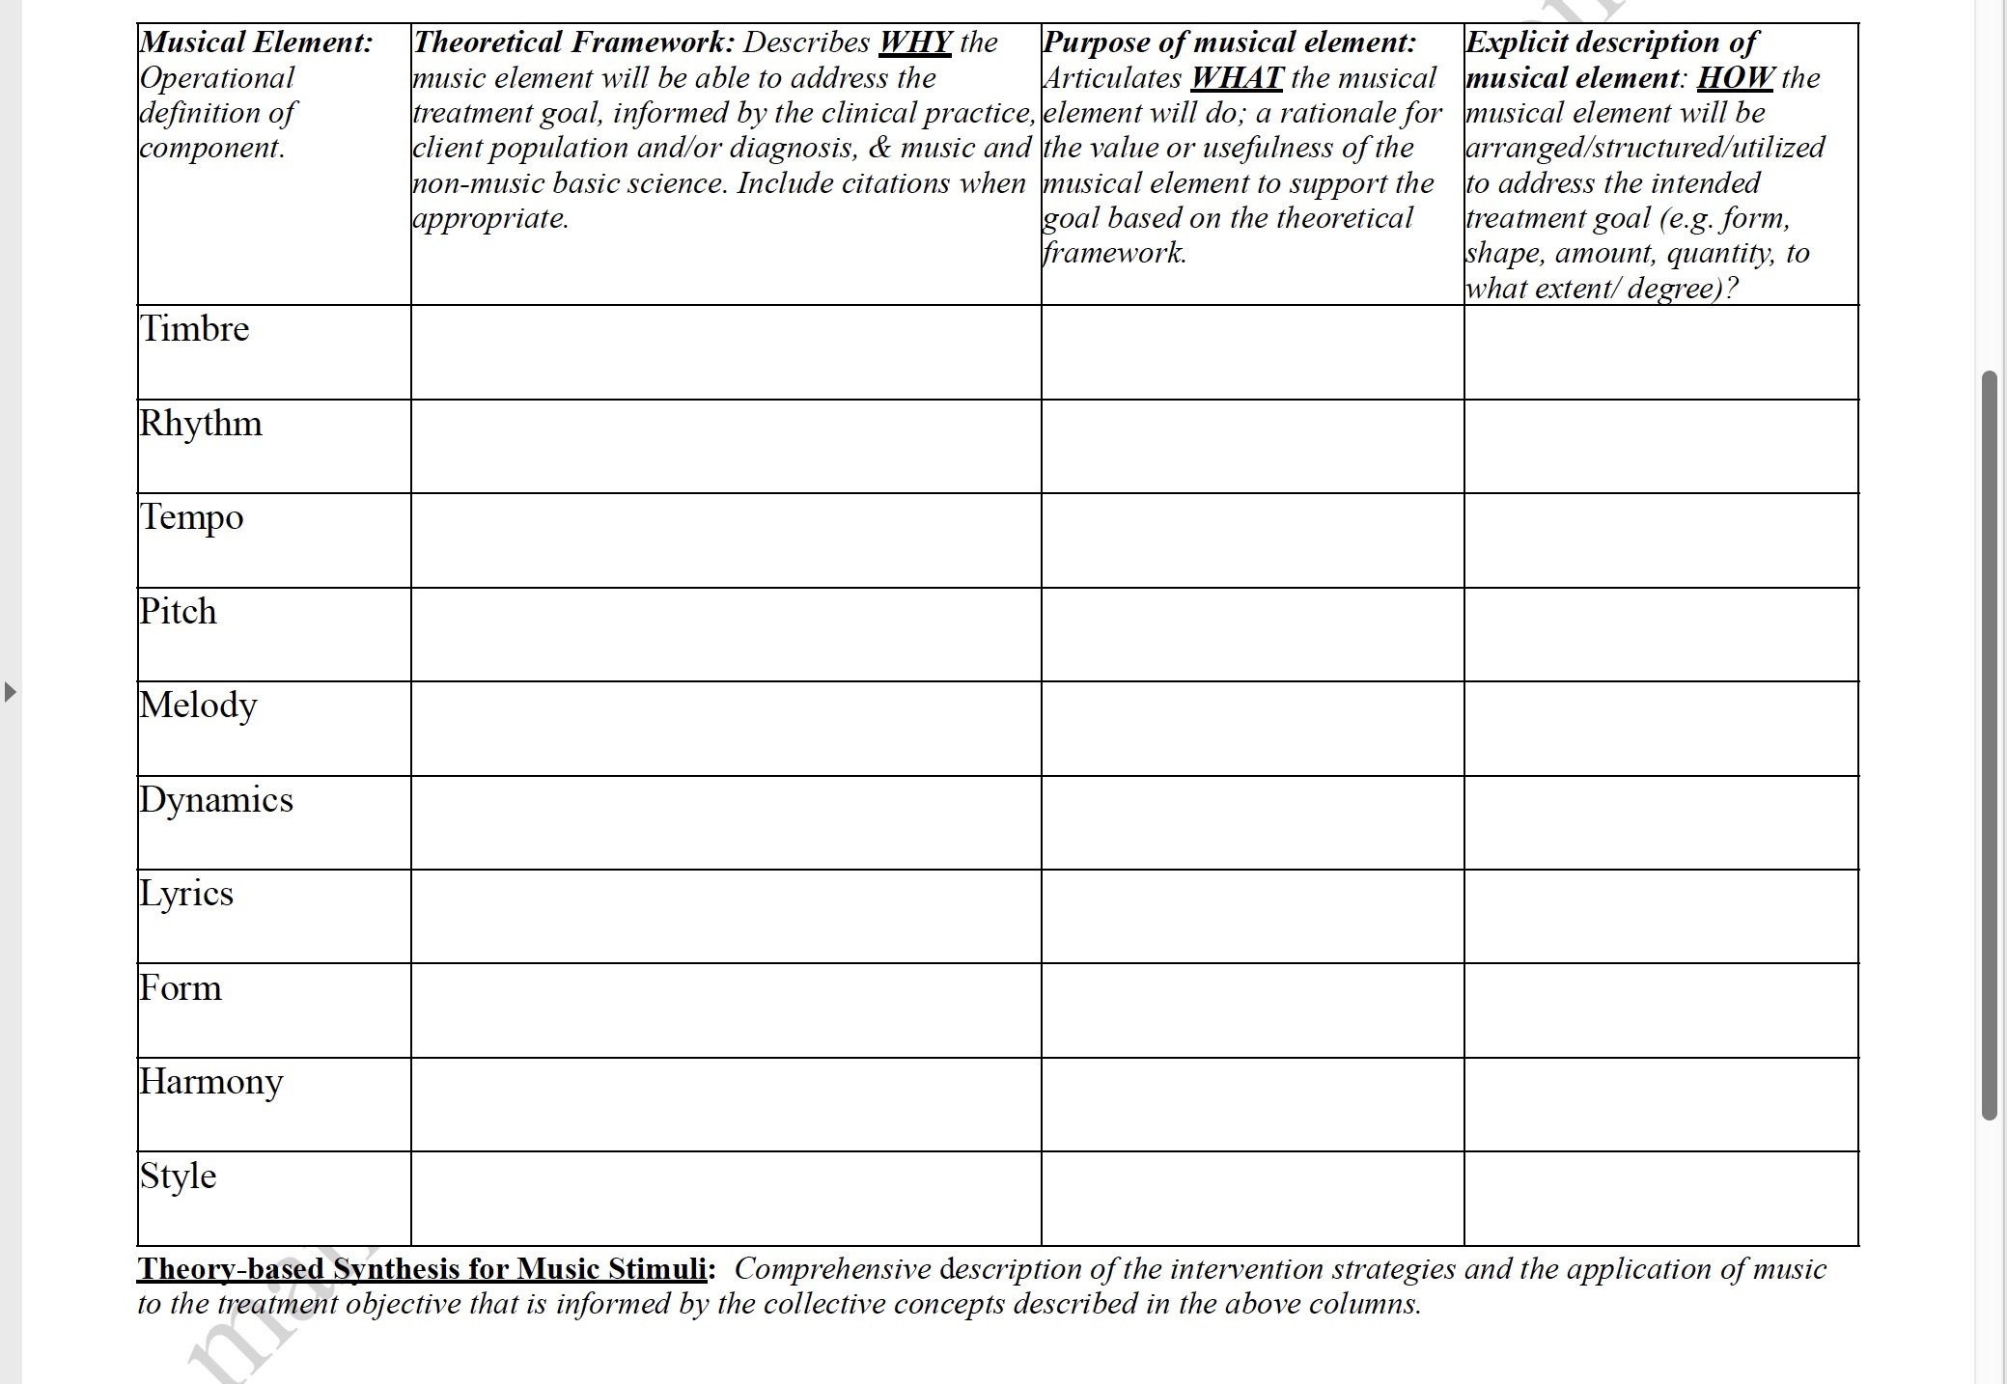

Slide 16
Goal Areas:
Fine and gross motor movement
Nonverbal and verbal communication
Attention
Sensory tolerance
Pain
Stress & anxiety
Positive coping
Memory recall
Socialization
Self esteem
Emotional expression

Slide 17
Therapeutic Instrumental Music Performance (TIMP)
Goal → to exercise and stimulate functional movement patterns through instrument play
Priming
Feedforward vs. Feedback
Example: Crossing midline, trunk, range of motion

Slide 18
Musical Neglect Training (MNT)
Left neglect, right or left visual inattention
Goal → focus attention to neglect or unattended visual field and stimulate hemispheric brain arousal
Assessment: Albert’s Line Crossing Test
Example: Tone Bar Scale

Slide 19
Musical Attention Control Training (MACT)
Goal → Sustained, divided, selective, alternating attention
Assessment: Trail Making
Example: Every time you hear this.. Play... Shaker and drum exercise
Stop and go cue and high and low cue: divided

Slide 20
Musical Executive Functioning Training (MEFT)
Goal → to practice executive function skills
  Organization
  Problem solving
  Decision making
  Reasoning
  Comprehension
Example: Creating musical scene (mountain, river)

Slide 21
Rhythmic Auditory Stimulation (RAS)
Goal → Gait Training
Assessment: 10 meter walk
Example: https://www.youtube.com/watch?v=fbDKHGg9upQ&t=17s (:17)

Slide 22
Melodic Intonation Therapy (MIT)
Goal → To use patients unimpaired ability to sing to facilitate speech production.
Diagnostics: Expressive or Broca’s Aphasia
Example: https://www.youtube.com/watch?v=EK5qqYYxjn4&list=PLzVt_EBL2TF6XTobOJgi0f3HXlJMjSb_m

Slide 23
Patterned Sensory Enhancement (PSE)
Goal → provide spatial, temporal, and force cues to movements that are not intrinsically rhythmic
Example: Piano, upper and lower extremities

Slide 24
Other Music Therapy Interventions:
Lyric Analysis
Songwriting
Drumming
Improvisation
Music Listening

Slide 25
Music therapy at the CED:
Adult and Child Groups at Stepping stones
Teen Autism group
Pace
Dream catchers
UCM – Respite Care Group
Foster family support group
Intergenerational choir
FCI Hazelton
Individual sessions

Slide 26
Cost Effectiveness
Increases the Patient Experience
Group and Individual Sessions
Increased Motivation in Participants
Reimbursement Options

Slide 27
Reimbursement: Medicare & Medicaid
Medicare
  Partial hospitalization Programs – Mental Health
  Prospective Payment System – Nursing facilities, in-patient psych, hospice, in-patient rehab
  Minimum Data Set – Restorative Care (skilled or residential facilities)
Medicaid
  Waivers (TBI, I/DD, A&D)
    - Some states specifically list music therapy and some states qualify music therapy under other categories
Notes:
Since 1994, music therapy has been identified as a reimbursable service under benefits for Partial Hospitalization Programs (PHP). Falling under the heading of Activity Therapy, the interventions cannot be purely recreational or diversionary in nature and must be individualized and based on goals specified in the treatment plan. The current HCPCS Code for PHP is G0176. The music therapy must be considered an active treatment by meeting the following criteria:
Be prescribed by a physician;
Be reasonable and necessary for the treatment of the individual’s illness or injury;
Be goal directed and based on a documented treatment plan;
The goal of treatment cannot be to merely maintain current level of functioning; the individual must exhibit some level of improvement.
Medicaid
There are currently a few states that allow payment for music therapy services through use of Medicaid Home and Community Based Care waivers with certain client groups. In some situations, although music therapy may not be specifically listed within regulatory language, due to functional outcomes achieved, music therapy interventions qualify for coverage under existing treatment categories such as community support, rehabilitation, or habilitation services.
Examples:
Arizona
Medicaid coverage for music therapy provided to individuals with developmental disabilities.
Indiana
Home and Community-Based Waivers managed by the Division of Disability and Rehabilitation Services includes music therapy as a covered service for the following three waiver programs: Developmental Disability Waiver, Autism Waiver, and Support Services Waiver.
Maryland
Music therapy is a covered service under the state's Autism Waiver and the Residential Treatment Center Demonstration Waiver.
Michigan
Music therapy is a covered service under the state's Medicaid Children's Waiver Program.
Texas
Music therapy is listed as a health service under several in Home and Family Support Program Waivers.
Wisconsin
Music therapy is a covered service within the Brain Injury Waiver (BIW) and the Children's Long-Term Support Waiver.
Private Insurance
The number of success stories involving third party reimbursement for the provision of music therapy services continues to grow as more clinicians seek this coverage. In response to the increasing demand, the music therapy profession has worked to facilitate the reimbursement process for clients of music therapy services.
The American Music Therapy Association now estimates that approximately 20% of music therapists receive third party reimbursement for the services they provide.
Music therapy is comparable to other allied health professions like occupational therapy and physical therapy in that individual assessments are provided for each client, service must be found reasonable and necessary for the individual’s illness or injury and interventions include a goal-directed documented treatment plan.
Companies like Blue Cross Blue Shield, United Healthcare, Cigna, and Aetna have all paid for music therapy services at some time. Success has occurred on a case-by-case basis when the therapist implements steps within the reimbursement process. Like other therapies, music therapy is reimbursable when services are pre-approved and deemed medically or behaviorally necessary to reach the individual patient's treatment goals.
Other Sources
Additional sources for reimbursement and financing of music therapy services include: many state departments of mental health, state departments of developmental disabilities, state adoption subsidy programs, private auto insurance, employee worker’s compensation, county boards of developmental disabilities, IDEA Part B related services funds, foundations, grants, and private pay.

Slide 28
Reimbursement: Other Sources
Health insurance (limited BCBS/WV Professional Service)
IDEA Part B and Part C funding (Related Service in Schools)
State and County Departments of Developmental Disabilities
Workers’ Compensation
Private Auto Insurance
Foundations and Grants
Private Pay

Slide 29
Music can lift us out of depression or move us to tears..
It is a remedy, a tonic, orange juice for the ear.
But for many of my neurologic patients, music is even more–
It can provide access even when no medication can, to movement, to speech, to life.
For them, music is not a luxury, it is a necessity.
- Oliver Sacks

Slide 30
May you be filled with loving kindness
May you be well
May you be peaceful and at ease
May you be happy, happy
May you be happy, happy
May you be filled with loving kindness
May you be well
May you be peaceful and at ease
May you be happy, happy
May you be happy, happy
We’ll all be happy, happy

Slide 31


Katie Martin, MT-BC, NMT
Creative Arts Therapy Coordinator
Center for Excellence in Disabilities kathleen.martin@hsc.wvu.edu
304-293-4692 ext. 60638 www.cedwvu.org
Notes:
Key Talking Points:
How to contact the program, Center, make a referral, etc.

