Slide 1
R*E*A*P – The Interdisciplinary Concussion Management Protocol and How a Good RTL Plan is the Key to Good Concussion Management
2018 Traumatic Brain Injury Conference
May 12, 2018
Karen McAvoy, PsyD

Slide 2
Why?
How does concussion affect me?
As an educator?
As a related service provider?
As an Athletic Trainer? As a Coach? As a Parent?
Isn’t concussion a medical and athletic problem?
What is all this hype about?
Aren’t there bigger issues?

Slide 3
Goals:
To make concussion information meaningful
To help to de-mystify concussion and brain injury and legislation and bring the details down to “brass tacks”
To help you take the best care you can of kids while keeping your case loads manageable
To help you help your teachers
To help you help each other
To help you help your district systematize
To help you share the responsibility of concussion management

Slide 4
Who Am I?
School Psychologist – 2 Elementary Schools, 2 Middle Schools, 1 High School, 1 Charter School
Coordinator of Mental Health, Brain Injury Team, Manifestation Determinations
Brain Injury Specialist for Colorado Department of Education
Co-Founder and Owner of GetSchooledOnConcussions.com
Clinical Psychologist
Director of the Center for Concussion, Rocky Mountain Hospital for Children, Denver, CO.
Director, Concussion and NeuroHealth Center, Berkana Rehabilitation Institute, Ft Collins, CO.
Author of REAP – Remove/Reduce*Educate*Adjust/Accommodate*Pace

Slide 5
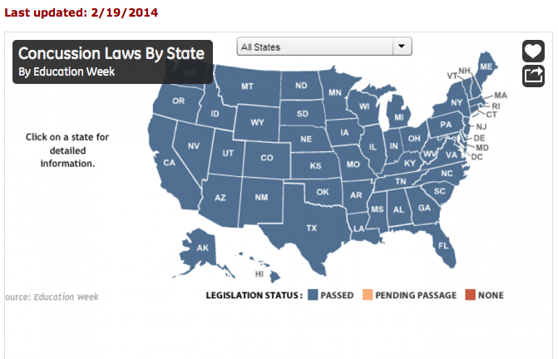
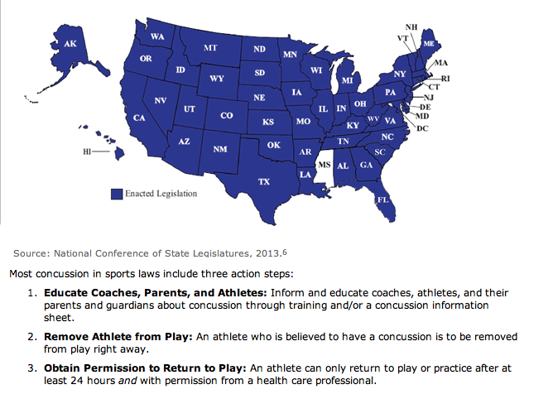
National RTP/RTS Return to Play/Sport Legislation
All rights reserved: © GetSchooledOnConcussions.com

Slide 6
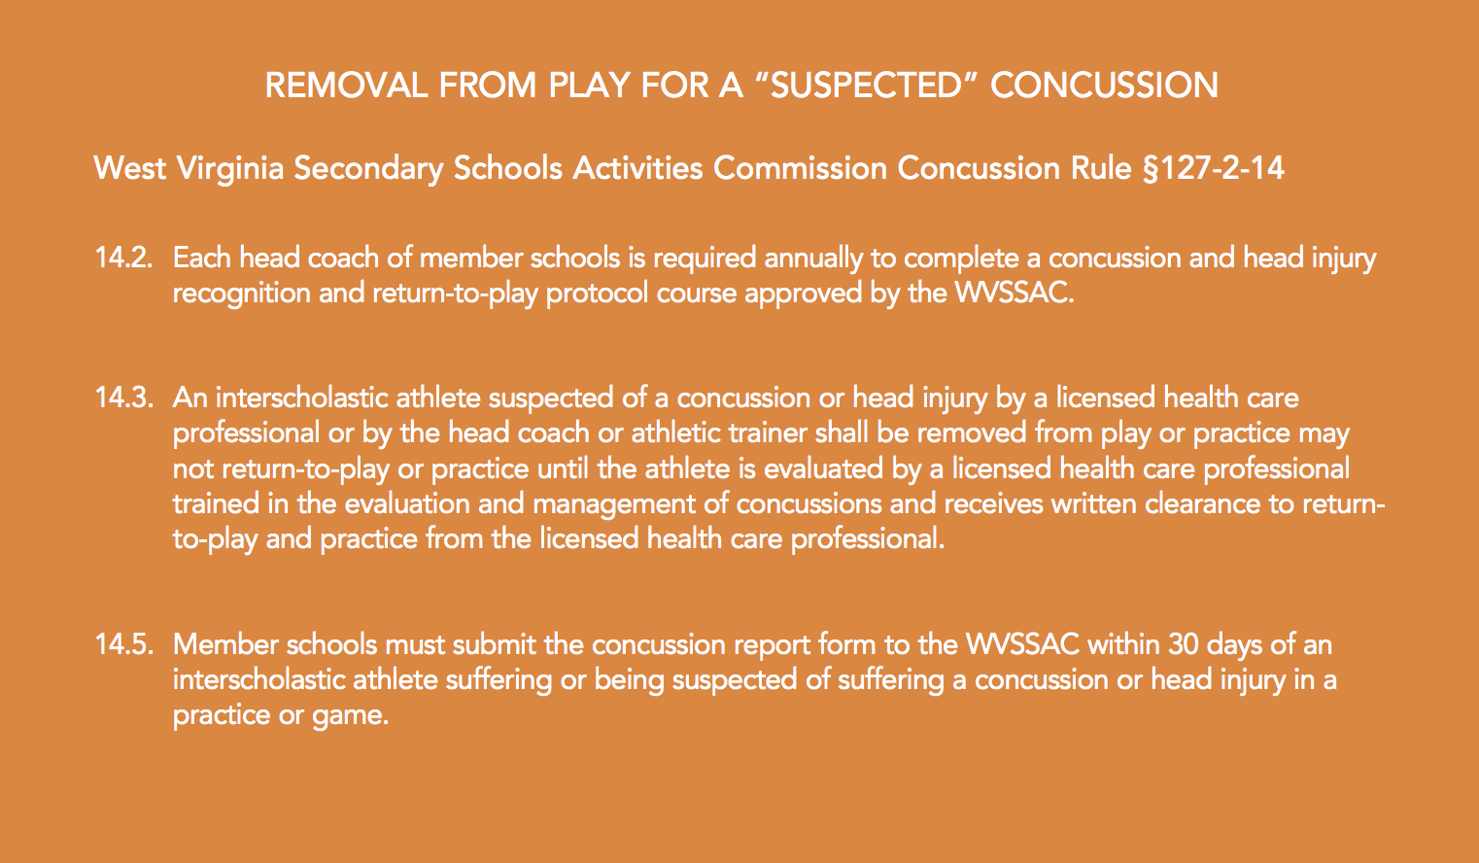
West Virginia Law

Slide 7
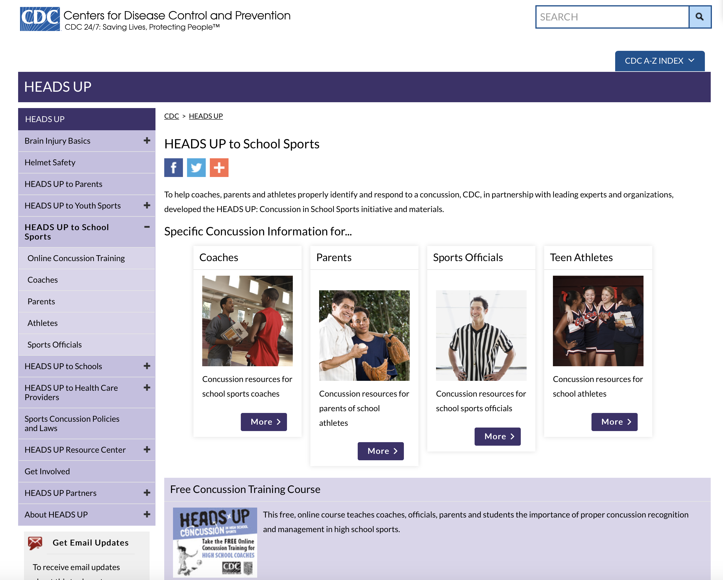
CDC Materials for Coaches and Athletes

Slide 8
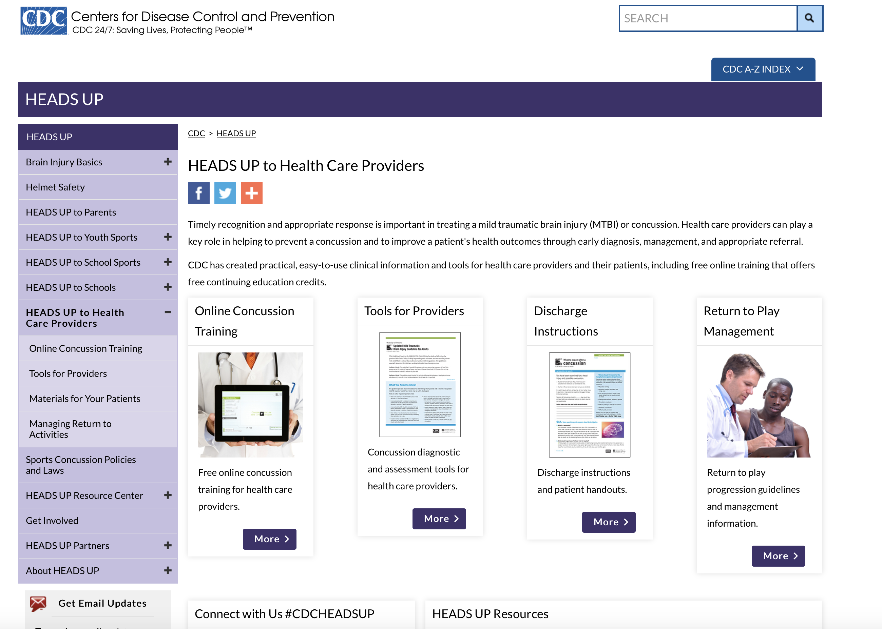
CD Materials for Medical Professionals
All rights reserved: © GetSchooledOnConcussions.com

Slide 9
CDC Materials for Educators

Slide 10
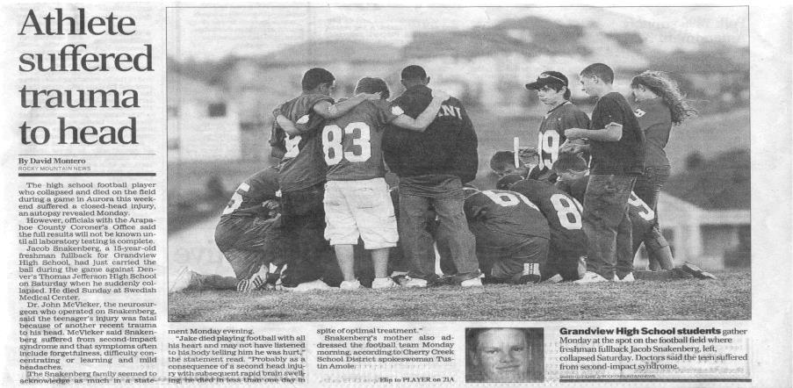
Isn’t concussion a medical and athletic problem?
All rights reserved: © GetSchooledOnConcussions.com

Slide 11

Video

Slide 12
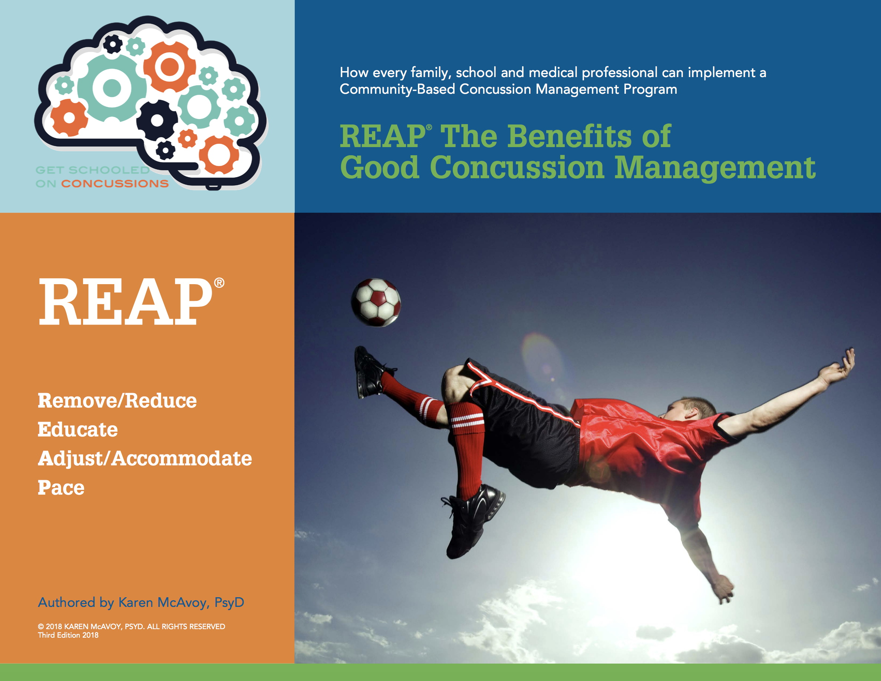
www.REAPconcussion.com

Slide 13
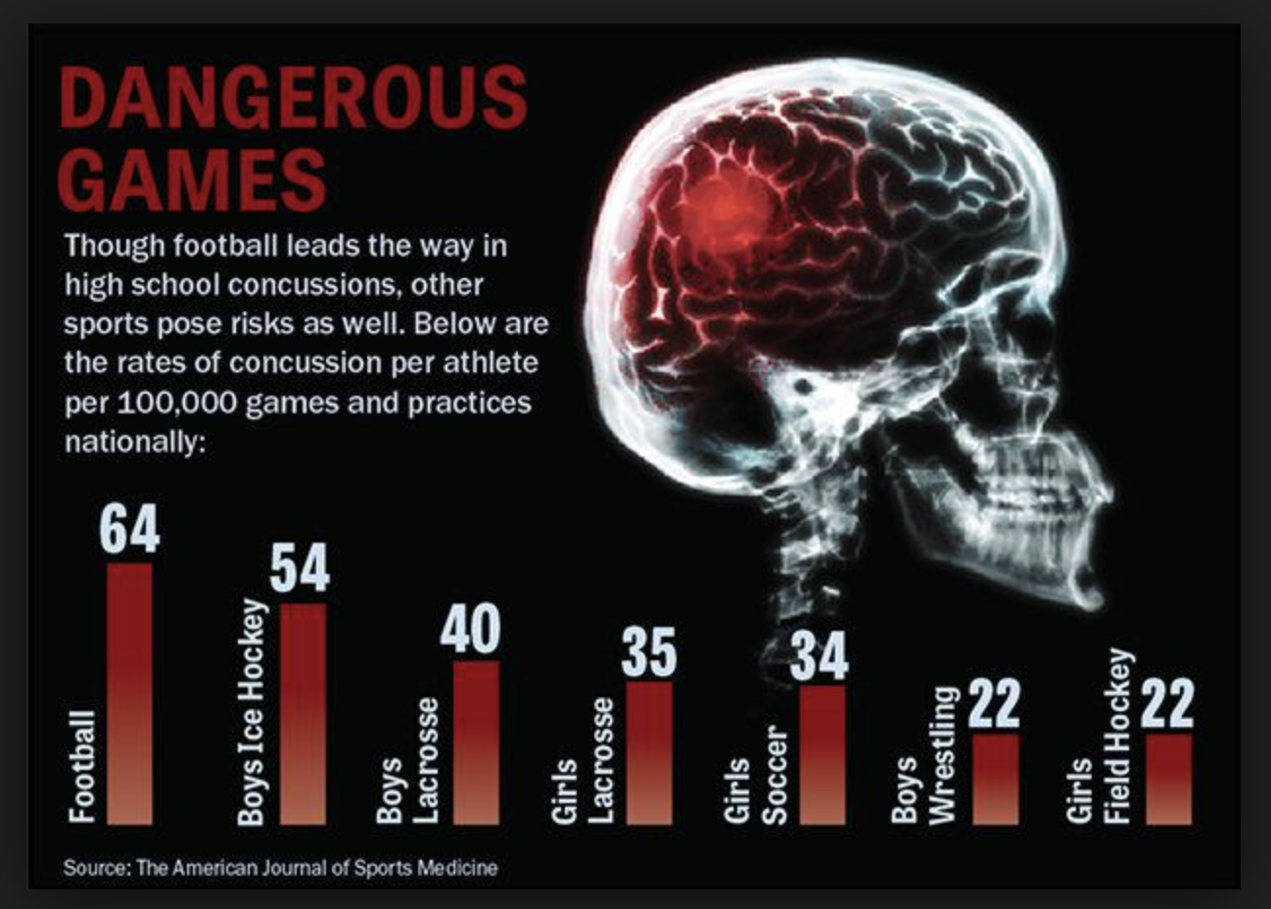
Here are the facts…
Concussions do happen in sports

Slide 14
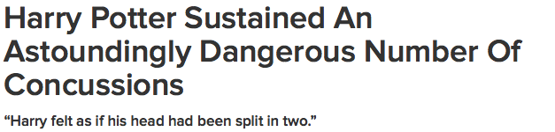
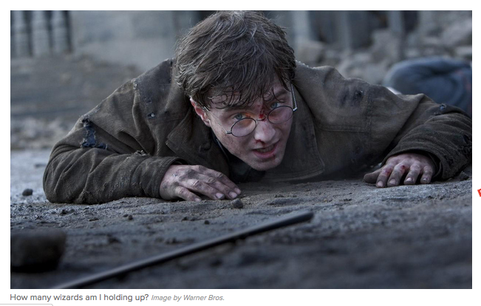
BUT … 40% + are concussions are from non-sports related activities (Eagan-Brown, BrainSTEPS)

Slide 15
Newest Statistics on timeframe of recovery
70% of students with a concussions between the ages of 5 to 18 years will resolve their concussion in 4 weeks
(Zemek, et al. 2016)
And … Staying home and “resting more” does not make a student with a concussion recover faster. Resting for 1 to 2 days followed by a gradual re-introduction of activity (school, social) show a faster recovery (Thomas et al. 2015)
Not every athlete with a concussion will return to sport but every single student who sustains a concussion will return to school/work, to learn and to an active, home and social life!

Slide 16
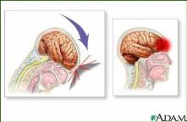
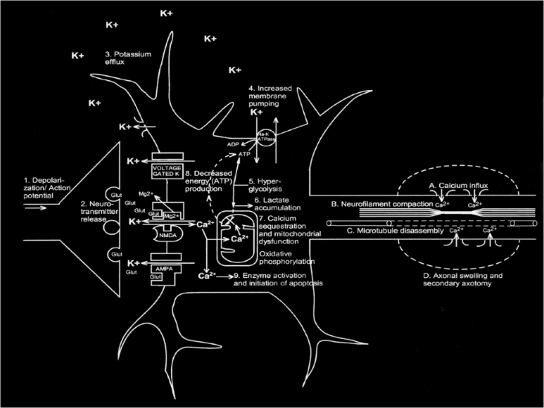
Pathophysiology
Energy crisis
Notes:
Limited understanding of metabolic process in humans. Research is based on rodent model.
No gross anatomic findings with concussion

Slide 17

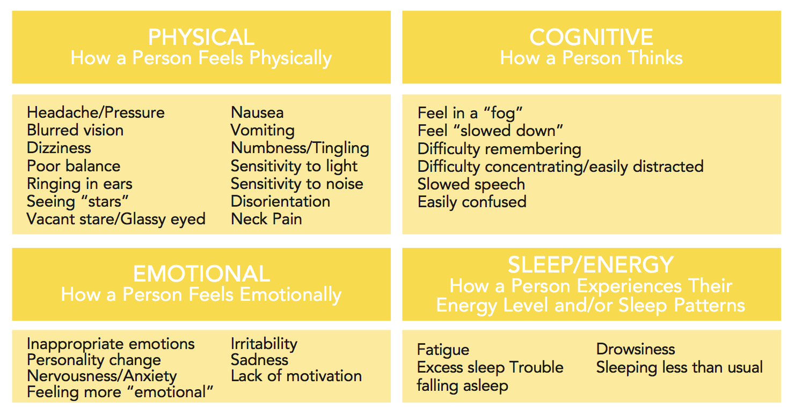
Short Term Impact
(Second Impact Syndrome) = rare
Symptoms: hallmark of concussion
All rights reserved: © GetSchooledOnConcussions.com

Slide 18

Postconcussive Syndrome
May persist for a year or more:
Decreased mental processing speed, short-term memory and attention span
Irritability
Fatigue
Sleep disturbance
Persistent headache
General “foggy” feeling
Deterioration of energy to push through pain everyday and the effects of social isolation, frustration, loss of self
All rights reserved: © GetSchooledOnConcussions.com
Notes:
Most patients with mtbi recover within 5-10 days, unclear how many go on to have long term issues, especially in kids.
One study suggested as many as 5-10% may have long term disabling problems

Slide 19

All rights reserved: © GetSchooledOnConcussions.com

Slide 20
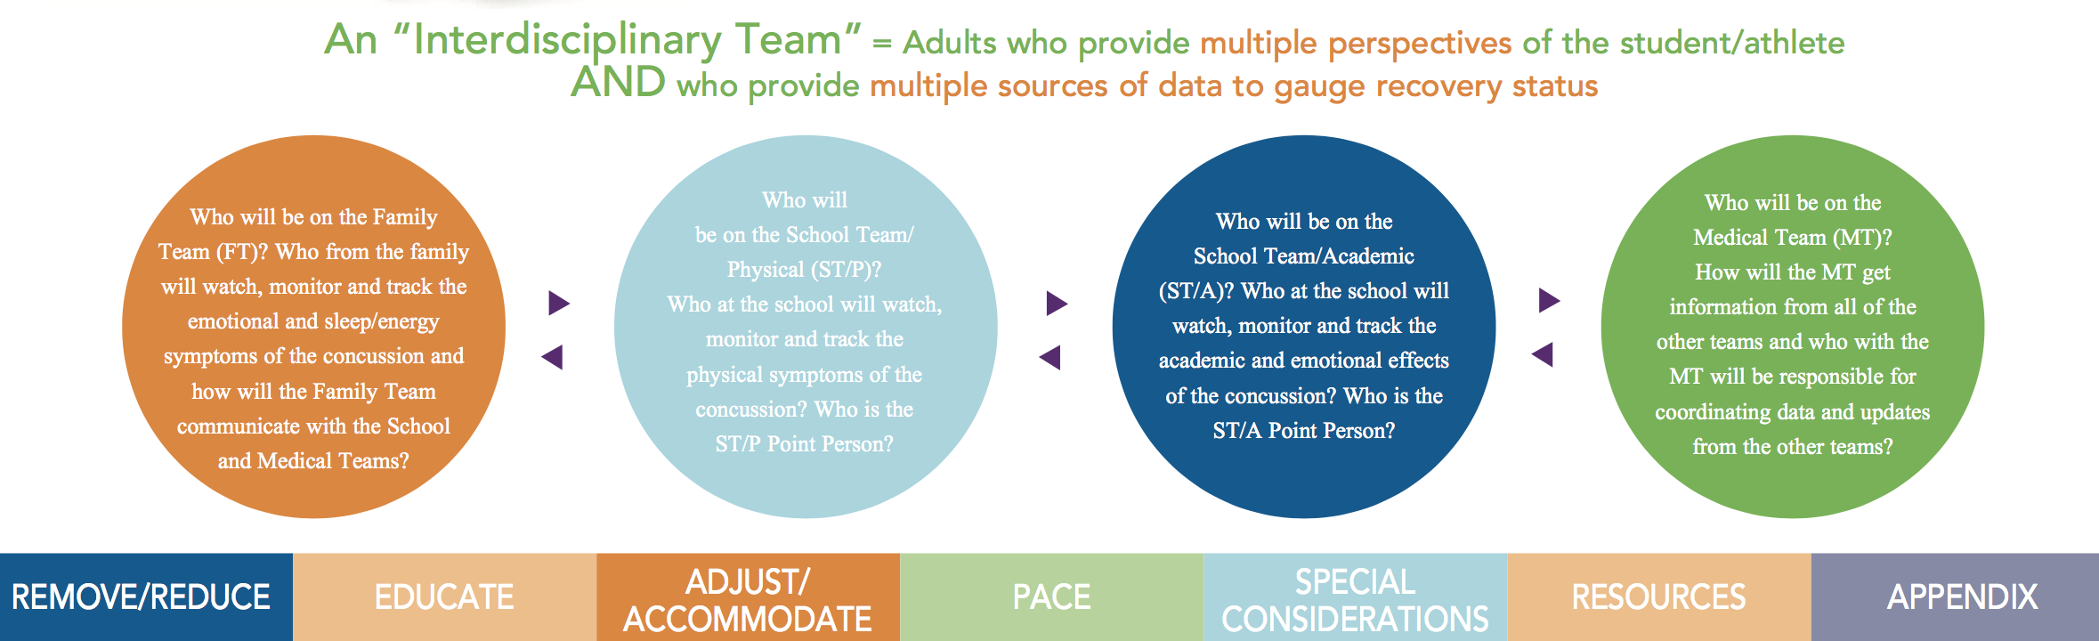
Every Team and Team Member has an important role!
There is NO Return to Play/Sport until there is first Return to School, Return to Learn and Return to Doing the Dishes at home!
REAP Page 4

Slide 21
SCHOOL PHYSICAL:
Coach
ATC
C
O
N
C
U
S
S
I
O
N
Health
Care
Provider
Day 1/Week 1 Week 2 Week 3 Week 4
All rights reserved: © GetSchooledOnConcussions.com
Notes:
Diagnosis
CT/Bleed
Pathophysiology - cells
Rest/Reduce
Fish oils
Magnesium

Slide 22
School Team - Physical
Often sees the incident and” suspects” the presence of concussion
Must immediately REMOVE from PLAY
Does not allow return to play until medically cleared
The school ATC often has the athlete check in daily symptom check in the training room
Weekly administration of neurocognitive test (if doing neurocognitive testing at school)
Keeps the athlete engaged with the team
Encourages attendance at school at school with academic supports and decreased home stimulation for weeks 1, 2, 3,4+
Newest Rehabilitation recommended – Safe , low level, sub-symptom threshold cardio AT HOME or in physical therapy
All rights reserved: © GetSchooledOnConcussions.com

Slide 23
Medical Assessment
Urgently/ED
Diagnosis of concussion, R/O a more serious concern, REMOVE from play
By definition, concussion is not declared on a CT scan or MRI
Be thoughtful about choice to scan:
  Observation, symptom reduction
  Non-focal neurological assessment
All rights reserved: © GetSchooledOnConcussions.com

Slide 24
Medical Assessment
Clinic
Medical history
Concussion history
School history
Concussion Modifiers/Risk factors:
  Gender
  Headache history/migraine history/family history
  Past concussions
  LD, ADHD
  Mental Health concerns
All rights reserved: © GetSchooledOnConcussions.com

Slide 25
Treatments
The “dizzy” kid:
  Oculomotor
  Vestibular
  Balance
Cervicogenic
Auditory Processing Disorder: tinnitus
Autonomic instability
Education, support, cognitive behavior therapy, relaxation, anxiety reduction
All rights reserved: © GetSchooledOnConcussions.com

Slide 26
Family Team
REDUCE
Limit (don’t eliminate) texting.
Limit TV, video games, computer time.
Limit homework.
Keep home from dances, games, the mall. Decrease stimulation.
REST!
School Academic Team
Keep home if severely symptomatic (usually 2-4 days)
Return to school when symptoms are present but tolerable, intermittent and amenable to rest.
Limit (don’t eliminate) school work, REMOVE non-essential work, REDUCE semi-essential work
PACE
MENTAL
DEMANDS
C
O
N
C
U
S
S
I
O
N
Day 1/Week 1 Week 2 Week 3 Week 4
All rights reserved: © GetSchooledOnConcussions.com

Slide 27
Family/Home Intervention
Take the child/adolescent for follow-up medical evaluation/treatment
Bed REST for severe symptoms, overall REST and REDUCE from activities
Minimal mental stimulation until symptoms improve
Limit (don’t eliminate) texting, video games, computer time, TV, reading, homework. No mall, dances, games or extra-curricular activities until able to be back at school with good symptom management
Help integrate child back as soon as can tolerate – INFORM school of concussion!
Can lift home restrictions as symptoms improve over 4 weeks
All rights reserved: © GetSchooledOnConcussions.com

Slide 28
RETURNING TO SCHOOL
No such thing as “medical clearance” for school
REAP Page 8
All rights reserved: © GetSchooledOnConcussions.com

Slide 29
Return to School vs. Return to Learn
RTS
RTL
Return to School is defined as the process of the student physically walking back into a school setting. The decision to send a child to school on any given day is directed by the parent and is dependent upon the student’s ability to manage symptoms well enough to be physically and cognitively present in the classroom to listen and learn
Return to Learn is defined as the process by which educators help students with concussion maximize learning while minimizing symptom flare-ups. A successful Return to Learn plan is directed by educators, especially general education teachers, who have knowledge and skill in differentiated instruction to meet the needs of all students regardless of medical, psychological, learning, behavioral or social conditions
REAP Page 4

Slide 31
Return to Learn is “Differentiated Instruction” for Concussion
REAP Page 9

Slide 32
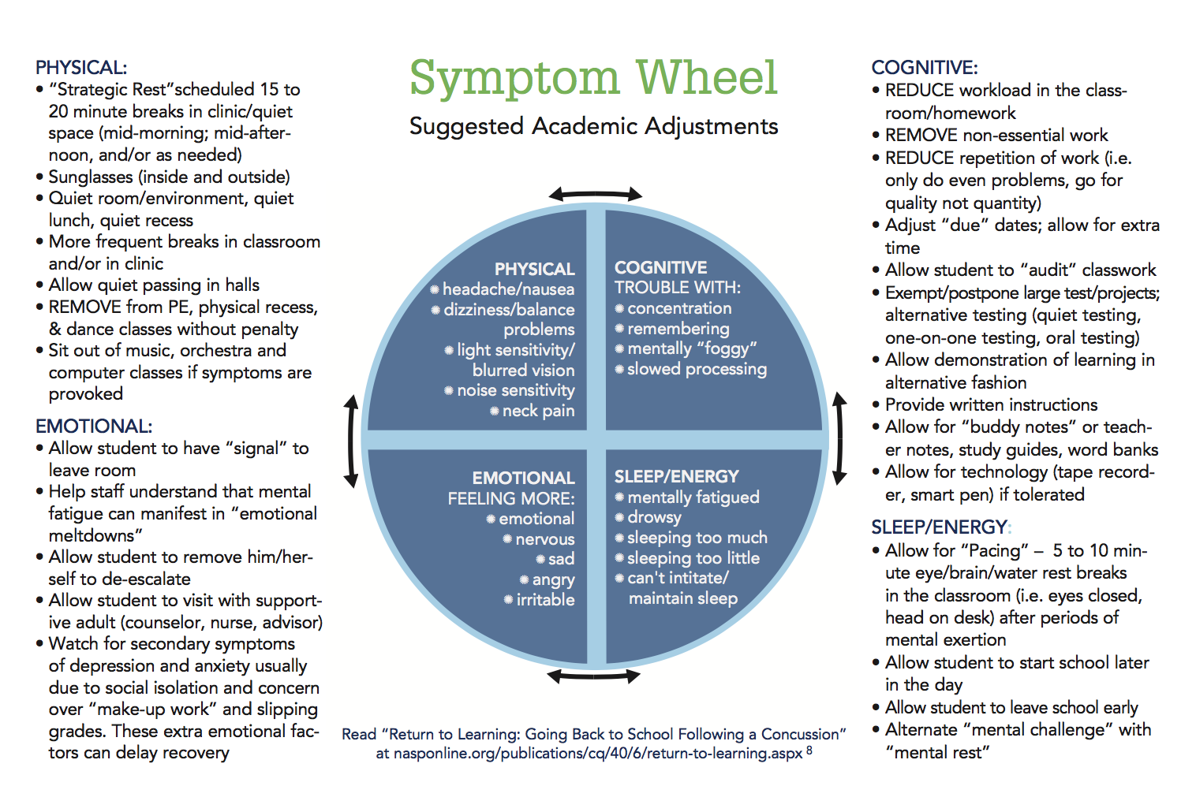

All rights reserved: © GetSchooledOnConcussions.com
REAP Page 10

Slide 33

Are YOU Ready to
Get Schooled
On Concussions?

Slide 34
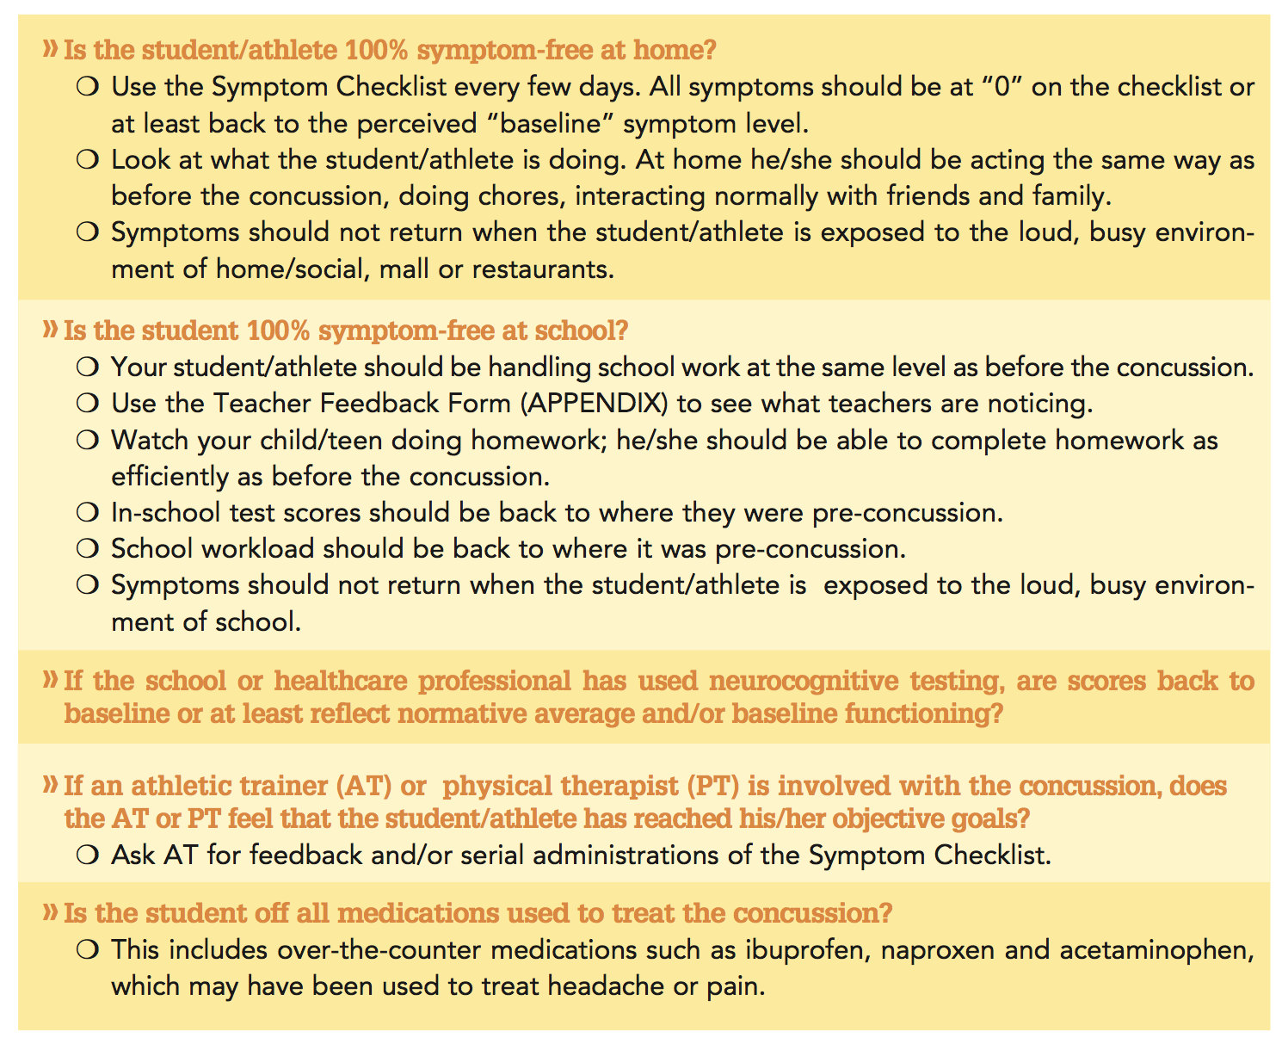




When can I go back to my sport?
REAP Page 11
All rights reserved: © GetSchooledOnConcussions.com

Slide 35

Coach
ATC
C
O
N
C
U
S
S
I
O
N
100% back to pre-concussion learning level at school
now!
Health
Care
Provider
100% back to pre-concussion level at home now!
T I M E (usually between 1 to 28 days)
All rights reserved: © GetSchooledOnConcussions.com

Slide 36
REAP Page 15
All rights reserved: © GetSchooledOnConcussions.com

Slide 37
REAP Page 16
All rights reserved: © GetSchooledOnConcussions.com

Slide 38
This is why a well-developed, well-executed, interdisciplinary team approach to:
Return to School
Return to Learn
Return to Activity (including some social activities, electronics, normalization of teenage life)
Plan leads to a faster, safer Return to Play/Sport!
Return to Activity is defined as the process of encouraging a person with a concussion to begin to add in sub-symptom threshold levels of physical and cognitive activity WHILE still in the recovery phase. A gradual re-introduction of cognitive, social and cardio activity (safe aerobic activity under close supervision) has been found to be therapeutic.4 Return to Activity differs from the progressive Graduated Return to Sport and it is not intended to take the place of the Graduated Return to Sport. Return to Activity happens prior to Graduated Return to Sport with the goal of contributing to asymptomatic status, thus allowing for the start of the Graduated Return to Sport. Widely applied, Return to Activity is a positive term used to encourage people recovering from concussion to stay engaged in their own physical, cognitive and emotional rehabilitation

Slide 39
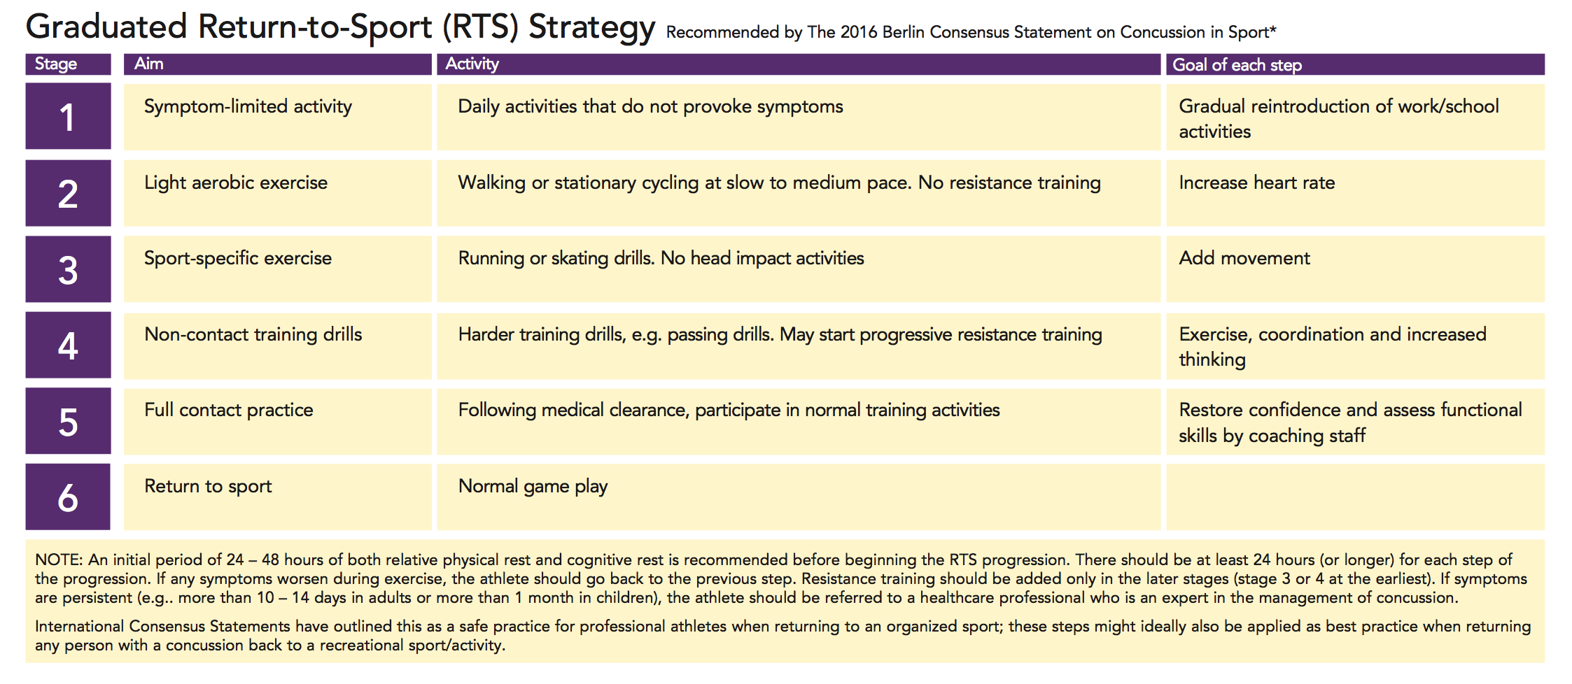
#RTLB4RTS
Graduated Return to Sport is the process of progressively returning athletes back to sport once they are 100% symptom-free
REAP Page 12

Slide 40
A lot of Moving Parts
Student
Parent
Educator Counselor
It’s not hard
but
it’s complicated!
Licensed Health
Care
Provider
Coach
Athletic
Trainer
All rights reserved: © GetSchooledOnConcussions.com

Slide 41
Here’s my favorite part as an educator …
So … If the majority of students with a concussion can (and usually are) back at school within 2 to 4 days from the date of their injury …
And 70% of students will make a slow and steady recovery over 1 to 4 weeks …
But they feel lousy and symptomatic (headache, dizzy, tired) over those 4 weeks …
And they have trouble concentrating, remembering and getting work done at a quick speed …
But they are not “sick” enough to be home from school or completely exempted from any and all schoolwork…

Slide 42

You do the math!
Where does concussion management really happen?
YES! In the general education classroom!
(Fortunately) the majority of concussions are not a 504 issue or an IEP issue!
Good concussion management = quick, flexible, short-term, academic “adjustments“
(not accommodations aka 504; not modifications aka Special Ed)
“adjustments“, supports, differentiated instruction

Slide 43
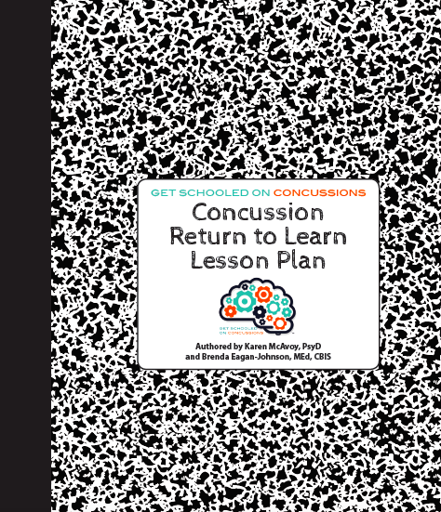
What to do in the classroom?
What to do about missed instruction?
What to do about make-up work?
What to do about quizzes/test?
What to do about extracurricular activities?
All rights reserved:
© GetSchooledOnConcussions.com

Slide 44
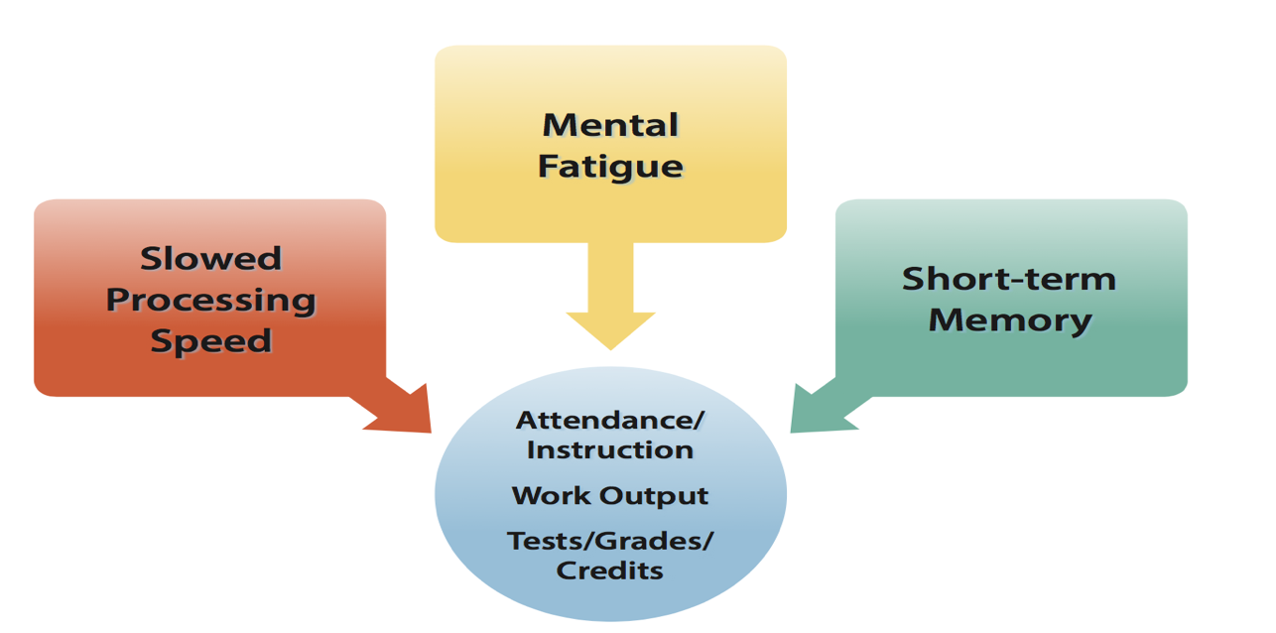
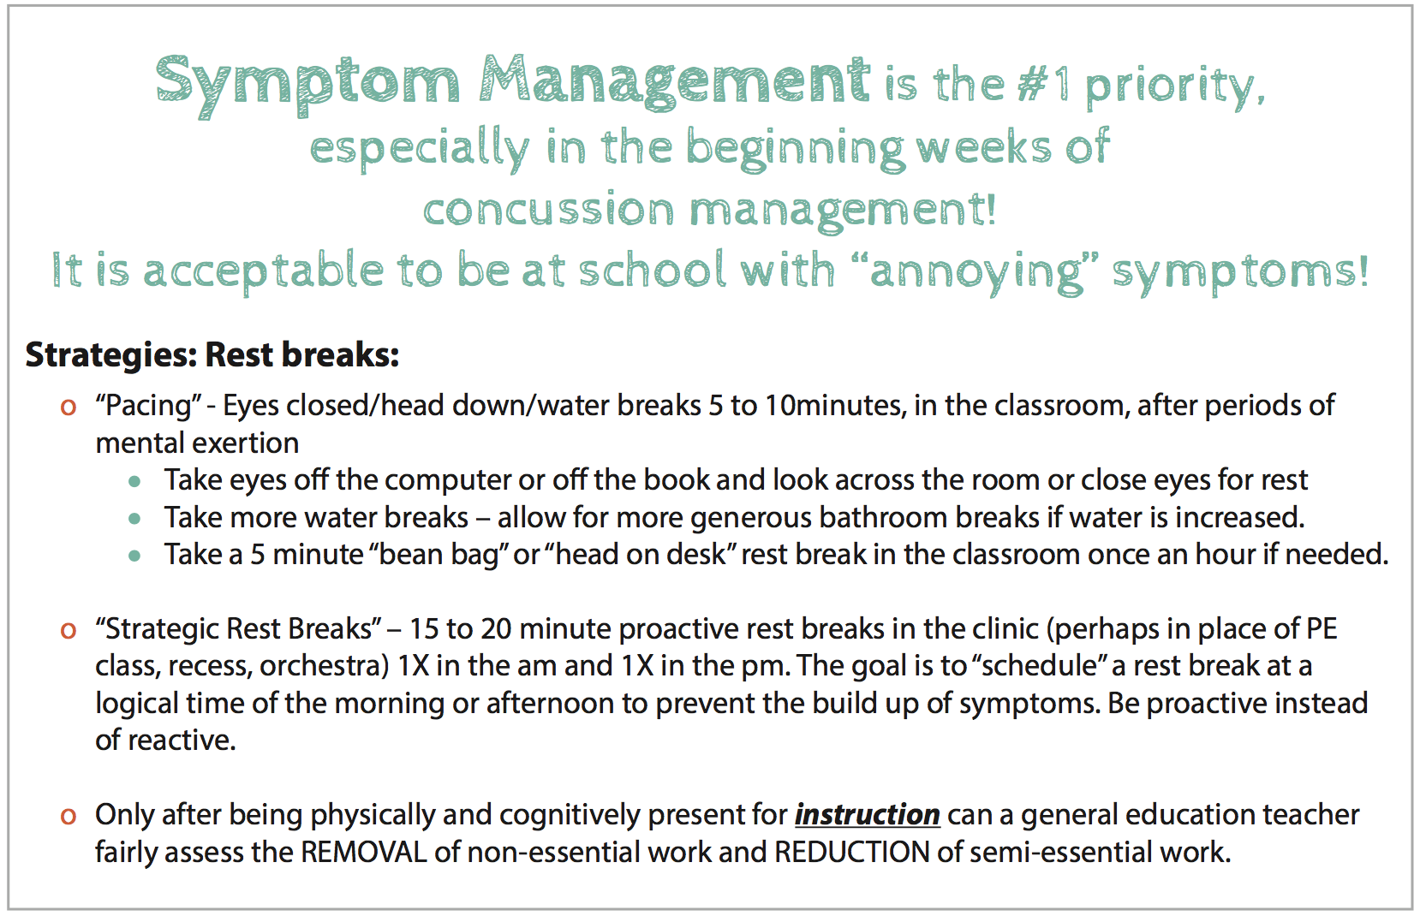
1. Mental Fatigue
Symptom Management is KEY!

Slide 45
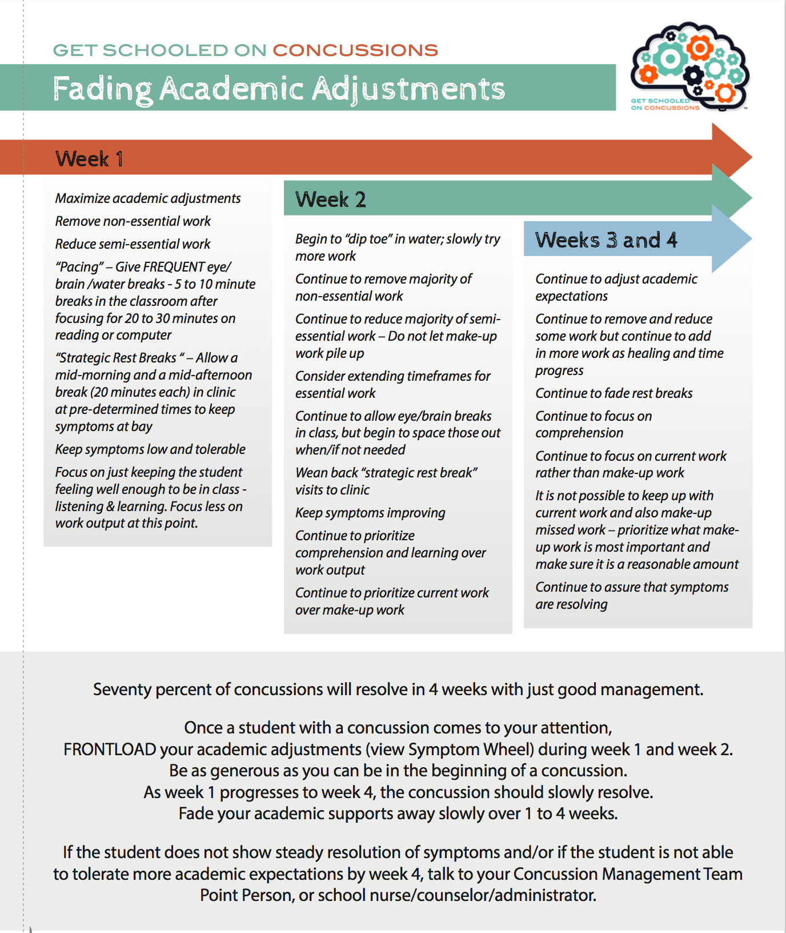
All rights reserved:
© GetSchooledOnConcussions.com

Slide 46
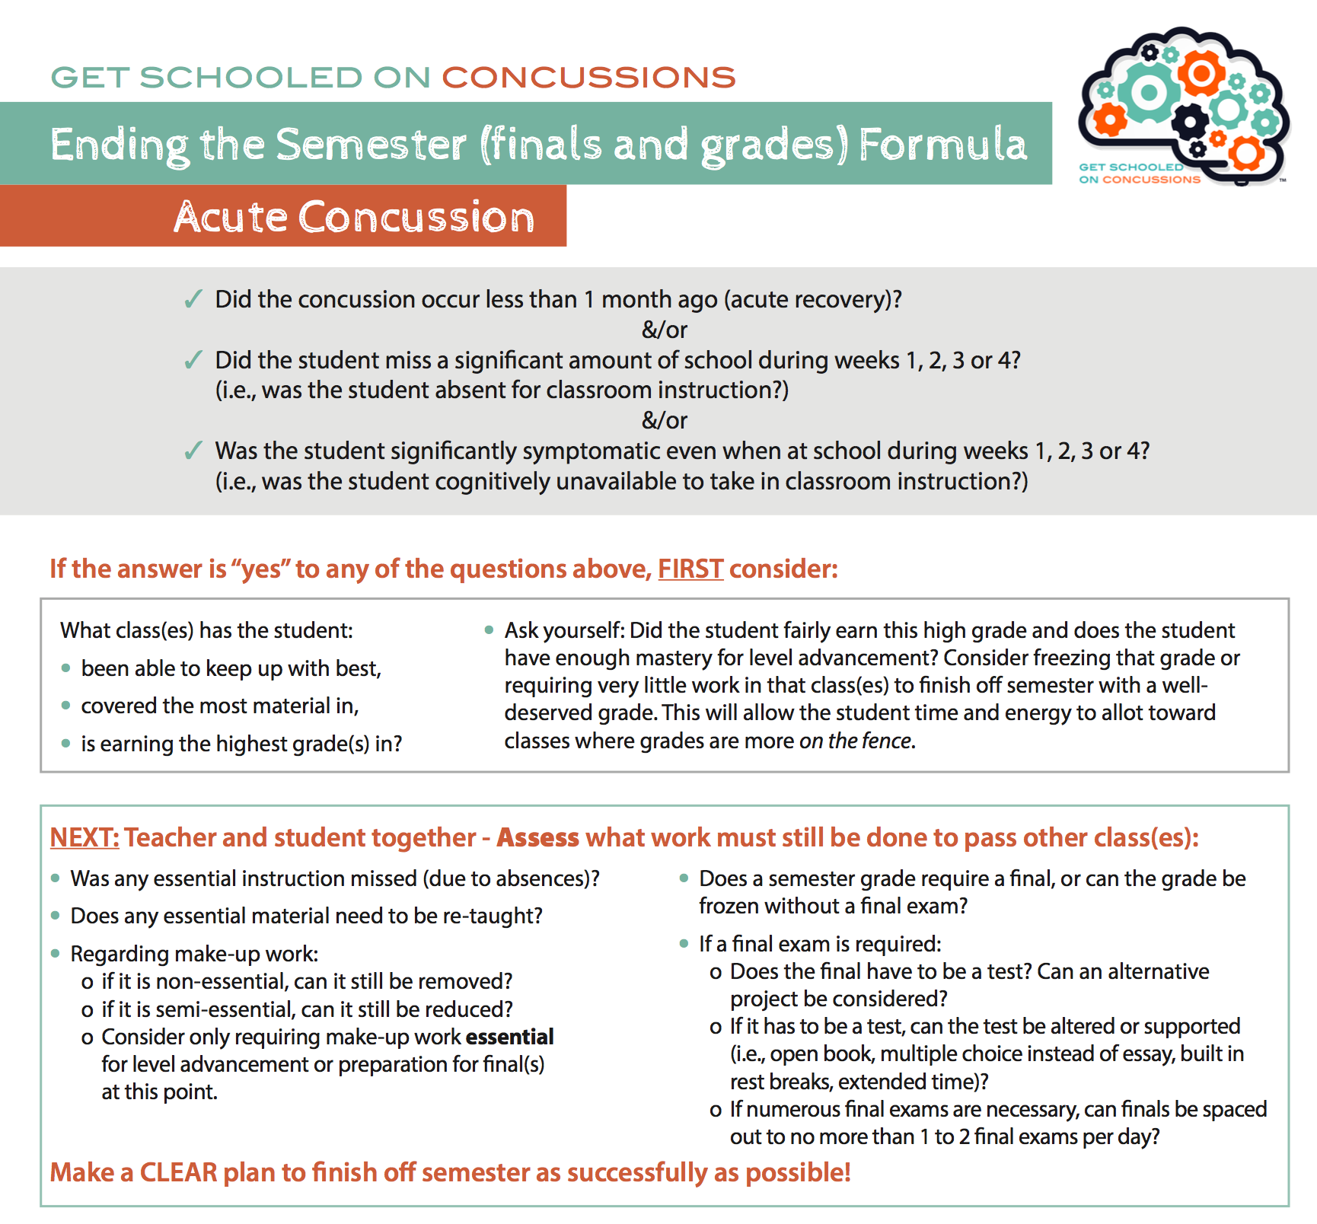
All rights reserved: ©
GetSchooledOnConcussions.com

Slide 47


It takes a village – working together, we will take better care of ALL our children, not just athletes and not just those who fall under Return to Sport protections!
All rights reserved: © GetSchooledOnConcussions.com

Slide 48
Colorado Department of Education:
Download
Concussion Guidelines
All rights reserved:
© GetSchooledOnConcussions.com

Slide 49
Colorado Department of Education
Search: TBI
Download: Brain Injury Manual
All rights reserved:
© GetSchooledOnConcussions.com

Slide 50
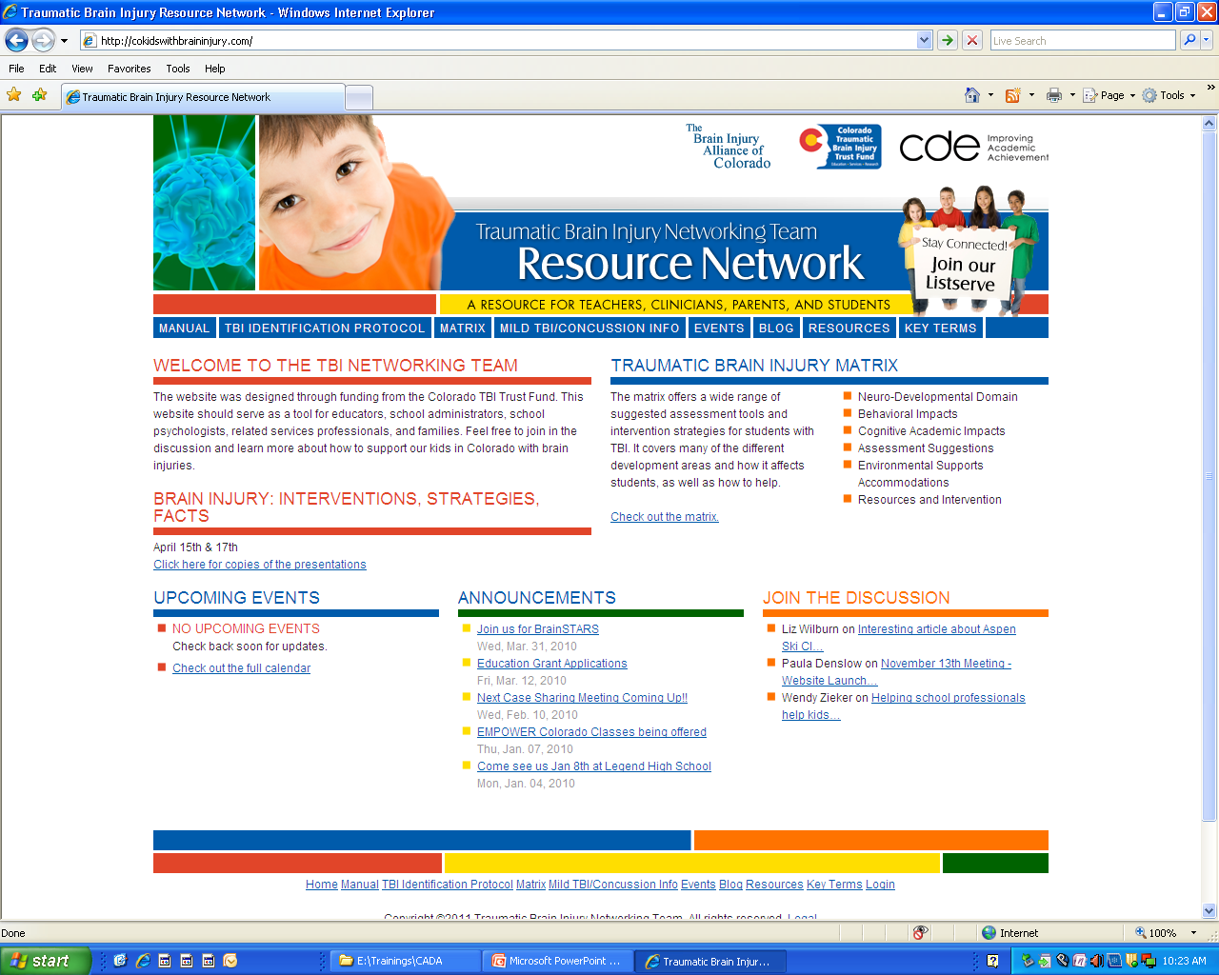
WWW.COKIDSWITHBRAININJURY.COM
All rights reserved: © GetSchooledOnConcussions.com

Slide 51




Resources
Information on Concussion Management:
Get Schooled On Concussions:
*Website FOR educators, BY educators – to empower teachers, especially general education
Teachers to differentiate instruction for students with concussion immediately, flexibly and nimbly
www.GetSchooledOnConcussions.com
REAP Concussion Management Program:
*Community-based model for Concussion Management
www.REAPconcussion.com
CDE Concussion Management Guidelines:
Multi-disciplinary Team Approach includes information on Concussion Legislation in the State of Colorado
* Guideline may be viewed for free on-line
www.cde.state.co.us/HealthAndWellness/BrainInjury.htm
Centers for Disease Control and Prevention:
Educational materials for School Nurses, Coaches, Teachers, Counselors, Parents, Students, and Athletes
* Materials can be viewed on-line or ordered for free.
www.cdc.gov/concussion/
CO Kids with Brain Injury
Website for school professionals and families which includes materials, publications and resources for kids who have sustained a mild, moderate or severe brain injury
www.cokidswithbraininjury.com
All rights reserved: © GetSchooledOnConcussions.com

Slide 52

Thank you!

Slide 53
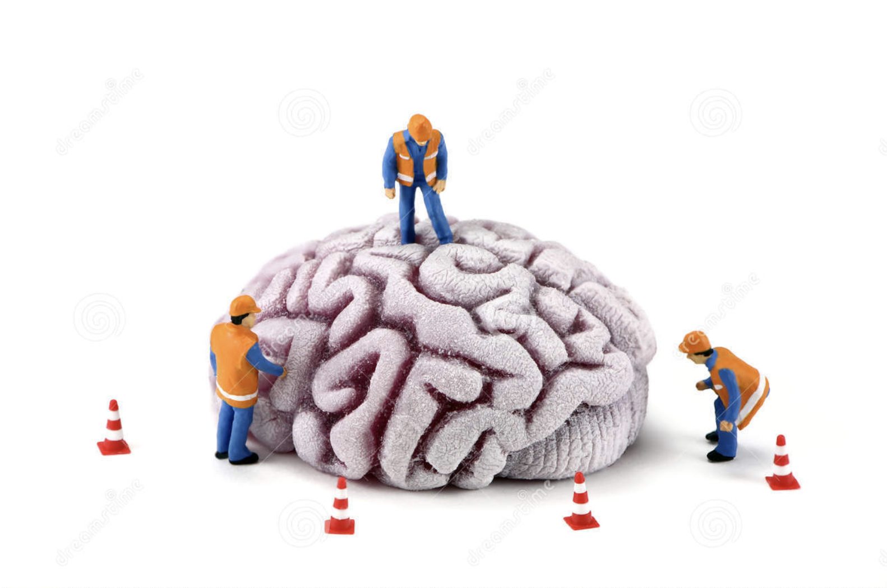
Questions?
My contact info:
Karen McAvoy, PsyD
Karen@GetschooledOnConcussions.com
www.GetSchooledOnConcussions.com
REAP
info@REAPconcussion.com
www.REAPconcussion.com
REAP is currently in:
CO, NY, FL, NJ, WA, AL, IA, NE, WV, Spanish
REAP being customized right now for:
HI, SC and NC
All rights reserved:
© GetSchooledOnConcussions.com

