Slide 1

Positive Behavior Support Overview
TBI Conference
Anastasia Riley, MBA CBIS
Notes:
Talking Points
UCEDDs were created in 1963 by the federal government with the enactment of Public Law 88-164 to serve people with intellectual disabilities.
Today, there are sixty-seven (67) Centers across the country, authorized under the Developmental Disabilities Assistance and Bill of Rights Act of 2000 (PL-106-402), to serve as resources for Americans with a wide range of disabilities.
The sixty-seven (67) Centers, at least one in every state and territory is affiliated with a major research University and serves as a resource for people of all ages.
The West Virginia Center is a unit within West Virginia University (WVU), Health Sciences, and because of the placement within the University, has access and alignment with the Schools of Pharmacy, Public Health, Nursing, Medicine and Dentistry. Reporting authority with WVU tacitly supports the opportunity for collaboration, education and training needed to support and strengthen the state’s capacity to meet the needs of persons with disabilities.
CEDs role is to provide education and training to University students in multiple disciplines; educate direct care providers who serve persons with disabilities; and provide policy makers with objective information about the status of disabilities services in West Virginia.
West Virginia's Center also provides gap filling direct services and supports in an effort to improve availability and acceptability of services.
On average, over the past five years, the national network of UCEDDs
Provided professional preparation for working in the disability field to over 2,000 students annually.
Provided technical assistance and training each year to over one million health, education, mental health, and policy-making professionals, as well as people with disabilities and their families.
Provided direct (clinical or other) services to more than 700,000 individuals with developmental disabilities and/or their families annually.
Conducted nearly 3,000 research projects each year whose results may benefit people with disabilities.
Developed and disseminated over 7,000 different publications annually to bring the most current information to professionals and the community.
Federal appropriations for Centers are not intended to support all facets of operations.
There is an expectation that federal resources will be leveraged to secure additional monies from state and local agencies, to address issues specific to each state.
West Virginia's Center for Excellence in Disabilities in partnership with the Developmental Disabilities Council (DDC) and the State Protection and Advocacy agency, West Virginia Advocates, is engaged in capacity building, advocacy and system change that promote the integration and inclusion of people with disabilities in community life.

Slide 2


With a grant from the WV Bureau for Behavioral Health and Health Facilities
Center for Excellence in Disabilities
Positive Behavior Support Project
2

Slide 3

A part of West Virginia University & WVU Health Sciences Center
Center for Excellence in Disabilities
Positive Behavior Support
Notes:
Key Talking Points: Recommendation is to start out explaining that your program is a part of CED, then lead into program information and training topic
-CED is a unit within West Virginia University (WVU), Health Sciences, and because of the placement within the University, has access and alignment within the Schools of Pharmacy, Public Health, Nursing, Medicine and Dentistry.

Slide 4
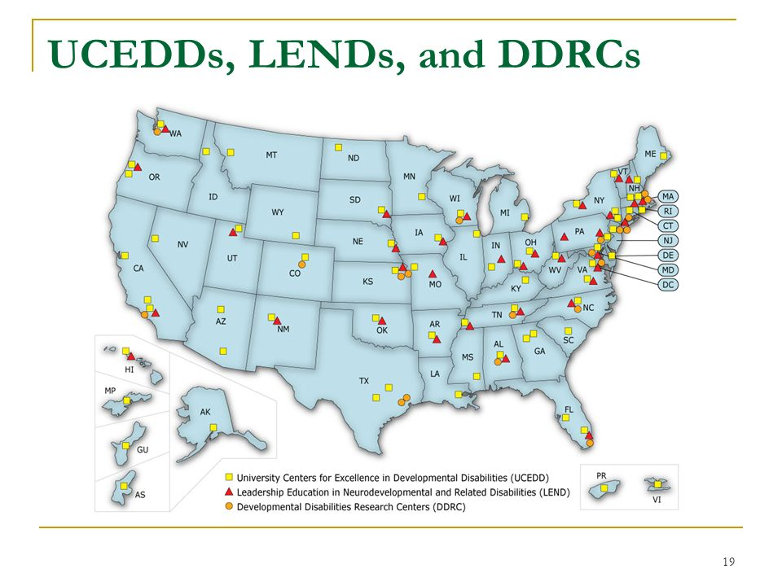

Part of a National Network
Center for Excellence in Disabilities
Positive Behavior Support
Notes:
Key Talking Points:
-The CED is a University Center for Excellence in Developmental Disabilities Education, Research and Service (UCEDD) designated and funded by the U.S. Department of Health and Human Services, Administration for Community Living, Administration on Intellectual Disabilities.
-UCEDDs were created in 1963 by the federal government with the enactment of Public Law 88-164 to serve people with intellectual disabilities.
-Today, there are sixty-seven (67) Centers across the country, authorized under the Developmental Disabilities Assistance and Bill of Rights Act of 2000 (PL-106-402), to serve as resources for Americans with a wide range of disabilities. The sixty-seven (67) Centers, at least one in every state and territory is affiliated with a major research University and serves as a resource for people of all ages.

Slide 5
WVU CED’s Role:
Education and training to University students in multiple disciplines to prepare a workforce that is able and willing to serve persons with disabilities
Technical assistance to individuals with disabilities and direct care providers who serve them to enhance their skillset and improve service quality
Gap filling direct services and supports in an effort to improve availability and acceptability of services for West Virginians
Dissemination of information about the status of disabilities services in West Virginia and the nation
Research activities conducted in collaboration with partners, to improve services and policies related to individuals with disabilities and their families.
Center for Excellence in Disabilities
Positive Behavior Support

Slide 6
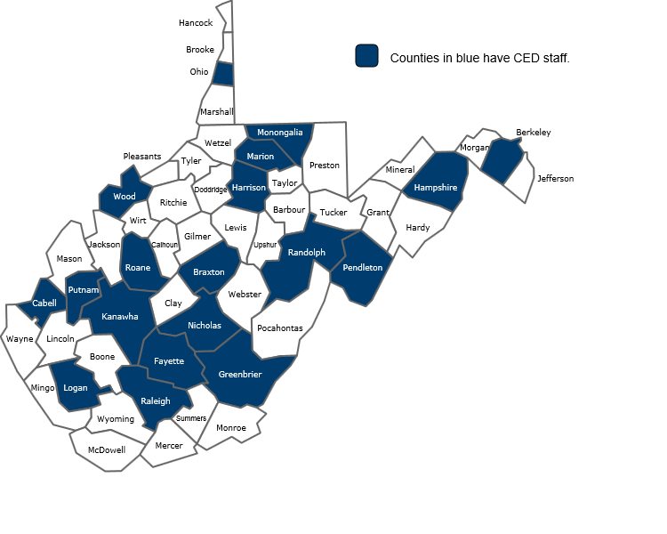
About WVU CED
Serves individuals with disabilities across the life span in all 55 counties
7 Programs
4 Clinics
Approx. 90 Staff
Multiple state and federal partners
Center for Excellence in Disabilities
Positive Behavior Support
Notes:
Taking Points:
Staff are hosted by partner agencies and located across the state
Partners include:
WV Dept of Health & Human Resources (DHHR)
WV Division of Rehabilitation Services (DRS)
WV Dept of Education (DOE)
WV Developmental Disabilities Council (DDC)
WV Advocates (WVA)
Maternal and Child Health Bureau (MCHB) /Health Resources and Services Administration (HRSA)
Administration for Community Living (ACL) / US Dept. of Health and Human Services

Slide 7
Become an Affiliate
Looking for a way to be more connected to CED? Individuals can now sign up to be an Affiliate of the CED. Affiliates will:
Receive updates on CED news and events
Have opportunities to provide input regarding programs, services and research projects
http://www.cedwvu.org/about-ced/become-an-affiliate/
Center for Excellence in Disabilities
Positive Behavior Support

Slide 8

Session Goal
Increase awareness and skills in the application of positive behavior support strategies.
Center for Excellence in Disabilities
Positive Behavior Support Project
7

Slide 9
Session Objectives
Identify the fundamental concepts of Positive Behavior Support.
Define and give three examples of “proactive strategies.”
Identify the functions of behavior.
Explain ways to improve quality of life.
8

Slide 10
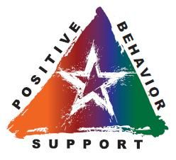
What is PBS?
Positive Behavior Support
Person-centered
Positive
Proactive
Data-driven
Center for Excellence in Disabilities
Positive Behavior Support Project
Notes:
PBS is not a one size fits all approach to dealing with people, though its strategies have been demonstrated to be effective with a large number of individuals across a wide variety of populations. In order to facilitate the best behavioral outcomes, Positive Behavior Support is:
Person-centered – Several in-depth assessments are conducted with the client to assess various areas of their life. To accomplish this, a team is assembled which consists of those who know the person best in a variety of settings, and who can attest to that individuals strengths and gifts.
Positive – Focused on increasing positive, adaptive behaviors that will benefit the client in all areas of life. When positive behaviors are frequently rewarded and encouraged, it naturally gives less opportunity for problem behaviors to occur.
Proactive – PBS is focused primarily on preventing problem behaviors from occurring by identifying triggering events and conditions. It is much easier to deal with a problem behavior in a preventative manner than de-escalating it once it has occurred.
Data-driven – In order to determine potential causes of problem behavior, and to ensure that interventions are effective at reducing it, PBS utilizes ongoing data collection to provide an objective view of the client within various situations.

Slide 11
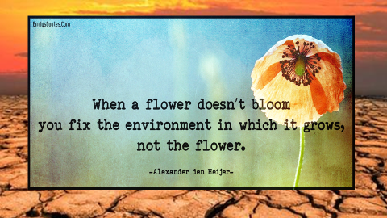

Slide 12
Positive Behavior Support is…
  Proactively changing the environment to prevent problem behavior and set the person up for success
  Finding the purpose or function of a problematic behavior
  Finding replacement behaviors to serve that same function
    Reinforcing replacement behaviors
    Teaching in a strength-based way
  Improving quality of life
    Supporting the individual and helping them reach their full potential
Center for Excellence in Disabilities
Positive Behavior Support Project
Notes:
Clarify in presentation that PBS is NOT based upon:
- Punishment
Instead, PBS involves teaching new, appropriate skills to compete with undesired behavior, and rewarding the person’s use of those new skills.
[See Side effects of Punishment Hand-Out]
- Focus on the bad behavior
Instead, we look at everything about the person including their dreams. We look at the setting in which they are having trouble.
- A Magic Wand/”Fixing” the person
PBS recognizes that we can’t simply drop into a situation, do something solely to the person by themselves, and expect lasting and meaningful change. We do get progress over time when everyone is involved and works together to make changes in the various things (places, people, personal interactions, events, opportunities, etc.) that make up the person’s environment.

Slide 13
ABCs of Behavior
A – Antecedent (Triggers)
What event causes the behavior to occur?
B – Behavior (Target)
What action we want to focus on and target?
C – Consequence (Function)
What does the person get or get away from as a result?
Center for Excellence in Disabilities
Positive Behavior Support Project
Notes:
Antecedents are what happens before the behavior starts. They are called triggers.
For example, a trigger for a tantrum may be another client getting attention.
The behavior is the target—it is what you want to change.
The consequence is the action that is maintaining the behavior. What function does this behavior serve? Does it get the person attention if he yells out in class? Does it get the person a candy bar if she cries in the grocery store?
You will be collecting ABC data to determine the frequency, triggers, and functions of the behavior you target to decrease or eliminate.

Slide 14
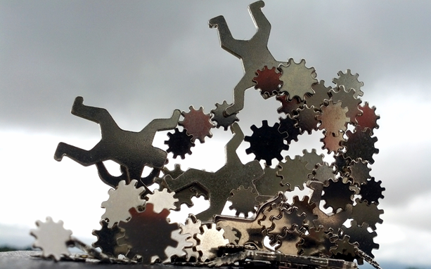
Our A-B-Cs are all connected…
Notes:
As living creatures interacting in the world, we serve as signals, encouragers, discouragers, or provokers to one another. The unique impact we have on each other is to the types of Behaviors and Consequences we have provided in that interaction, whether momentary or life-long.
When we are attempting to encourage behavior change, we have to ensure that the incentives for such change is meaningful to the focus individual. We therefore need to collect and utilize as much information as possible about what an individual can do, likes to do, and will be motivated to do.

Slide 15


Antecedents
Events that occur before a behavior
  Slow Triggers - Things that create the beginnings of a “bad day”
    Feeling sick
    Being hungry
    Feeling tired
  Fast Triggers –The straw that breaks the camel’s back; the immediate things that set off the behavior
    Loud noise
    Difficult task
    Not being able to do a task
Center for Excellence in Disabilities
Positive Behavior Support Project
Notes:
We call events that occur immediately prior to a problem behavior fast triggers.
It is important to know the triggers of the person you work with to help them avoid or adapt to those situations. It is also important to know your own triggers so you can do the same. We all have triggers and need something to help us cool down at times. Knowing what these triggers are will help us better prepare for the cool down.

Slide 16
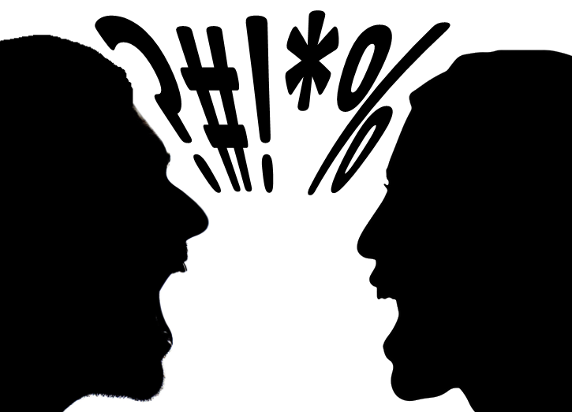
Power Struggles
A situation where a person who believes he or she is in control feels threatened by the perceived confrontational action of another person and responds negatively in an effort to regain control.
Center for Excellence in Disabilities
Positive Behavior Support Project

Slide 17

You Know It’s a Power Struggle When You Feel…
Provoked
You want to control another person
Challenged
Like saying,
  “I’ll make you do it”
  “You can’t get away with that”
Center for Excellence in Disabilities
Positive Behavior Support Project
Notes:
People usually do not realize they are in a power struggle until it has already happened.
A show of hands--how many of you have been in a power struggle? We have all been in one.
Examples: Getting your child to put shoes on, taking your dog out to use the restroom, etc.
When we can recognize it – it is easier to be the bigger person and side step the power struggle.

Slide 18
How to Avoid a Power Struggle
Appear calm
Speak quietly and slowly
Sit down—don’t tower over the other person!
  Non-threatening body language
Eye contact without staring
Be aware of triggers--theirs and yours
Offer choices, don’t give orders
Center for Excellence in Disabilities
Positive Behavior Support Project
Notes:
Demonstrate how to not tower over someone and approach them on the same level.
Know what usually makes you angry so you can prepare your relaxation technique.
For example you know to go take a breather if someone calls you a ugly.
Everyone wants some control, especially over their own life.
Giving choices allows someone to have control over the situation and allows for more freedom.
People are often more receptive to doing something when given a choice.
No one likes to be ordered around.

Slide 19
How to Avoid a Power Struggle
Listen to gain trust
  Try to put yourself in their shoes for the situation
Find something to agree about
  Praise the good
Use humor appropriately
Make the person part of the solution
Center for Excellence in Disabilities
Positive Behavior Support Project
Notes:
Listen to see the “why.” For example, maybe you are working with someone who does not want to go to the bathroom anymore. Try to find the reason why. Were they abused by someone in the bathroom? By listening you will find out why they are now having issues and you can report this to stop further abuse and get your client help.
You may disagree on something that is human nature but to establish good feelings again and get the person to compromise with you, you must first find something to agree about.
People usually do not stay mad when they are laughing, humor can help de-escalate a situation quickly.
Ask the person what they would want to do instead. For example say your client refuses to take a shower for 4 days in a row and they are starting to have an odor; you want them to shower but they do not want to. You could ask what they would be willing to do instead to get clean maybe they would be willing to use a wet soapy washcloth to clean up. If the person is non-verbal you could still offer alternatives to the shower through pictures, such as the washcloth or bath, and have them point. Explore why the person does not want to take a shower!
When someone chooses what they are going to do for themselves it empowers them and will make them more willing to work with you on issues in the future.

Slide 20
Creating Proactive Strategies Based on the Antecedent
Proactive Strategy = A way to avoid or adjust to an antecedent to prevent the problem before it starts
  Avoiding = If we can eliminate the trigger in real life why not
  Adjusting = Calming techniques; ways to cope with the situation
  Many of us figure out ways to avoid or adjust on our own but kids often need help in coming up with these ideas.

Slide 21

Examples: Proactive Strategies
Sunglasses or head phones
Using a different tone of voice
Always having snacks and water on you at all times
A reminder notebook or recording device
Checking out a situation in advance
A quiet relaxing space to go to calm down
Teaching relaxation methods
Sensory integration techniques
Center for Excellence in Disabilities
Positive Behavior Support Project
Notes:
Any other ideas?

Slide 22
Check mark √ the items that you find relaxing.
Cross out any items you find stressful.
Use the back to create a personalized calming strategies action plan.
Activity:
What is Calming to you?

Slide 23
Precursor Behaviors
Behaviors that signal a problem before it begins
Think about some thing you may do:
  Pace
  Certain expressions
  Withdraw
Identify someone’s specific precursor behaviors to stop a target behavior before it happens
Redirection can be very effective when precursor behaviors are present
Center for Excellence in Disabilities
Positive Behavior Support Project
Notes:
What are some of your precursor behaviors? Does anyone grit their teeth or make a fist? This is a good thing to know what someone’s precursor behavior is so you can help them calm down before the problem behavior starts.

Slide 24
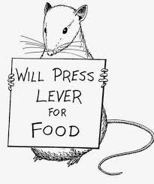
Behavior
Behavior is anything and everything someone does.
  All behavior serves a purpose.
Target behaviors - are behaviors we want to decrease and replace with more appropriate behaviors
Replacement behaviors - are behaviors that we teach the client to engage in, rather than the problem behavior in order to meet the same function
Center for Excellence in Disabilities
Positive Behavior Support Project
Notes:
There is always a reason why we do what we do.

Slide 25
Defining the Behavior
Operational Definitions:
  Observable
  Measureable
  Pass the Dead Man’s Test (A dead man can’t do it)
Define:
  Target Behavior
    Ex: Physical Aggression: Hitting, kicking, spitting at another person
  Replacement Behavior
    Ex: Hit Pillow: Take a pillow and punch it
So everybody sees it the same way
Center for Excellence in Disabilities
Positive Behavior Support Project
Notes:
Observable and measurable-this does not include things like ‘angry, depressed, annoyed, etc.” What does angry look like? These types of descriptions must be made observable and measureable.
Make the definition be clearly understandable across environments and providers.
Everyone should agree on the specific target problem behavior as well as the replacement behavior you want to teach them. This is essential for good data collection.
If you have questions, ask the BSP.

Slide 26
Behavior
What is the behavior telling us?
All problem behaviors are communicating something.
  Does the person want attention?
  Does the person want a break?
  Does the person want an item/activity?
  Does the person want sensory stimulation?
Center for Excellence in Disabilities
Positive Behavior Support Project
Notes:
If a person lacks communication or social skills, they might engage in behaviors like physical aggression that we might consider maladaptive.
For that person who might not be able to verbalize and/or wait for what they want or need, aggressive behavior might be a very quick and effective way to obtain those things. So, if you can identify what a person is trying to get when they display their behavior, you can try and teach them more adaptive, replacement behaviors.

Slide 27
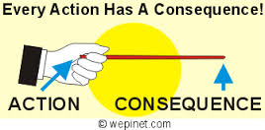
Consequences
What happens immediately after the target behavior.
What does a client get or get away from by performing a behavior?
There is a consequence Naturally good or bad to EVERY behavior in life.
Center for Excellence in Disabilities
Positive Behavior Support Project
Notes:
Emphasize that consequences:
Are what the person gets or gets away from following the target behavior
Don’t inherently refer to something bad, disciplinary, or punishing
Did they get attention?
Did they get out of something?
What did they get or get away from?
What was the payoff for the behavior?

Slide 28
Functions of Behavior
4 Main Categories:
Sensory
Escape
Attention
Tangible
Remember… SEAT
Center for Excellence in Disabilities
Positive Behavior Support Project
Notes:
The functions are the reason why the behavior occurred, which can be determined by looking at what has happened immediately after the behaviors occurred.
The same behavior (e.g., hitting someone) can serve different functions at different times, for different individuals, and someone might be displaying the same behavior to serve more than one function.

Slide 29
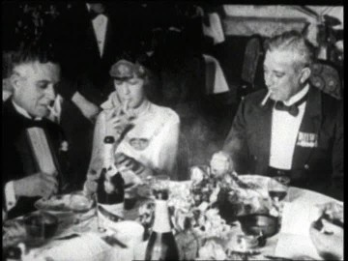
SEAT at the Table
What potential functions are served by the behavior of smoking?
Sensory input from nicotine
Escape/delay from other activities (i.e., smoke breaks)
Attention from/socialization with others
Tangible access to a physical object
If you have ever tried to quit, were all these functions successfully met by doing something else?

Slide 30
Functions of Behavior
What is the purpose or function of the behavior?
Can another more socially appropriate behavior serve the same function(s)?
    We need to make the replacement behavior easy and accessible
    We need to teach the person to use the replacement behavior
Center for Excellence in Disabilities
Positive Behavior Support Project
Notes:
All behavior happens for a reason.
What need is the behavior communicating?
Sometimes we don’t see the reinforcer. For example:
Talking to a student who is misbehaving in class.
Allowing a resident to avoid a chore when he/she curses.
What happens when a student breaks a school code of conduct? He or she may get suspended. If that student finds school aversive, do you see how the suspension rewards the unwanted behavior?

Slide 31

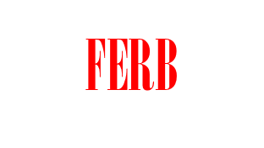
Desired Behavior
Challenging Behavior
“Aggression”
“Disruption”
“Elopement”
“Following rules”
“Being nice”
“Working/playing
/living independently”
What the person does
(behavior) +
How the environment responds
(functionally equivalent
reinforcement)

Slide 32
Replacement Behaviors Need to…
Serve the same function as the problem behavior
Be taught when calm
Be easier than the problem behavior
Be reinforced more than the problem behavior
Fit the relevant context of the person’s life
  It is also key to make old target behaviors irrelevant (not reinforced anymore)
Center for Excellence in Disabilities
Positive Behavior Support Project

Slide 33
Replacement Behavior Examples
Original Behavior | Replacement Behavior | Function Being Met
Self injury | Scribbling heavily, rage drawing | Sensory stimulation
Screaming & yelling in public | Joining a theatre group or talking to new people | Social attention
Hitting someone | Walking away | Escape from an undesired task
Stealing an item | Asking for the item on credit or saving up for it. | Obtain a preferred item
Notes:
These are just examples.

Slide 34
How to Learn New Skills
Demonstrate and then let the person try
    Practice
Break tasks down to one step at a time
Role Play
Scripting
Social Stories
Reminders like Visual Cues
Center for Excellence in Disabilities
Positive Behavior Support Project

Slide 35

Reinforcers
Are consequences that make the behavior more likely to occur
Are more than just a reward
  They are also a motivator
Need to be constantly re-evaluated to make sure they are effective
  Can change daily or based on satiation factors
Meet the function and beyond
Utilize current preferences / lifestyle
Center for Excellence in Disabilities
Positive Behavior Support Project
Notes:
Reinforcers are different for everybody, and can also change (sometimes, considerably) for the same person across time.
It is important to continually reinforce behavior when a person first demonstrates appropriate life skills.

Slide 36
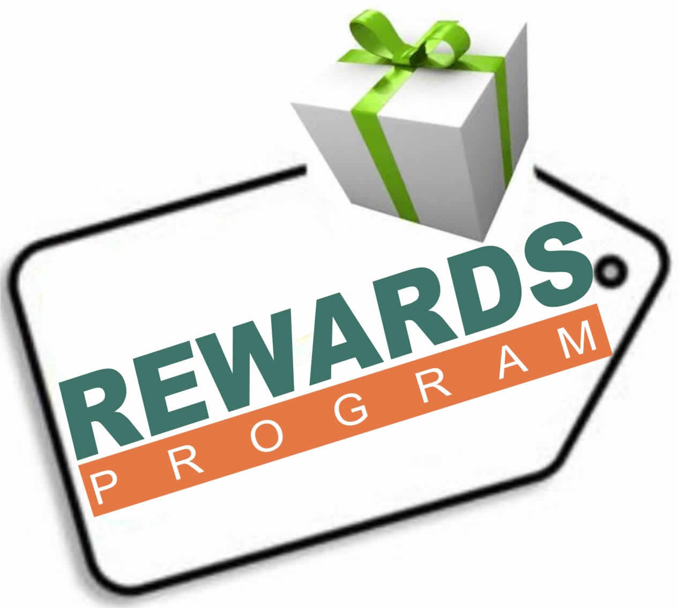
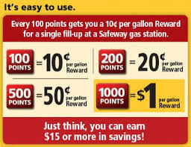
Token Economies
Give tokens as written transparently
Never take away earned tokens
  Will create anger and loss of momentum
Offer a token mall or shop
Show progress toward goal to achieve greater success
  Is also an ongoing positive reinforcer
Center for Excellence in Disabilities
Positive Behavior Support Project
Notes:
Often, the main reinforcer someone is willing to work for is not immediately available.
We can provide the person with a symbol or token that can count towards receiving the reinforcer later.
The act of providing the person with tokens for appropriate behavior increases the number of positive interactions the person experiences in their day.
You are on token economies, too. Do you have a grocery store gas card? Or a gas station coffee card? You earn points for 20 cents off gas or a free coffee.
This probably increases your behavior of using those businesses.

Slide 37
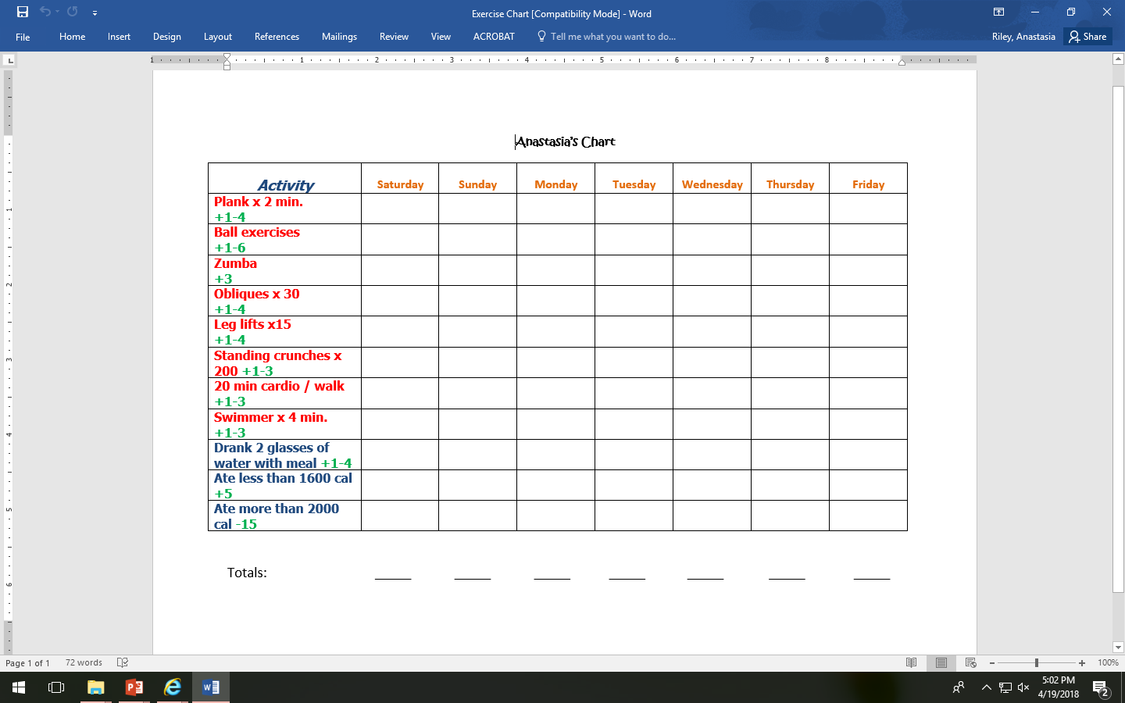
Self Token Economy Chart

Slide 38
Building community involvement and inclusion
Use the person’s preferences and help them feel comfortable in a new situation.
  Most people like to try new things w a friend for support
Creating opportunities – Look in the paper, on-line for a list of activities in the area – ask the person what interests them.
Job and volunteer opportunities
Generalized social support systems
  Bowling league
  Adult classes
  Paint and Wine/Deserts

Slide 39
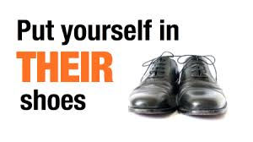
RESPECT-ing Rights
People with a disability have the same rights as people without a disability.
  They have the same rights as any other American citizen.
  Having a guardian does not mean they can take away certain rights.
Remember to put yourself in your client’s shoes to see if you would want someone telling you what to do.
Center for Excellence in Disabilities
Positive Behavior Support Project
Notes:
Do you make any bad decisions for yourself such as smoking, taking another helping of desert, or sleeping –in? You have the right to make those bad decisions for yourself as an American citizen and so do they!
Unfortunately, you could be in a car wreck tomorrow, suffer a traumatic behavior injury tonight, you could easily be in their shoes.

Slide 40
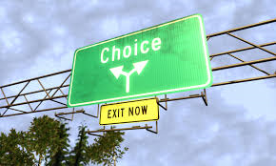
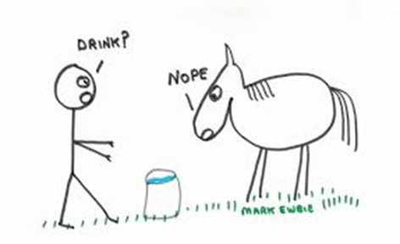
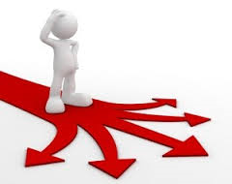
Increasing Choice
Respect choice – We need to give a person as much control over their own lives as possible.
Increase opportunities for choice – Always ask the person what they want
Help with decision-making - Help the person weigh out the pros and cons of their options
Center for Excellence in Disabilities
Positive Behavior Support Project
Notes:
People have different opinions and interests and we need to give the person as much choice and control over their own life as much as possible!
You can not force anyone to change! You can only give them the resources to make that decision for themselves.

Slide 41
SODAS
Situation
Option 1
Pros ☺ | Cons ☹
Option 2
Pros ☺ | Cons ☹
Option 3
Pros ☺ | Cons ☹
☺ Solution ☺

Slide 42

Improving Quality of Life
How can we help this person reach their full potential?
How can we give them more choices and control over their life?
How can we help them improve their relationships with other? Learn how to develop these relationships
How do we help the person achieve more independence?
Center for Excellence in Disabilities
Positive Behavior Support Project

Slide 43
Mindfulness – Paying attention non-judgementally in the present moment.
Benefits:
  Improves Lifestyle
  Reduces Stress
  Emotional Resiliency
  Slows Aging
Techniques:
  Progressive Relaxation
  Having a mantra
  Savoring
Mindfulness Exercise
http://appstudywvu.wixsite.com/mindfulstepswv/relaxationiphone

Slide 44
Savoring
Focus on sensory impressions in a moment-to-moment fashion
  Take 10 minute walk; activities; convos; friends
Savor food – eat slowly and appreciatively
  Mediterranean Diet alleviates depression
    Rich in Veg, fish, complex carbs, legumes, nuts; low in red meat
    “Rainbow Diet” – eating naturally colorful foods
    Eat more Omega 3 (salmon, flaxseed, legumes)
    Good diet = less prison fights
(Johnson, 2012)

Slide 45
Gratitude Diary
Each day – write 3-5 things you likes
  What happened to me? Why did it happen?
  What did I do right? Why did I do that?
Write one thing you didn’t like
  Ask yourself: And how is it also good, a blessing in disguise?
  Find 2-3 ways it helps you

Slide 46
Aspects to Consider
Health
Choice / Control
Independence
Happiness / Optimism
Social Supports
Living Situation
Spiritual Beliefs
Resilience in Adversity
Confidence
Resources
46
Notes:
Do Aspects to Consider Activity

Slide 47

Dreaming
47
Notes:
It makes us all feel good to dream, to daydream, to envision our future.

Slide 48
Person Centered Planning
Person-centered planning is a process that uses creative facilitation tools to assist a focus person in developing a plan on how they wish to live or be in the future.
Person Centered Planning is at the heart of Positive Behavior Support.
Center for Excellence in Disabilities Positive Behavior Support Project

Slide 49
Assessment Tools to Facilitate Person-Centered Planning
Circles of Support
MAPs (Making Action Plans)
PATHs (Planning Alternative Tomorrows With Hope)
The CED PBS Project has a free 2 day trainings available on Person Centered Planning. http://pbs.cedwvu.org/training.php
Center for Excellence in Disabilities Positive Behavior Support Project

Slide 50
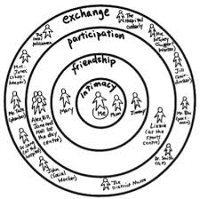
Circle of Support
Center for Excellence in Disabilities Positive Behavior Support Project
Inclusion Press

Slide 51
Eight Questions of MAPs:
“What is a MAP”?
“What is person’s history or story?”
“What are your dreams?”
“What are your nightmares?”
“Who is the person?”
“What are the person’s strengths, gifts, and talents?
“What does the person need?”
“What is the plan of action?”
Center for Excellence in Disabilities Positive Behavior Support Project
1997, Forest, O’Brien, Pearpoint, Snow, Inclusion Press

Slide 52
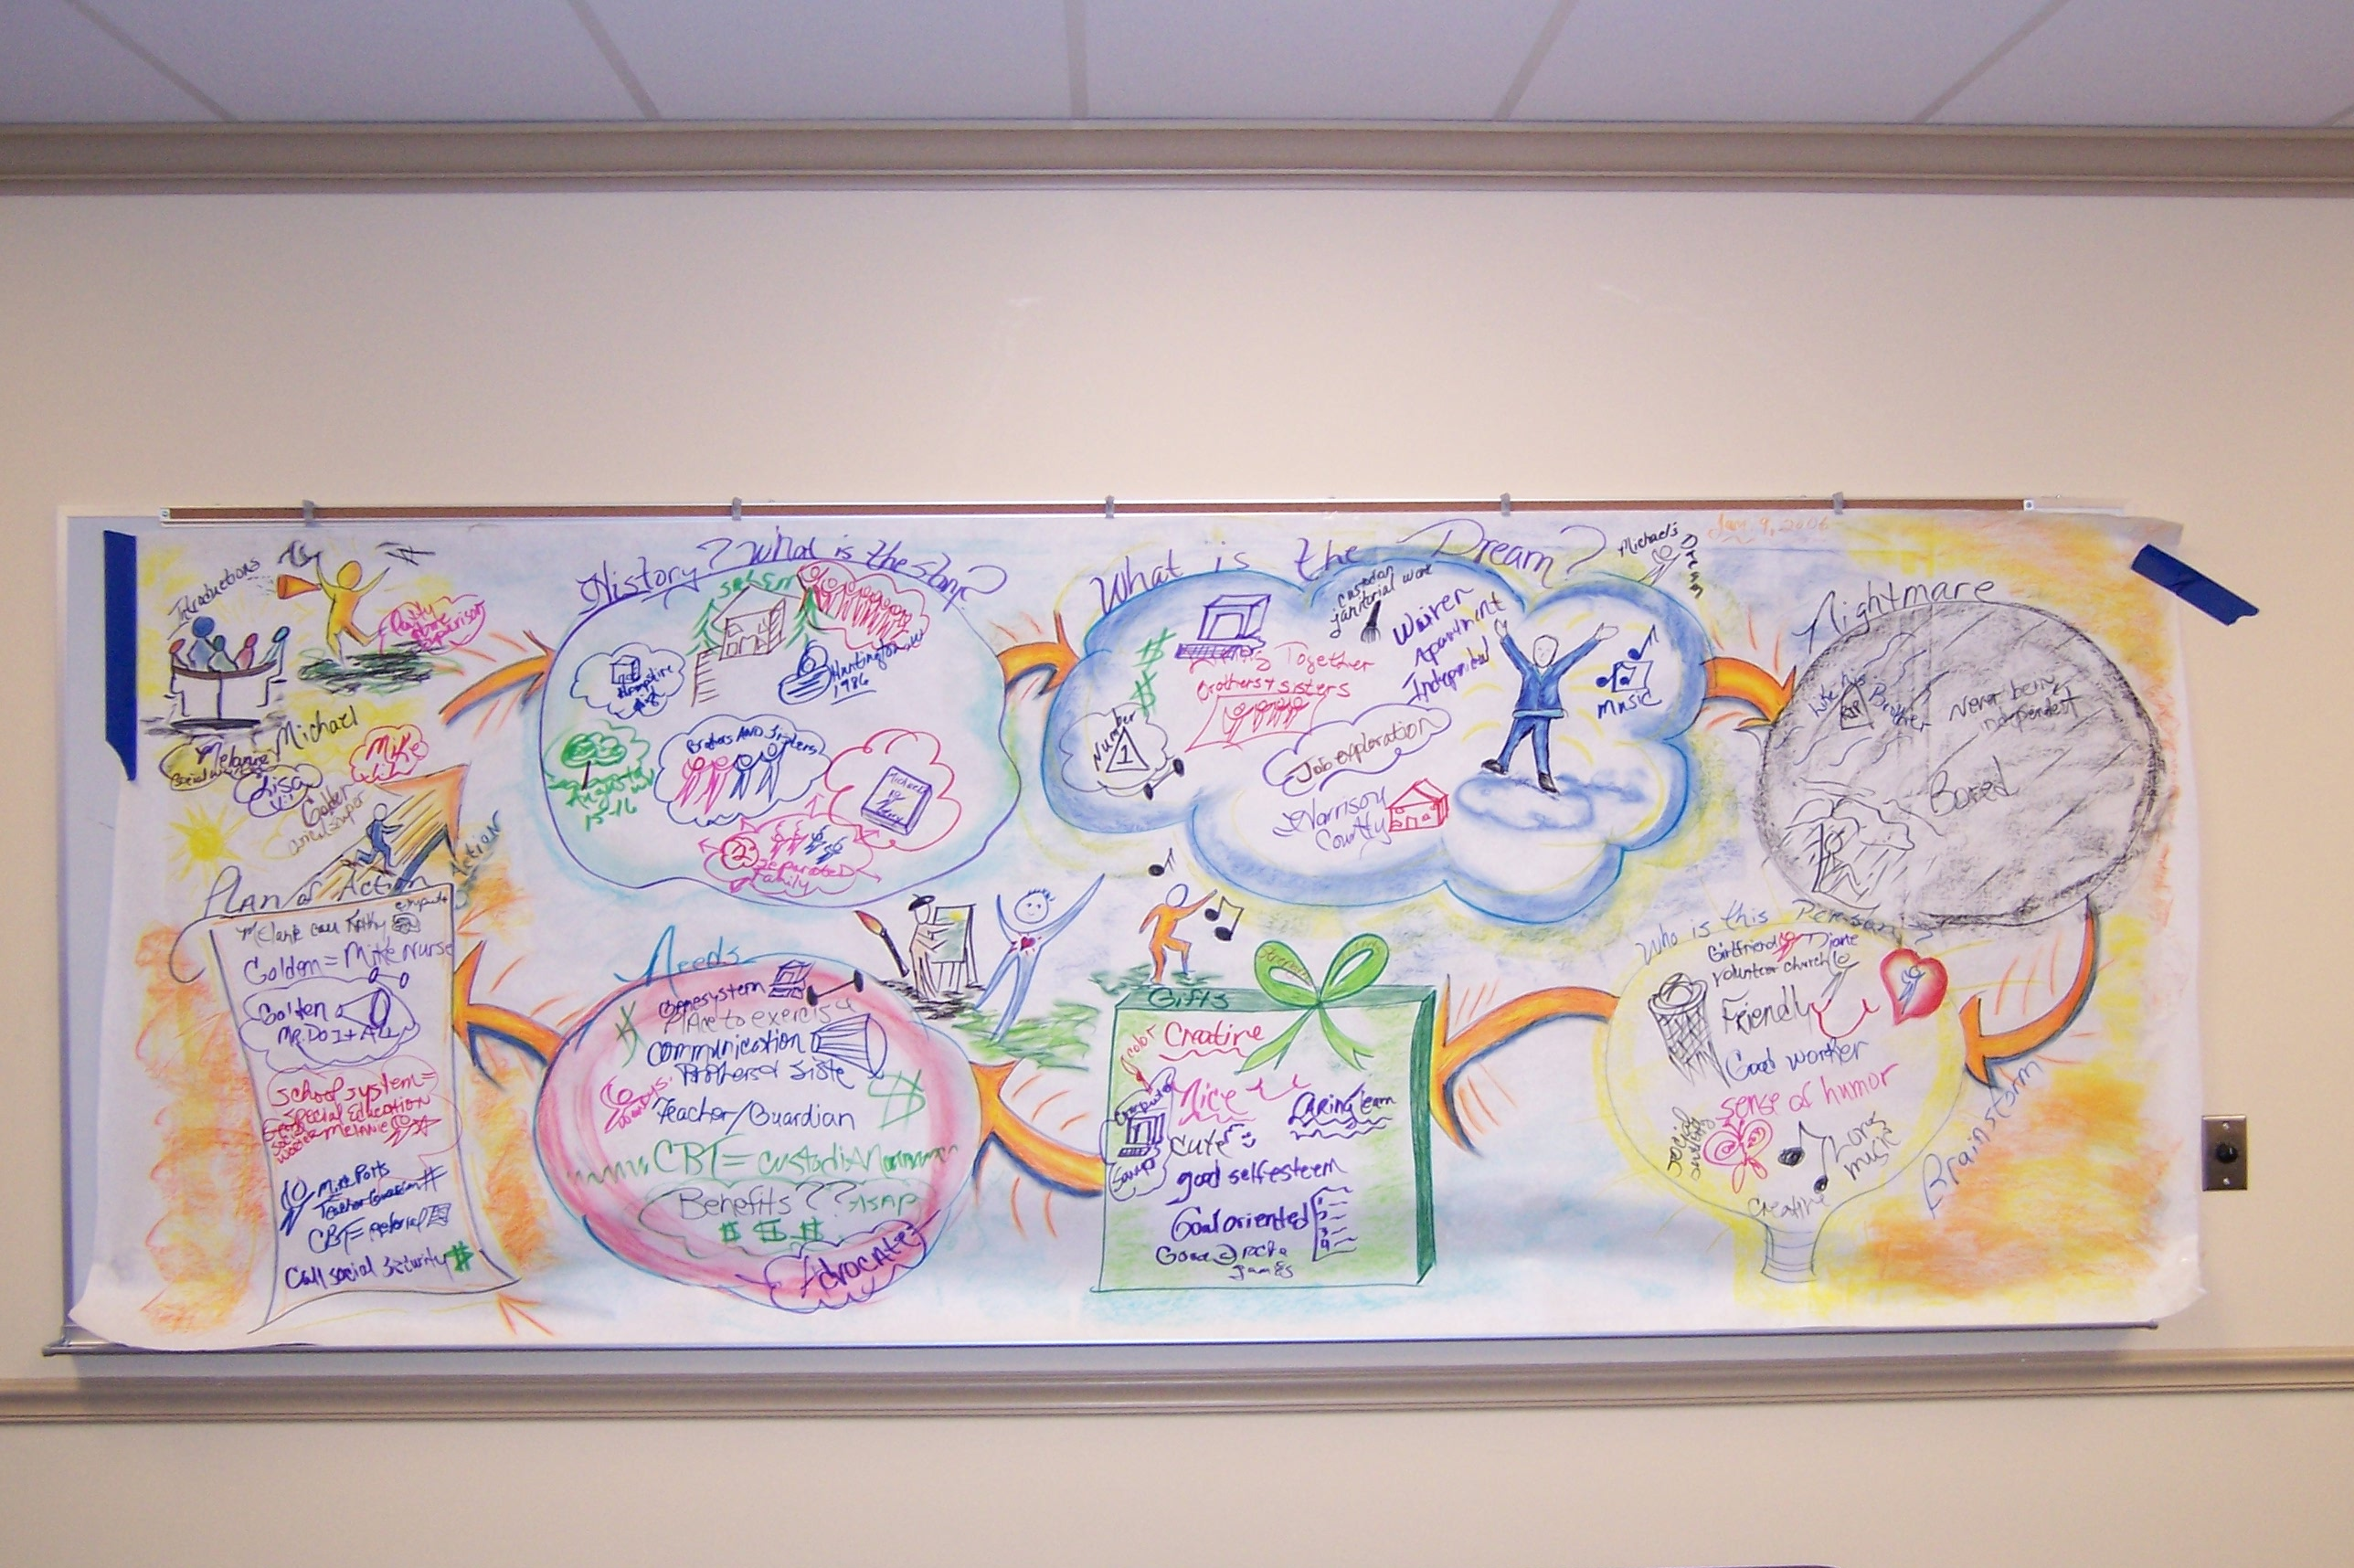
Example of a MAP- by Kathy Torsney

Slide 53

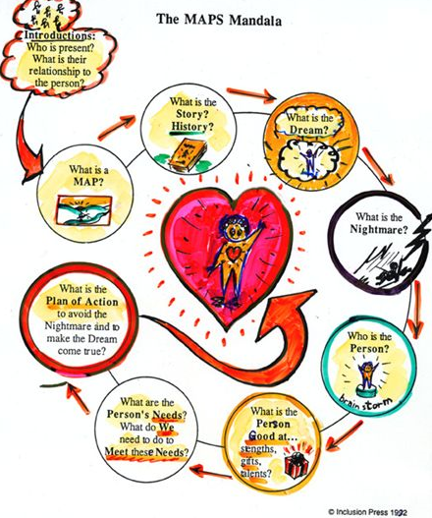
Activity:
Mini Map
Center for Excellence in Disabilities Positive Behavior Support Project
Notes:
Have the class state a few of their examples.

Slide 54


What is a PATH?
The PATH evolved from the MAPs process. It offers an extension of the MAPs steps by adding a more detailed plan of action.
The PATH breaks down the steps into separate action plans for 3 month; 6 months, and 1 year. It works by imagining the future focusing on the dream goals and thinking back in time on how you got there.
Center for Excellence in Disabilities Positive Behavior Support Project

Slide 55
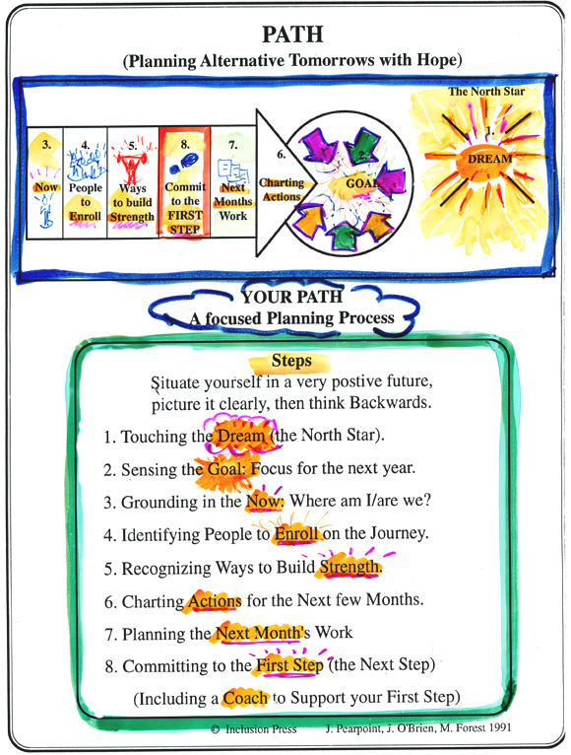

Slide 56
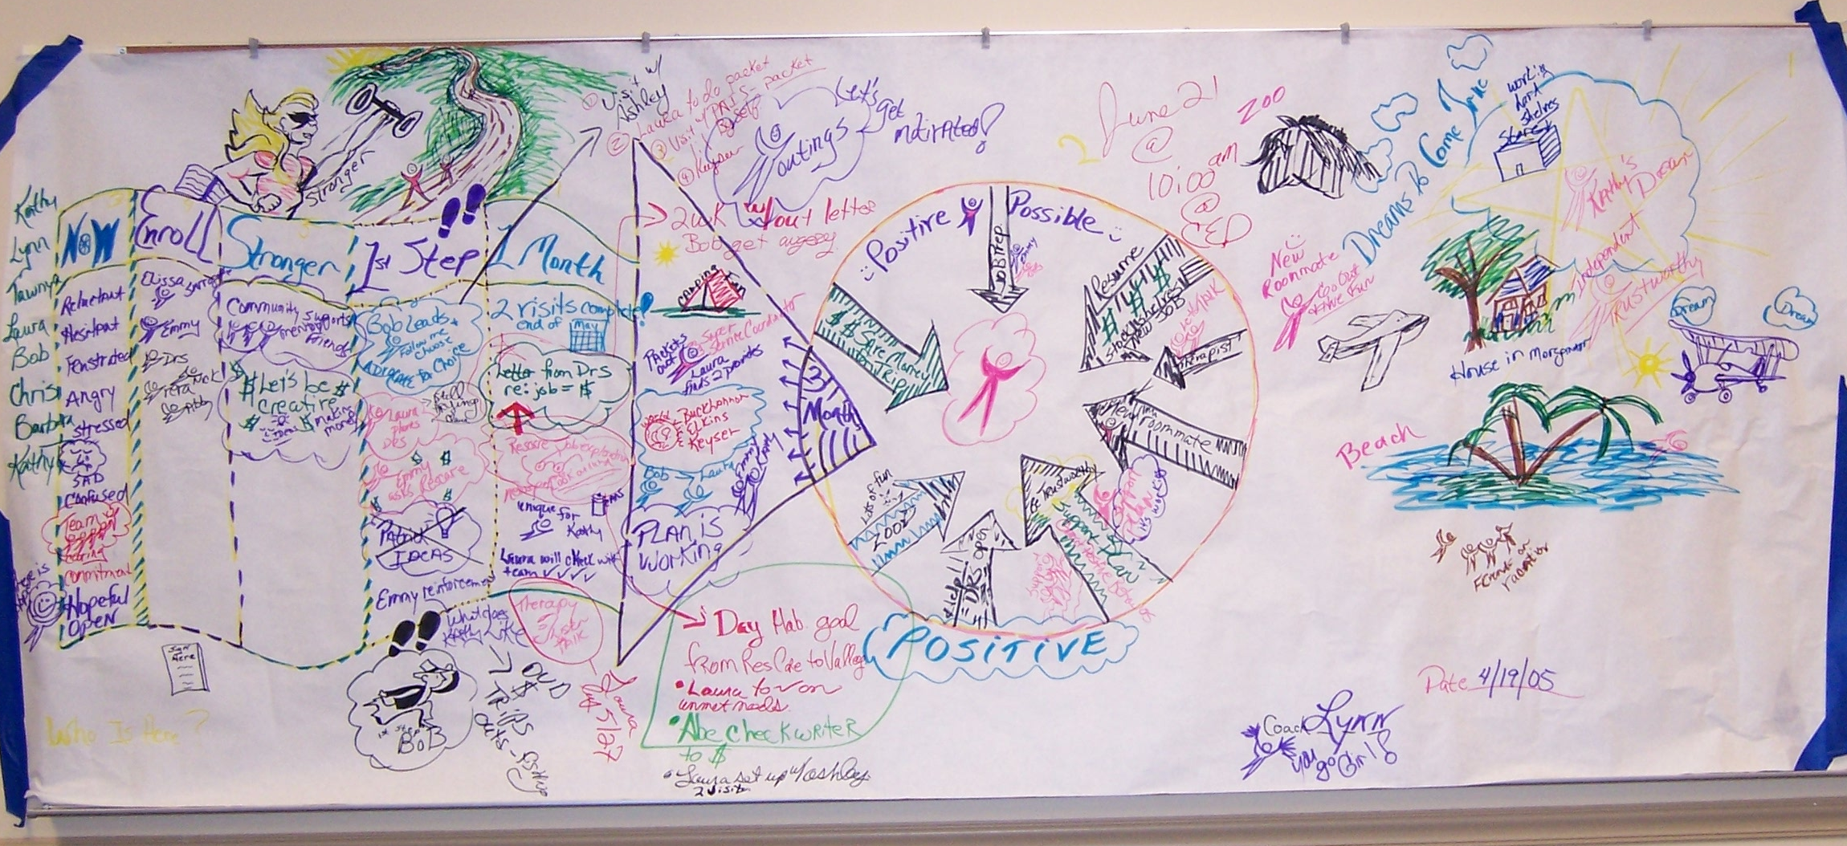
Example of a PATH
Center for Excellence in Disabilities Positive Behavior Support Project

Slide 57
Hopes and Dreams
What are the person’s dreams?
How can we help them reach their dreams or at least the aspects of the dream that are most important to them?
  Become a doctor = Work as patient aide at a hospital
  Be Batman = Helping others - Volunteering
  Mermaid = Go scuba diving
How can we give our clients opportunities to explore their interests?
Center for Excellence in Disabilities Positive Behavior Support Project
Notes:
Everyone has dreams, and it is especially important to recognize and encourage dreams and goals with people who may have been told by others about all the things they cannot do.
Have a Family? Get a job? Drive? Be a mermaid? Be Batman?
Join the dance group, take an art class, visit the humane society, join a bowling league, start a social group

Slide 58
PBS is:
Support
Respect
Teamwork
Proactive
Positive
Quality of Life
Person Centered
Data-Driven
Center for Excellence in Disabilities Positive Behavior Support Project

Slide 59
References
Smolkowski, K. School-wide Positive Behavior Interventions & Supports. Oregan Research Institute. http://homes.ori.org/~keiths/bibliography/behavior-schoolwide.html
Cooper, B. (2013) 10 Simple Things you can do today to make you happier, backer by science. Buffersocial. https://blog.bufferapp.com/10-scientifically-proven-ways-to-make-yourself-happier
10 Ways to Boost your Happiness. Realbuzz.com. Healthy Active Living. http://www.realbuzz.com/articles/10-ways-to-boost-your-happiness/#pagination-top
Johnson, D. L. (2012). How Positive Psychology Changes our Lives. Cross Country Education.
Falvey, M.; Forest, M.; Pearpoint, J.; Rosenberg, R. (1997) All My Life’s a Circle Using the Tools: Circles, MAPS & PATHS. Inclusion Press.
Inclusion Press. http://www.inclusion.com/
Center for Excellence in Disabilities Positive Behavior Support Project

Slide 60
Thank You!
Questions? Comments?
Anastasia Riley, MBA CBIS
Behavior Specialist
aheasley@hsc.wvu.edu
304-290-6229
Center for Excellence in Disabilities Positive Behavior Support Project

