Slide 1
Concussion in sport
From the field to the clinic
C. Andrew Gilliland, M.D.
KDMC/Marshall Sports Medicine

Slide 2
Goals/Objectives
1. Become comfortable with sideline evaluation/diagnosis of concussion including SCAT-5use
2. Familiarize practitioner with standard office management of concussion and return to play
3. Familiarize practitioner with testing modalities such as IMPACT, King-Devick, neuropsych testing
4. Familiarize practitioner with post-concussion syndrome and management
5. Introduce controversial/future topics such as chronic traumatic encephalopathy, serologic testing

Slide 3
Outline
Definition/Historical Perspective
Acute Diagnosis/Sideline Management
Clinical Evaluation
Return to play
Prevention
Testing
Future direction
Take home points
My approach
Case discussion (if time allows)
SCAT-5 sample cards
During this presentation, if text is in red it is my approach/opinion

Slide 4
SCAT 5
Released in April 2017.
Beefed up return to learn components
Added on ”red flags”
11 “R’s” of concussion
Recognise; Remove; Re-evaluate; Rest; Rehabilitation; Refer; Recover; Return to sport; Reconsider; Residual effects and sequelae; Risk reduction
“Persistent symptoms” defined
10-14 days for adult
> 4 weeks in kids

Slide 5
SCAT 5 - Rapid Neurologic Screen
Balance assessment
Ocular movement
Cranial Nerves
Coordination
Gait
Reading

Slide 6
“Sideline market”
Multiple companies coming to sideline with evaluation tools
EyeSync
imPACT
C3Logix
King-Devick
Forced to electronic/iPad based
We still use paper versions here

Slide 7
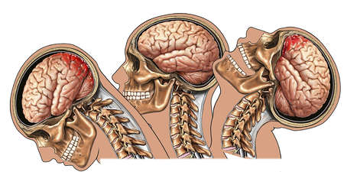
OLD Definition of concussion As defined by 3rd International Consensus statement Zurich, 2008
Concussion is defined as a complex pathophysiological process affecting the brain, induced by traumatic biomechanical forces
Typically thought of a coup-contrecoup injury but can be due to other forces as well

Slide 8
OLD Definition continued
May be caused by a direct blow to the head/face/neck/body with impulsive force directed towards the head
Typically results in the rapid onset of short lived impairment of neurologic function that resolves spontaneously
Concussion may result in neuropathological changes, but the acute clinical symptoms largely reflect a functional disturbance rather than a structural injury.
Concussion results in a graded set of clinical symptoms that may or may not involve loss of consciousness <10%

Slide 9
New Definition from 5th consensus
Sport related concussion is a traumatic brain injury induced by biomechanical forces. Several common features that may be utilized in clinically defining the nature of a concussive head injury include:

Slide 10
New definition from 5th consensus
SRC may be caused either by a direct blow to the head, face, neck or elsewhere on the body with an impulsive force transmitted to the head.
SRC typically results in the rapid onset of short-lived impairment of neurological function that resolves spontaneously. However, in some cases, signs and symptoms evolve over a number of minutes to hours.
SRC may result in neuropathological changes, but the acute clinical signs and symptoms largely reflect a functional disturbance rather than a structural injury and, as such, no abnormality is seen on standard structural neuroimaging studies.
SRC results in a range of clinical signs and symptoms that may or may not involve loss of consciousness. Resolution of the clinical and cognitive features typically follows a sequential course. However, in some cases symptoms may be prolonged.
The clinical signs and symptoms cannot be explained by drug, alcohol, or medication use, other injuries (such as cervical injuries, peripheral vestibular dysfunction, etc) or other comorbidities (eg, psychological factors or coexisting medical conditions).

Slide 11
Definition/Classification History
No longer exists in sports medicine parlance. It is a concussion or not.
Management based upon “grade” was an issue
Vienna 2001 was first consensus statement from Consensus on “Concussion in Sport”
Prague 2004 introduced the idea of:
Simple (7-10 days)
Complex (> 10 Days)
Introduced SCAT card
Zurich 2008
Abandoned classification
Introduced SCAT 2 (vestibular evaluation)
Important to note that the consensus only applies to age 10
Under age 10 concussions present differently and symptoms
Zurich 2012
SCAT 3
CHILDHOOD SCAT
- 5TH Berlin consensus!! 2017 Just described primary changes

Slide 12
Classification systems
Over 25 different classification systems
Consensus meetings were bred from this
3 primary well accepted methods
American Academy of Neurology
Cantu
Colorado Medical Society
Grading/classification not used in sports medicine world
Simple/Complex still in vernacular

Slide 13
Concussion like symptoms??
No such thing in ICD-10
Dehydration?
“Go-To” for coaches
“Dazed”
TKO in boxing/Standing 8 count
Bell rung

Slide 14
Epidemic???
1.6-3.8 million sports-related concussions yearly (2013)
Almost 9% of high school sport related injury
Higher incidence or recognized more?
Media hot topic
Misunderstanding
NFL rules modification
High risk sports:
football, m/w soccer (womens soccer higher rate than football in recent NCAA study), hockey, wrestling, lacrosse
Females get concussions more often than male
Theoretical
Weaker core/neck musculature
Smaller heads
Male bravado underreporting?

Slide 15
NOMENCLATURE
Essentially zero difference between concussion and mild traumatic brain injury
Cultural change, apathetic to phrase “concussion”
Using phrase “mild traumatic brain injury” elicits a visceral reaction
Setting is important as is understanding of patient, team, parents, etc

Slide 16
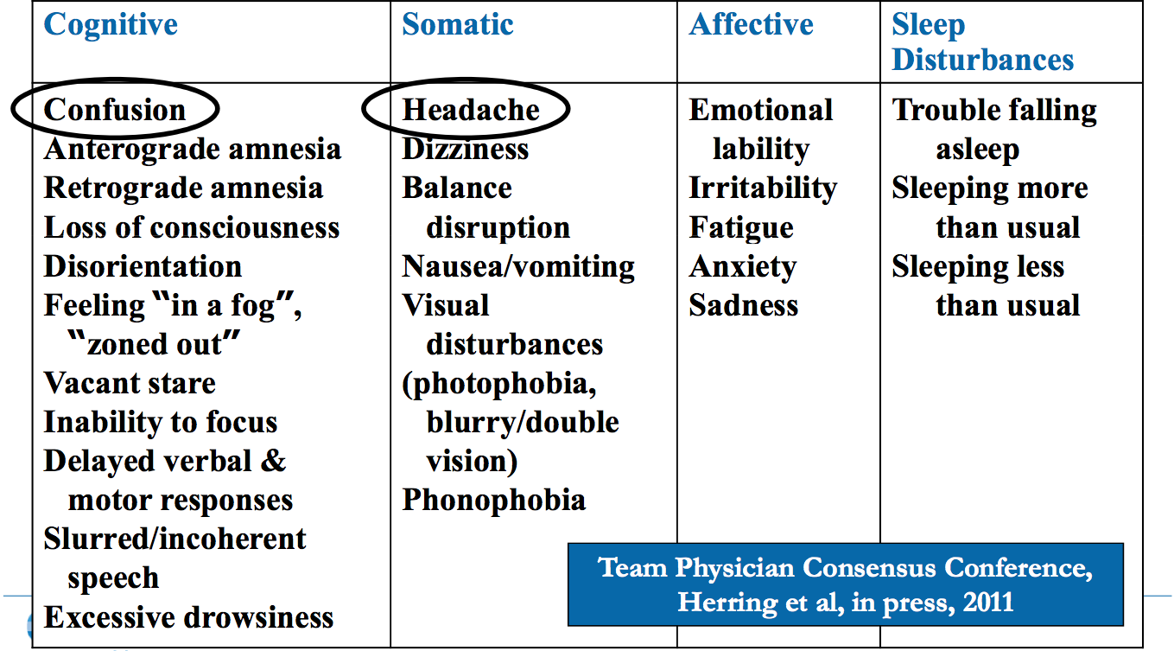
Signs and symptoms

Slide 17
Sideline evaluation
High suspicion
R/O C-spine
ABC’s
Go through symptom checklist and scoring
Orientation/Memory evaluation
Cognitive testing
BESS
Thorough exam

Slide 18
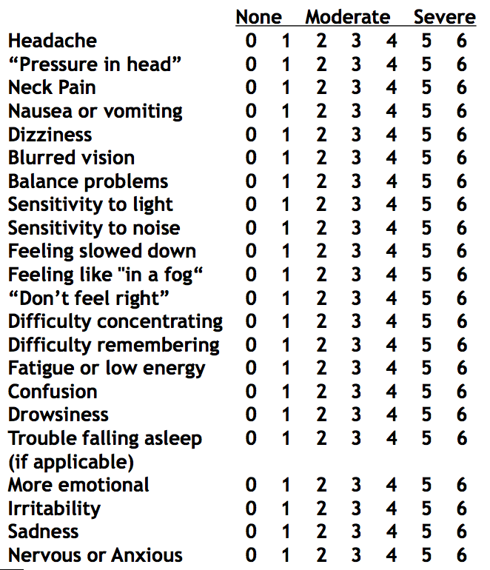
Symptom checklist/scoring

Slide 19
Orientation/Memory/Cognition
Modified maddocks
What venue?
What 1⁄2 is it?
Who just scored?
Who did we play last week?
Did we win?
Orientation
What month is it?
What’s the date?
What day is it?
What year is it?
What time is it, (within an hour) ?
Cognition
5 word recall, 3 trials
Months backwards Digit Span Backwards
Delayed recall

Slide 20
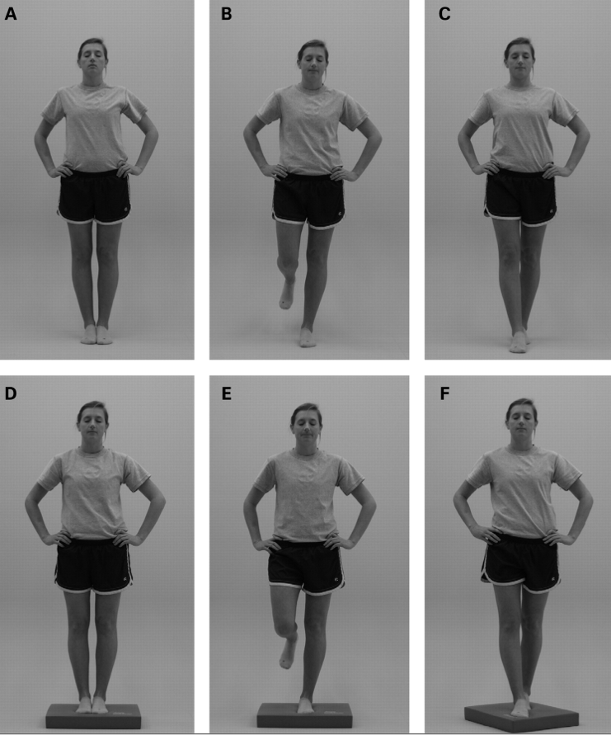
Balance/BESS testing

Slide 21
Timed tandem gait
Baseline heel-toe walk along a straight line 4 times with highest number as a “baseline”
Repeat at times of injury for comparison
More consistent compared to BESS however fatigability can play a role in performance

Slide 22
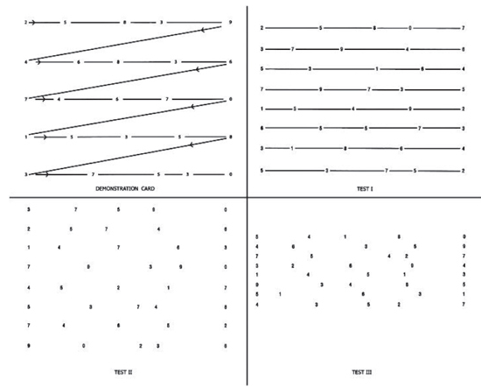
King-Devick Testing
Falling into more favor
Well researched in MMA, newer studies presented at AMSSM San-Diego with good support in collision sport environment
Easy to implement
PAPER BASED
Quick sideline test
1-2 minutes.

Slide 23
What is the premise?
Tests:
Cognition
Attention
Unrecognized but definite component of concussion
Saccadic eye movement
Horizontal and vertical
Mental fatigability
Ability to follow commands

Slide 24
King-Devick Testing
Not to be used alone but can compliment in addition to BESS, modified maddox, SCAT/SAC
If combining modalities for assessment sensitivity and specifity of detection increase significantly ON SIDELINE
SAC and BESS alone 90%
Adding KD test sensitivity goes to near 100%

Slide 25
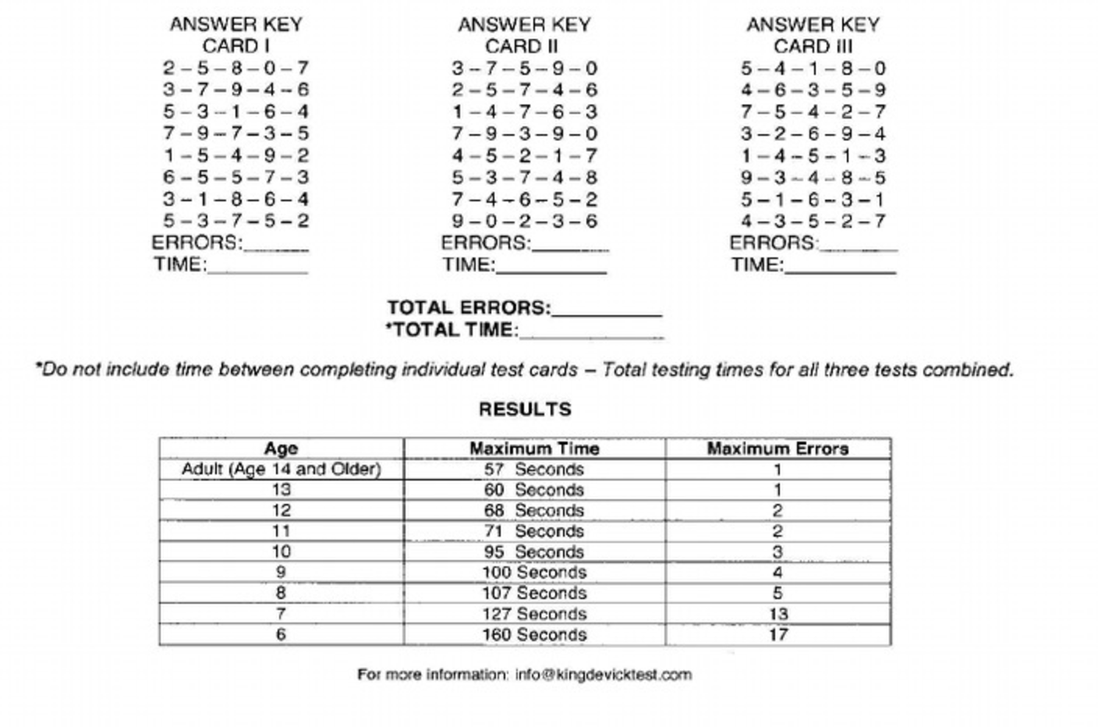
How to interpret King-Devick
Primarily deviation from baseline
Deviation can be in number of errors
Deviation can be in amount of time taken to complete (less than 4 seconds normal. 4-7 seconds “gray area”, 7 seconds or more suggestive

Slide 26
Physical Exam standards
No “gold standard” test
CN VII, CN III, CN I often injured in mild TBI.
Rarely do we check CN I but can have anosmia or dysosmia in up to 30% of head injury
There is no evidence that focus muscle testing has utility in concussion
There is utility however in assessing other pathology often of concern for practitioner including cervical spine

Slide 27
Physical exam standards
Consider dual task activity
Get up and go gait analysis combined with problem solving
BESS testing
Poor inter-rater reliability
Sensitivity of test is only .34
Very poor test/retest reliability .67

Slide 28
Physical Exam standards
Visual acuity/tracking is falling into favor as an objective measure of concussion
Dynamic visual acuity can be abnormal in up to 57% of children with brain injury
Read a snellen chart while shaking head “no”
Halmagyi test is a good test of vestibulo-occular movement
Grab cheeks and thrust to lateral side and eyes should stay fixated on stationary object

Slide 29
Eye Sync
Test of eye movement and attention combined
1-2 minutes
Baseline in pre-season and then put on goggles which track eye movement
Can also be used as clinical track for improvement over time
$$$$$$$$$$$$

Slide 30
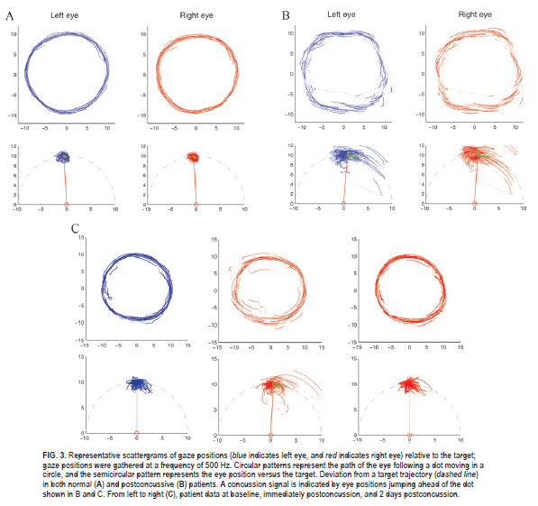

Slide 31
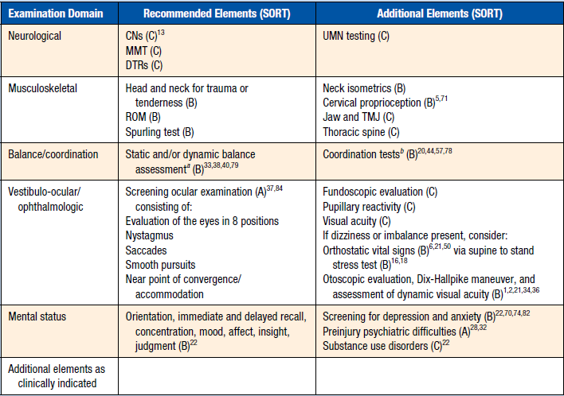
Strength of evidence for exam

Slide 32
Disposition on day of injury
WHEN IN DOUBT, SIT THEM OUT
Concussion consensus statement: NO SAME DAY RETURN TO PLAY if suspected concussion. Paradigm shift surprisingly.
My approach with ANY pediatrics
May modify pending upon level of participation (NCAA, professional, etc)
NCAA RELEASED UPDATED RECOMMENDATIONS 7/2014
Routine checks during game for status change
Discuss with parents about monitoring at home
Plan for clinical follow up

Slide 33
Signs for transport R/O intracranial bleed
In essence, “deterioration” and PE findings
LOC > 1 minute (NFL 30 seconds, me ANY LOC)
Headaches increasing
Repetitive Vomiting
Slurred Speech
Increased confusion
Odd behavior
Irritability
Seizure
Peripheral neurologic symptoms
Cervical TTP

Slide 34
Clinical Management
Routine symptom scoring should be basis for RTP
No clear evidence based Standardized assessment of concussion (SAC, SCAT, IMPACT)
Ideally neuropsych testing (IMPACT) day one post injury and repeat until asymptomatic
Compared to baseline (highly variable)
Avoid masking symptoms in acute setting
Medication??
No RTP or until FULLY asymptomatic (dependent upon level)

Slide 35
Clinical Management
Weekly follow up until asymptomatic
Loosened up depending on school/ATC
Exams including GCS, typically < 13 worse outcome
Anisocoria
Repeat symptom scores weekly
As part of SCAT, IMPACT
NEED to modify school environment
Excuse HW, tests, no notes, allow early exit, H/A breaks, ½ days, sunglasses, leave class 10 min early, leave school if persistent
Upon week 3, begin to consider post concussive syndrome

Slide 36
Activity modification
Activity modification should include physical AND cognitive rest
Limit screen time including texting, video games, computer time, etc
This typically involves directed written instructions to the school as the concussed individual may “look normal”.

Slide 37
Benefits of rest??
Versions 1, 2, and 3 of concussion consensus advocated for complete rest
Evidence for complete rest is weak after 48 hours
Depressive symptoms may manifest
I will advance activity as tolerated but NO CONTACT UNTIL CLEARED FULLY
“Simple math… if it bothers, don’t do it”
Advocate for early cardio in collegiate athletes
Early activity increases brain derived neutrophic factor which enhances recovery by decreasing oxidative stress and thus decreasing free radical accumulation

Slide 38
Post concussive syndrome
Most concussions resolve in 7-10 days
Younger takes longer
Persistent symptoms
H/A, visual changes, dizziness, fatigue, emotional lability
DSM-IV defines as 3 months
Introduce diagnosis possibility at 3 weeks and plan clinical strategy at week 4 after I make a tx “change”
Masking symptoms? Won’t release until “change” is removed from equation

Slide 39
Vestibular Rehab
Often under-recognized component
Vestibular system often lingers even after cognitive defects are cleared
Balance testing is now standard part of diagnosis/treatment
Adolescents typically rehab more quickly than their adult counterparts
May possibly aide in rapid resolution of symptoms

Slide 40
Risk factors of difficult recovery
Concussion History
#, previous severity of concussion (length)
Symptom severity
Total symptom score, duration of symptoms
“Fog”/”Dazed”
Signs
Loss of consciousness
Pre-existing conditions
Previous psych pathology
Age
Younger individuals take longer to resolve

Slide 41
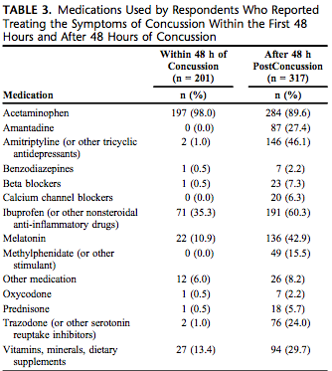
To give medications or not?

Slide 42
Return to Play planning
Individualized
Typically “Five Day” after asymptomatic
Longer in pediatrics patients
Revert to day previous
May be modified based upon comfort level
I do not go quicker than three/four days
Day one (AM run, sport specific activity)
Day two (Sport specific, non-contact)
Day three (Full contact)
Day four (release)
Falling out of favor. More rigorous and strict with RTP

Slide 43
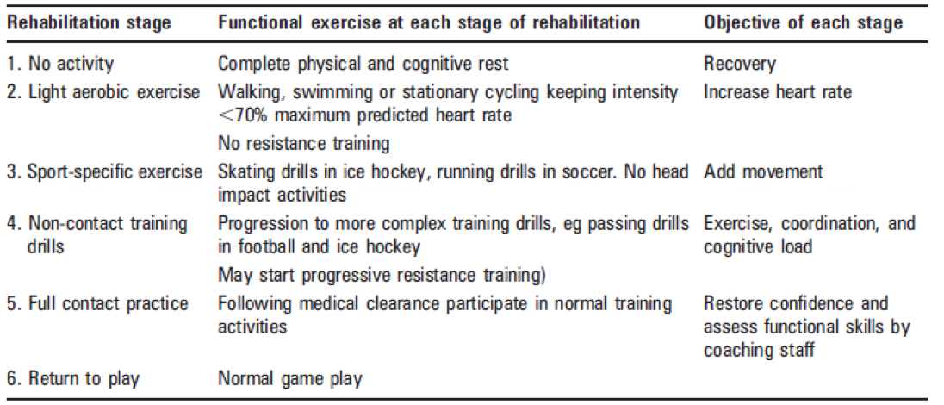
Standardized Consensus RTP guidelines

Slide 44
Neuropsych testing
2 forms
Formal
Performed and interpreted by neuropsychiatrist
Will isolate out specific cognitive deficits to base tx plan upon
Standard for post concussive syndrome
Computer based
In-office
$$$
Useful as a “tool” but not definitive at this point
IMPACT, CogSport, C3Logix, ANAM, Head Minder
Little evidence, primarily from private industry

Slide 45
imPACT testing?
Baseline vs. post injury
DO NOT HAVE TO HAVE BASELINE
Cognitive efficiency index
6 batteries of tests
Verbal Memory
Visual Memory
Visual Motor Speed
REACTION TIME
Impulse control
Symptom score

Slide 46
How to interpret imPACT test?
Cognitive efficiency index
Accuracy versus reaction time
“How well they took the test”
Symptom score
Reaction time
Weight less for memory, visual motor speed, impulse control
Will compare to normative means for age

Slide 47
Post concussed athlete

Slide 48
Who needs neuroimaging? What type?
Any LOC > 1 minute
Progressive/unchanging symptoms
> 10 days??
CT versus MRI
CT is superior for intra-cranial bleed in 48 hours or less
MRI superior for structural lesions
May consider functional MRI in PCS

Slide 49
Advanced imaging
Standard MRI low yield
SPECT
Medial Temporal Hypoperfusion pattern
PET
Decreased metabolic activity in medial temporal lobe, changes with cognitive activity
MRS (Magnetic Resonance Spectroscopy)
Measures fluctuation in neurometabolites
N-acetylaspartate, creatinine, choline, myoinositol, lactate
Functional MRI
Can detect differences in oxygenation which shows correlation in concussion

Slide 50
Second impact syndrome
Second head injury while still having symptoms from a previous head injury
Nearly 100% morbidity
Results in a loss of cerebral auto-regulation which results in cerebral vascular congestion, which often can progress to diffuse cerebral swelling and death
Anecdote from Wake Forest
http://www.matthewgfellerfoundation.org/

Slide 51
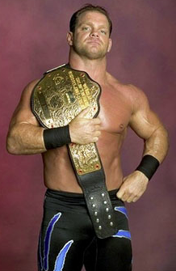
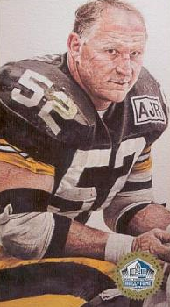
Chronic traumatic encephalopathy
Initially thought to extend to repetitive injury
“Punch drunk boxers”
Some evidence even after mild head injury
Evidence found in 18 y/o HS football player upon death
BU brain registry
87/91 Former NFL players
Selection Bias
McKee argues doesn’t need concussive event
Motor control issues
Parkinsonian
? Emotional control centers
Depression, Alcoholism, Suicide, Schizophrenia
Chris Benoit
Mike Webster

Slide 52
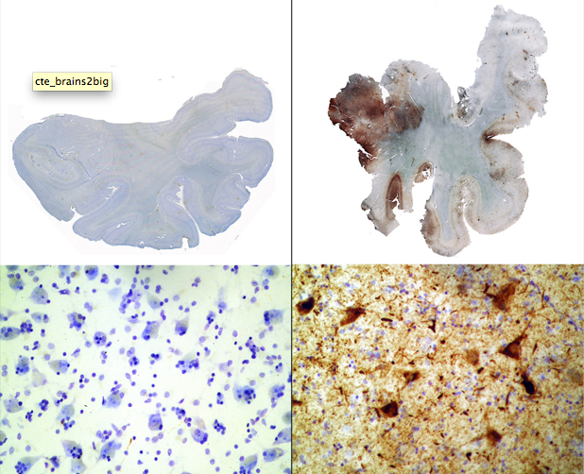
Chronic Traumatic Encephalopathy
No way to prevent at this point
Education
Proper concussion care
Early recognition of symptoms for intervention
Informed decision making?
Mike Grimsley NFL player

Slide 53
What can a practitioner do to prepare?
If taking care of a team:
Preseason education of coaches and parents
Baseline test of some sort (IMPACT, SCAT-3, SAC)
Do not defer/involve decision making with team
Clarify in advance if providing coverage
Standardize your diagnosis and treatment algorithm
NFL has good baseline program (free)
Develop your multidisciplinary team
Psychology, Rehab, School, Clinic

Slide 54
Prevention?
Mouth guards?
Decrease dental injury, unclear on concussions
Helmets?
Not definitive to decrease concussion (skiing, skateboarding exception) but do decrease the forces that cause concussion
Va Tech/Wake Forest STAR rating system
Education
AMSSM, NFL handouts

Slide 55
AMSSM/NFL Website
AMSSM “Find a doc”
NFL: Preventingconcussions.org:
Modified SCAT, baseline tests, post injury tests
Good resource, interactive talks, handouts available for print/order
Forms for school
Return to play plan

Slide 56
HEADS UP
Pop warner play vs. Heads Up play
In spite of flaws, still an excellent CDC resource
Tons of info
Graphics
Equipment informaiton

Slide 57
AAP recommendations 2010
Echoed sentiments of 2008 Consensus statement
Excellent overview of concussion
Discussed sport retirement
2013 update really started pushing academic accomodations

Slide 58
Sport Retirement
No definitive algorithm for retirement from sport
May require parental/school/athlete involvement
3 or more in a season, or 3 months of PCS
Evidence?
CTE

Slide 59
Future direction
Serologic testing
Genetic testing
Apo-E
Validation of neuropsych testing
“EKG”
King Devick
C3Logix
EyeSync

Slide 60
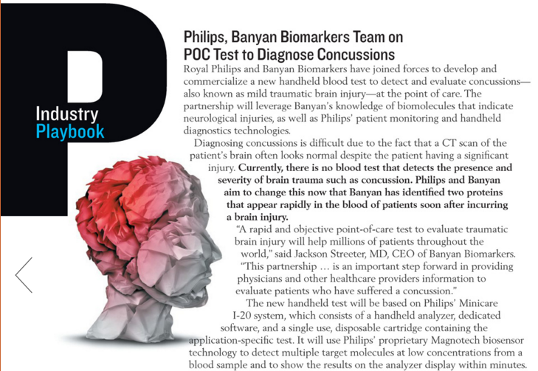
Serologic Testing

Slide 61
Serologic testing
The next “holy grail” if a POC test can be developed (cardiac enzymes)
No definite markers accepted yet
Multiple different markers in industry
Copeptin
Galectin 3
MMP 9
Occludin
Total Tau
S100

Slide 62
MU approach/standards
Baseline testing pre-season
BESS, KD, imPACT/C3Logix
Sideline evaluation
ANY signs or symptoms require immediate removal and detailed evaluation
SCAT 5 components, practitioner preference, Team physician contacted if ANY suspected concussion
Consider KD on sideline if time/situation allows

Slide 63
MU approach/standards
Impact/C3Logix within 24-48 hours of time of injury
Consider supplements including fish oil, melatonin
Sleep Hygeine
Academic accomodations
No return until self report asymptomatic and completion of staged return to play

Slide 64
MU sideline approach
Suspected Concussion:
ATC eval initially. MD can request eval
ATC student immediately puts up sideline tent
IMMEDIATE recall is tested
Apple, Table, Penny, Saddle, Brown
King Devick is performed by ATC
Allows MD a chance to observe and “get feel”
Physician does symptom scoring with ATC documentation
Allows ATC a chance to observe and “get feel”

Slide 65
MU sideline approach cont
Suspected Concussion cont”
Complete components of SCAT 5 as deemed necessary
Balance evaluation
Bess with Airex vs. Tandem Gait
Visual evaluation
Oculomotor tracking, Snellen, Pupils
Decision is made

Slide 66
MU transition from field to dx
If athlete held from day of competition:
24 hours imPACT test MUST be performed
Athlete is not allowed to participate in athletics until complete
MD evaluation within 24 hours
Meds including melatonin, tylenol, fish oil
Light cardio when symptoms score < 10
Advance as tolerated, no contact until ASx
NO return to play less than 3 days
Day 1 AM/PM Day 2 AM/PM Day 3 contact

Slide 67
Sideline tent?

Slide 68
SidelinER

Slide 69
How I handle it?
Possible concussed injury in a pediatric athlete
Day 1 – Done, monitor for change.
Clinical Day 1, out of school x one week, no sport, “zone out and watch Tommy Boy”
Impact testing
Compared to baseline if available
Worsen symptoms?
Weekly follow up until asymptomatic
School environment modifications at 1 week clinical f/u
If still very symptomatic at day 10 and no improvement trend, will obtain neuroimaging if not obtained
CT versus MRI

Slide 70
How I handle it?
Tx symptoms at week 3
Sleep cycle modification typically improves symptom score (Elavil, melatonin, propranolol)
If still symptomatic at week 4, dx with PCS
Send for formal neuropsych testing
Tx based upon elicited symptoms (ADHD, depression, H/A, etc)
No sport until asymptomatic, continue school modification
If still not cleared, consider formal psych referral, neuro referral
Cont to hold out of sport/retire
Low impact/exertion sports?
Golf, rifle, fishing
Very difficult
Sidney Crosby

Slide 71
How I handle it?
Basically follow the UPMC model
3 components
Sideline Modified Maddox, visual acuity, balance. Try to do them at same time
Neuropsych testing in clinic
Vestibular evaluation and rehab
Medicinal therapy if needed for sx

Slide 72
Case Presentations
Junior HS football
Hit in first half, “clears” by Halftime
Senior FB player
Dx with concussion, Sat out day one
6 weeks out, asymptomatic at 3 weeks, CT Scan, formal neuropsych testing, homecoming
Incoming college freshman
Hx of multiple concussions in HS
“Doing well, just have a headache on occ”

Slide 73
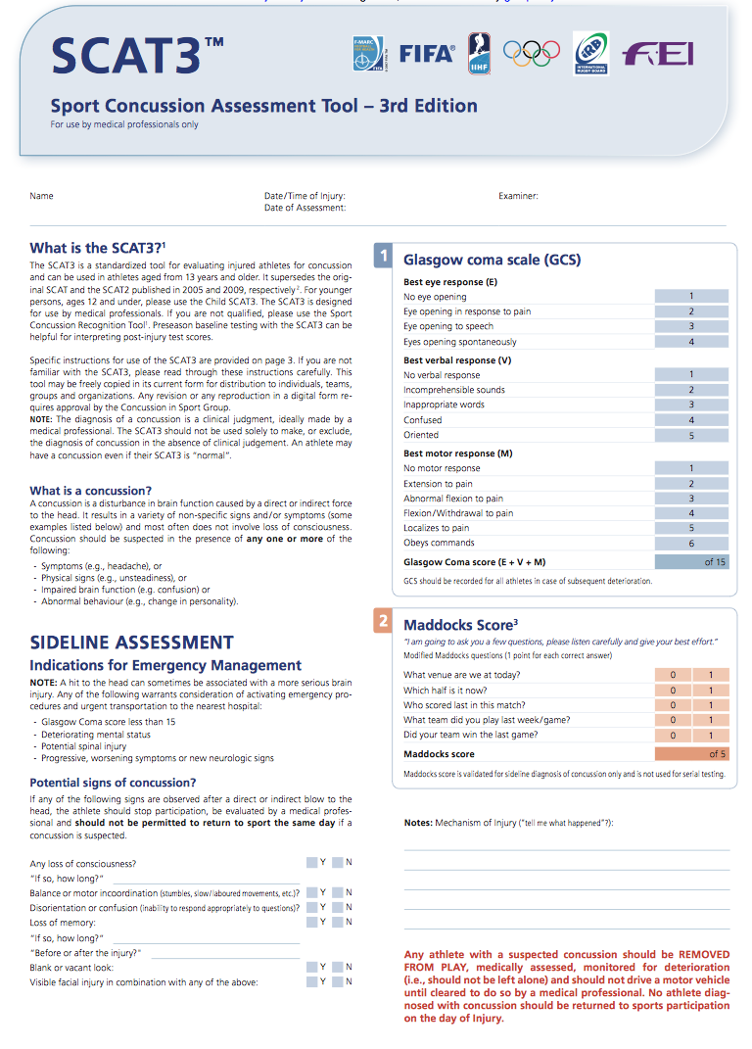
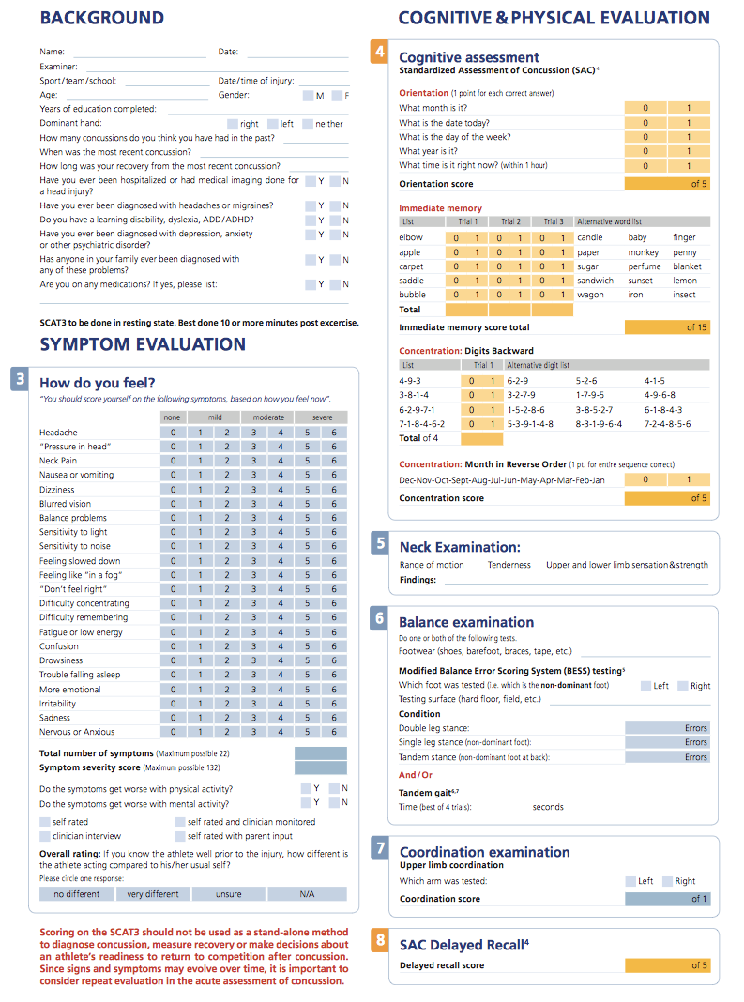
Scat-5 Sample Cards

Slide 74
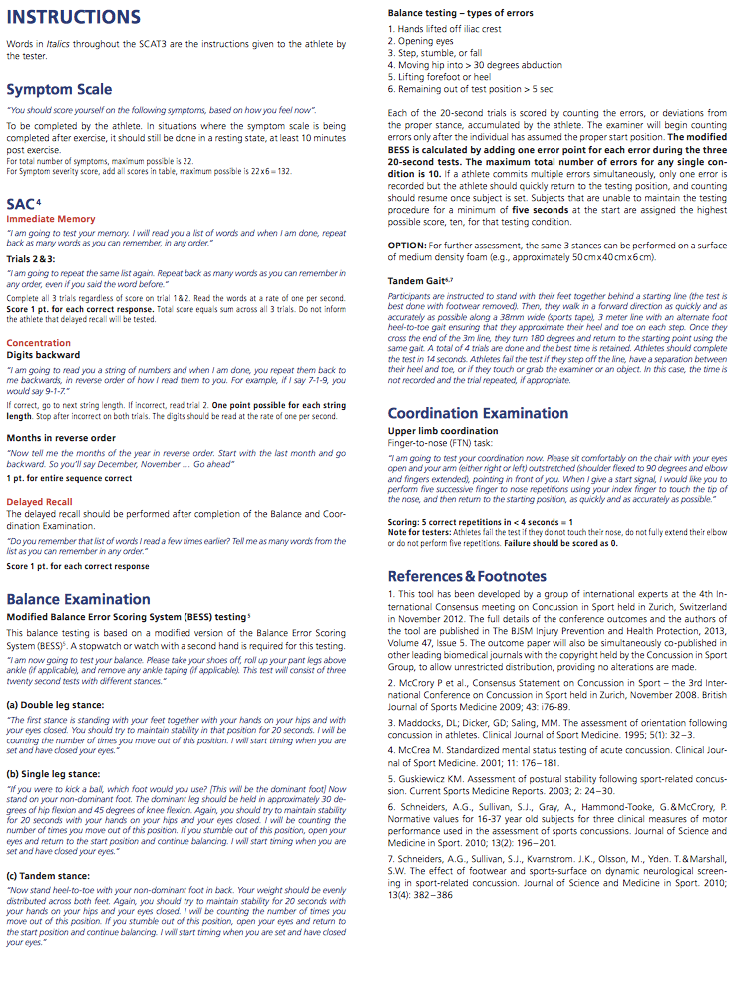
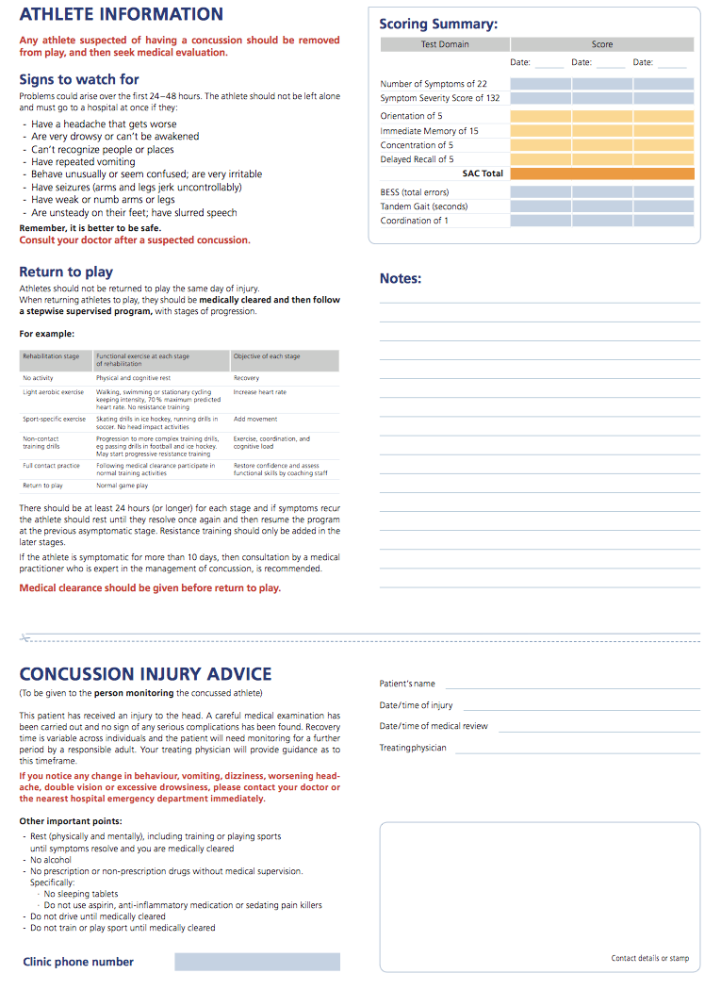
Scat-5 Sample Cards

Slide 75
Potpourri
Marshall concussion consortium
C3 Logix
Research
Sleep cycle
Rating the raters
Jim McMahon
https://www.youtube.com/watch?v=TNMuQdqdGa4
Infrascan

Slide 76
Sources
Consensus statement on concussion in sport Br J Sports Med 1 April 2013 vol. 47 no. 5 250-258
McCrory, Meeuwisse, Johnston, et al. Consensus Statement on Concussion in Sport. Clinical Journal of Sport Med 2009;19:185-200
Preventingconcussions.org, Multiple Articles. Accessed February 12, 2012
Hootman, Et Al, Epidemiology of Collegiate Injuries. J Athl Train. 2007 Apr-Jun; 42(2): 311–319
Halstead, Walter Et Al, Sport related concussion in Children and Adolescents. Pediatrics August 2010:126;597
Johnston KM, McCrory P, Mohtadi N, Meeu- wisse W. Evidence-based review of sport- related concussion: clinical science. Clin J Sport Med. 2001;11(3):150 –159
Dick RW. Is there a gender difference in concussion incidence and outcomes? Br J Sports Med. 2009;43(suppl 1):i46 –i50
Gessel LM, Fields SK, Collins CL, Dick RW, Comstock RD. Concussions among United States high school and collegiate athletes. J Athl Train. 2007;42(4):495–503
McCrory P. Do mouthguards prevent concussion? Br J Sports Med. 2001;35(2): 81– 82

Slide 77
Sources cont
Labella CR, Smith BW, Sigurdsson A. Effect of mouthguards on dental injuries and concussions in college basketball. Med Sci Sports Exerc. 2002;34(1):41– 44
Rowson, Duma, Et Al. Development of the STAR Evaluation System for Football Helmets. Annals of Biomedical Engineering 2011;39(80:2130-2140
Valovich McLeod TC, Schwartz C, Bay RC. Sport-related concussion misunderstand- ings among youth coaches. Clin J Sport Med. 2007;17(2):140 –142
Bazarian JJ, Veenema T, Brayer AF, Lee E. Knowledge of concussion guidelines among practitioners caring for children. Clin Pediatr (Phila). 2001;40(4):207–212
Boston University, Center for the Study of Traumatic Encephalopathy. Case studies. Available at: www.bu.edu/cste/case- studies. Accessed February 15, 2010
Jotwani V, Harmon KG. Postconcussion syndrome in athletes. Curr Sports Med Rep. 2010;9(1):21–26
McCrory P. Does second impact syndrome exist? Clin J Sport Med. 2001; 11(3):144 –149
McCrory P. When to retire after concussion? Br J Sports Med. 2001;35(6): 380 –382
CantuRC. Whentodisqualifyanathleteafter a concussion. Curr Sports Med Rep. 2009;8(1):6 –7

Slide 78
Sources cont
Patorkian, Corrigan. Concussion to Consequence: Ovid Webcast. http://journals.lww.com/cjsportsmed/Documents/ovid_lww_concussion_webcast_101811.pdf. Accessed at 8:43 PM February 24, 2012.
AMERICAN COLLEGE OF SPORTS MEDICINE. Concussion and the Team Physician: A Consensus Statement. Med. Sci. Sports Exerc. 2006. 395-399
Mccrory, P. Sports concussion and the Risk of Rhronic Traumatic Encephalopathy. Clin J Sport Med 2011;21:6–12
B. Alsalaheen, A. Mucha, et al., Vestibular rehabilitation for dizziness and balance disorders after concussion. Journal of Neurologic Physical Therapy, 2010, June; 34(2):87-93.
Matusz, Et. Al. A Practical Concussion Physical Exam Toolbox. Sports Health. June; 8:260-269
Ventura RE, Jancuska JM, Balcer LJ, Galetta SL: Diagnostic tests for concussion: is vision part of the puzzle? J Neuroophthalmol 35:73–81, 2015
Sideline concussion assessment tool fifth edition. BJSM. 4/2017
http://bjsm.bmj.com/content/bjsports/early/2017/04/28/bjsports-2017-097506SCAT5.full.pdf

Slide 79
Questions?

