Slide 1
Concussion: A view from the Sidelines
Gregory A. Elkins, MD

Slide 2
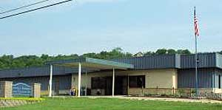
Lincoln Primary Care Center

Slide 3
What we AREN’T Going to Talk About
Return to Play Protocols
Return to Learn
Second Impact Syndrome
CTE

Slide 4
What we ARE going to talk about (Learning objectives)
Preseason Prep
Pregame Prep
In-Game Duties
Postgame

Slide 5
Preseason Prep
Pre-participation Exams
HISTORY!!!!
- Previous Concussions
- Migraines

Slide 6
Preseason Prep
Baseline Neurocognitive Testing
Time
Cost
? 2 Sets of Tests

Slide 7
Pregame Prep
Evaluation of Previously Injured Players
“Don’t make decisions when the stands are full and the band is playing”

Slide 8
Pregame Prep
Emergency Action Plans
All Sports
All Venues

Slide 9
Pregame Prep
Pregame Sports Medicine Timeout
Who?
How?
Where?

Slide 10
In-Game Duties
What are the people tasked with dealing with concussions doing?

Slide 11
In-Game Duties
Dealing with ALL injuries
Evaluation and treatment of musculoskeletal injuries
Icing, taping, re-taping and bracing
Monitoring heat (including water breaks, etc.)
Sudden Cardiac Death, etc., etc., etc.

Slide 12
In-Game Duties
Dealing with Coaches (and parents)

Slide 13
In-Game Duties
Observing the Field

Slide 14
Evaluating Possible Concussions
Presentation
Evaluation

Slide 15
Presentation
Down Athlete

Slide 16
Presentation
Athlete who presents to Sports Med with Symptoms

Slide 17
Presentation
Athlete sent to sideline by Official

Slide 18
Presentation
Athlete brought or pointed out by Coach or Teammate

Slide 19
Presentation
Athlete with abnormal activity observed by Sports Med

Slide 20
Evaluation
A little different than in the Clinic, Office or ER
Elkins Law of Down Athlete- “If there is one mud puddle on the field that is where the player goes down.”

Slide 21
Evaluation
General Observation
Mental Status
LOC

Slide 22
Evaluation
History!
History!!
History!!!

Slide 23
Evaluation
Neurological Exam

Slide 24
Evaluation
Specific Neuro Pysch Sideline Tools
Remember these are TOOLS, Concussion is a Clinical Diagnosis!

Slide 25
Evaluation
When in doubt, sit them out!

Slide 26
Evaluation
Transport?
Unstable or deteriorating neurological status

Slide 27
Monitoring
Watch the concussed athlete
Reevaluate at regular intervals
Make sure they do not re-enter-TAKE AWAY THE HELMET!!!

Slide 28
Postgame
The Sports Med team is usually the last to leave

Slide 29
Postgame
More potential Evaluations
Athletes pointed out by teammates, coaches or parents
Athletes with symptoms
Athletes noted to have extreme emotional lability (crying or laughing inappropriately, etc.)

Slide 30
Postgame
Plan for what is next for the athlete with concussion
Follow up
Return to Play/Learn
OK I mentioned them. Are you happy?

Slide 31
Postgame
Communicate with Parents
Written documents
Online resources (smart phones)
http://www.nfhs.org/media/1014739/parents_guardians_guide_to_concussion_final_2016.pdf
Parents may not be present

Slide 32
Postgame
Now we get to the stuff everyone wants to hear about; RTP, RTL, CTE!
But that’s another talk

Slide 33
Other Important Considerations
This talk focused on a football game in an ideal situation with an NATA Certified Athletic Trainer and maybe a Sports Medicine Physician. What if it’s a girls soccer practice or an away volleyball game?

Slide 34
Other Important Considerations
Emergency Action Plans are important, but our student athletes deserve NATA Certified Athletic Trainers!

Slide 35
Recap
Learning Objectives
Preseason Prep
Pregame prep
In Game Duties
Postgame Duties

Slide 36
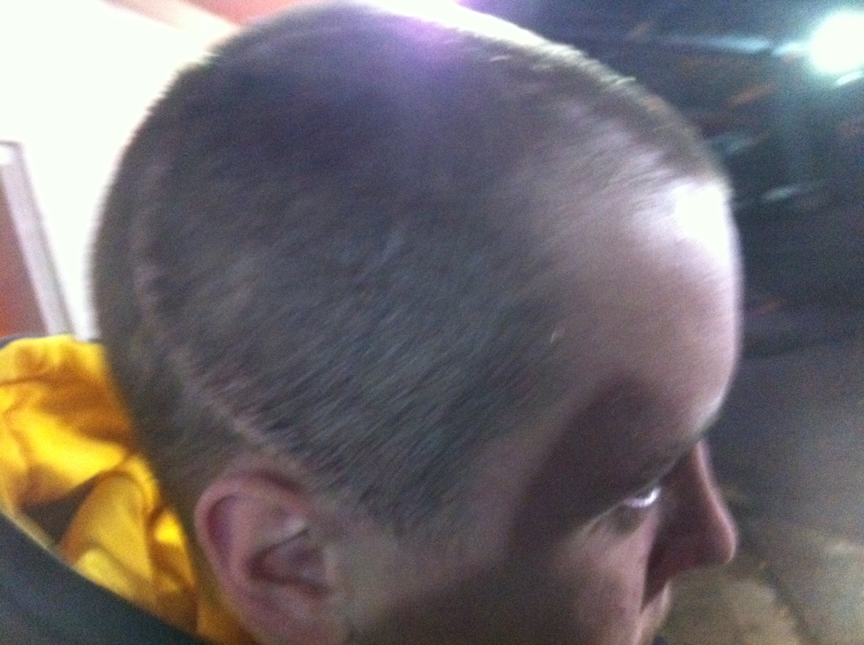

Slide 37
Thank You!
Greg.elkins@swvhs.org

