Slide 1
Compassion Fatigue: Looking Out for Yourself and Each Other
Anastasia Riley, MBA, CBIS
Terry Cunningham, MA, CBIS

Slide 2
A part of West Virginia University & WVU Health Sciences Center
Center for Excellence in Disabilities
Positive Behavior Support
Notes:
Key Talking Points: Recommendation is to start out explaining that your program is a part of CED, then lead into program information and training topic
-CED is a unit within West Virginia University (WVU), Health Sciences, and because of the placement within the University, has access and alignment within the Schools of Pharmacy, Public Health, Nursing, Medicine and Dentistry.

Slide 3
Part of a National Network
Center for Excellence in Disabilities
Positive Behavior Support
Notes:
Key Talking Points:
-The CED is a University Center for Excellence in Developmental Disabilities Education, Research and Service (UCEDD) designated and funded by the U.S. Department of Health and Human Services, Administration for Community Living, Administration on Intellectual Disabilities.
-UCEDDs were created in 1963 by the federal government with the enactment of Public Law 88-164 to serve people with intellectual disabilities.
-Today, there are sixty-seven (67) Centers across the country, authorized under the Developmental Disabilities Assistance and Bill of Rights Act of 2000 (PL-106-402), to serve as resources for Americans with a wide range of disabilities. The sixty-seven (67) Centers, at least one in every state and territory is affiliated with a major research University and serves as a resource for people of all ages.

Slide 4
WVU CED’s Role:
Education and training to University students in multiple disciplines to prepare a workforce that is able and willing to serve persons with disabilities
Technical assistance to individuals with disabilities and direct care providers who serve them to enhance their skillset and improve service quality
Gap filling direct services and supports in an effort to improve availability and acceptability of services for West Virginians
Dissemination of information about the status of disabilities services in West Virginia and the nation
Research activities conducted in collaboration with partners, to improve services and policies related to individuals with disabilities and their families.
Center for Excellence in Disabilities
Positive Behavior Support

Slide 5
About WVU CED
Serves individuals with disabilities across the life span in all 55 counties
7 Programs
4 Clinics
Approx. 90 Staff
Multiple state and federal partners
Center for Excellence in Disabilities
Positive Behavior Support
Notes:
Taking Points:
Staff are hosted by partner agencies and located across the state
Partners include:
WV Dept of Health & Human Resources (DHHR)
WV Division of Rehabilitation Services (DRS)
WV Dept of Education (DOE)
WV Developmental Disabilities Council (DDC)
WV Advocates (WVA)
Maternal and Child Health Bureau (MCHB) /Health Resources and Services Administration (HRSA)
Administration for Community Living (ACL) / US Dept. of Health and Human Services

Slide 6
Become an Affiliate
Looking for a way to be more connected to CED? Individuals can now sign up to be an Affiliate of the CED. Affiliates will:
Receive updates on CED news and events
Have opportunities to provide input regarding programs, services and research projects
http://www.cedwvu.org/about-ced/become-an-affiliate/
Center for Excellence in Disabilities
Positive Behavior Support

Slide 7
Session Objectives
Review definition and examples of compassion fatigue
Review warning signs of and self-assessments for compassion fatigue
Demonstrate self-care skills to prevent the onset or worsening of symptoms
Center for Excellence in Disabilities
Positive Behavior Support
7

Slide 8
Center for Excellence in Disabilities
Positive Behavior Support
8
Notes:
This slide is a word cloud of terms and concepts often related to compassion fatigue.

Slide 9
Compassion Fatigue (CF) Defined
Also called “vicarious traumatization” or secondary traumatization (Figley, 1995).
The emotional residue or strain of exposure to working with those suffering from the consequences of traumatic events. It differs from burn-out, but can co-exist. Compassion Fatigue can occur due to exposure on one case or can be due to a “cumulative” level of trauma.
The American Institute of Stress
Center for Excellence in Disabilities
Positive Behavior Support
Notes:
Before having attendees complete the assessment on the following slides, briefly discuss examples of what secondary trauma might look like in their daily personal or professional experience.
Secondary trauma need not be from a classic “traumatic event”; it can also arise from seeing individuals struggle in various systems where their safety, rights, and opportunities are severely restricted. Working with vulnerable populations provides many, many opportunities to observe such things.

Slide 10
Self-Assessment: Questionnaires
See handouts:
Compassion Fatigue Self-Test: An Assessment (Portnoy, 1996)
40 items, scored on a 3-point scale
Professional Quality of Life Scale (PROQOL, Version 5; Stamm, 2009)
30 items, scored on a 5-point scale
Center for Excellence in Disabilities
Positive Behavior Support
Notes:
The journal packet can be used to guide the balance of the training. The wording has been updated to reflect unpaid caregivers, and to include some added (person-centered ☺) activities.

Slide 11
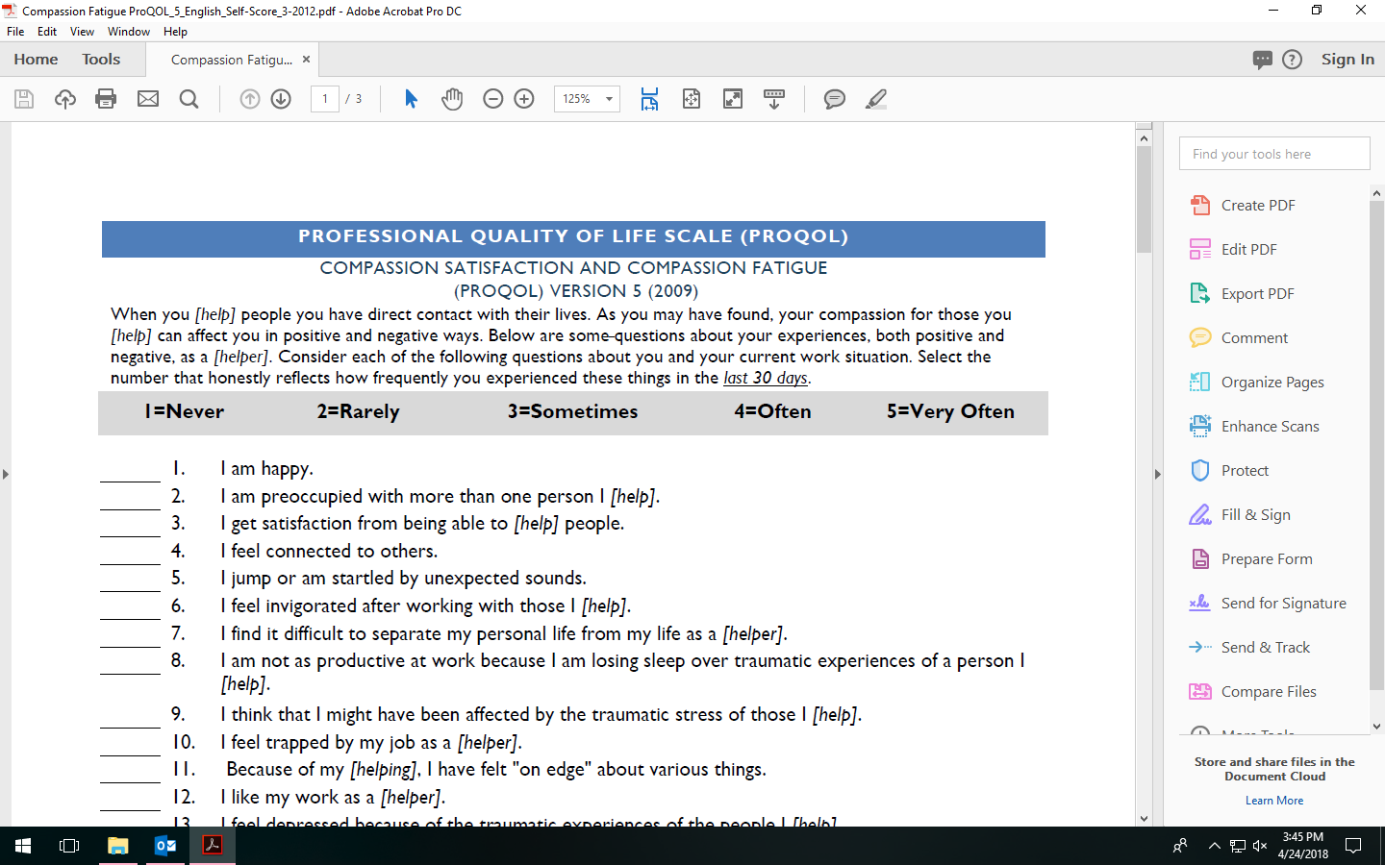
ACTIVITY:
Compassion Fatigue Self-Test
Center for Excellence in Disabilities
Positive Behavior Support

Slide 12
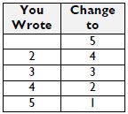
Cut-off Levels of Possible Concern
Compassion Fatigue Self-Test
Answered “1 (Very True)” to 15 or more items
PROQOL, Version 5
Compassion Satisfaction Scale
Burnout Scale (remember to reverse * items)
Secondary Traumatic Scale
Scores above 42 are in the top 25% of those who complete the PROQOL
Center for Excellence in Disabilities
Positive Behavior Support
Notes:
The journal packet can be used to guide the balance of the training. The wording has been updated to reflect unpaid caregivers, and to include some added (person-centered ☺) activities.

Slide 13
Compassion Fatigue vs. Burnout
Compassion Fatigue
Highly Variable in Onset:
Can develop in a rapid or more gradual manner
Directly related to the nature of the work and “overuse” of compassion skills
Faster recovery time (if recognized and managed early)
Burnout
More Stable in Onset:
A cumulative, more gradual process marked by exhaustion and withdrawal
Typical Progression in Stages:
Enthusiasm→Stagnation→
Frustration→Apathy
Associated with the stress of the workload and institution, NOT the nature of the work
Center for Excellence in Disabilities
Positive Behavior Support
13
Notes:
When comparing the two, also stress how the solutions for addressing each would look different.

Slide 14
Compassion Fatigue vs. Burnout
Similar symptoms can exist in both conditions. These include:
Emotional exhaustion
Reduced sense of personal accomplishment
Mental exhaustion
Decreased interactions with others (isolation)
Depersonalization
Physical exhaustion
The American Institute of Stress
Center for Excellence in Disabilities
Positive Behavior Support
14
Notes:
Personal example – boy shot brother
Feel supported to help yourself cope with the emotional experience

Slide 15
Who is Vulnerable to CF? (Figley, 2012)
Center for Excellence in Disabilities
Positive Behavior Support
https://www.youtube.com/watch?v=7YIDFSBUwtY
15
Notes:
https://www.youtube.com/watch?v=7YIDFSBUwtY

Slide 16
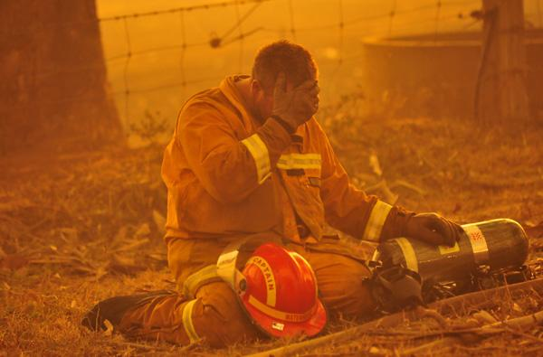
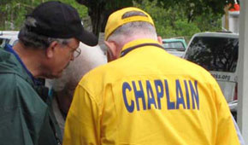
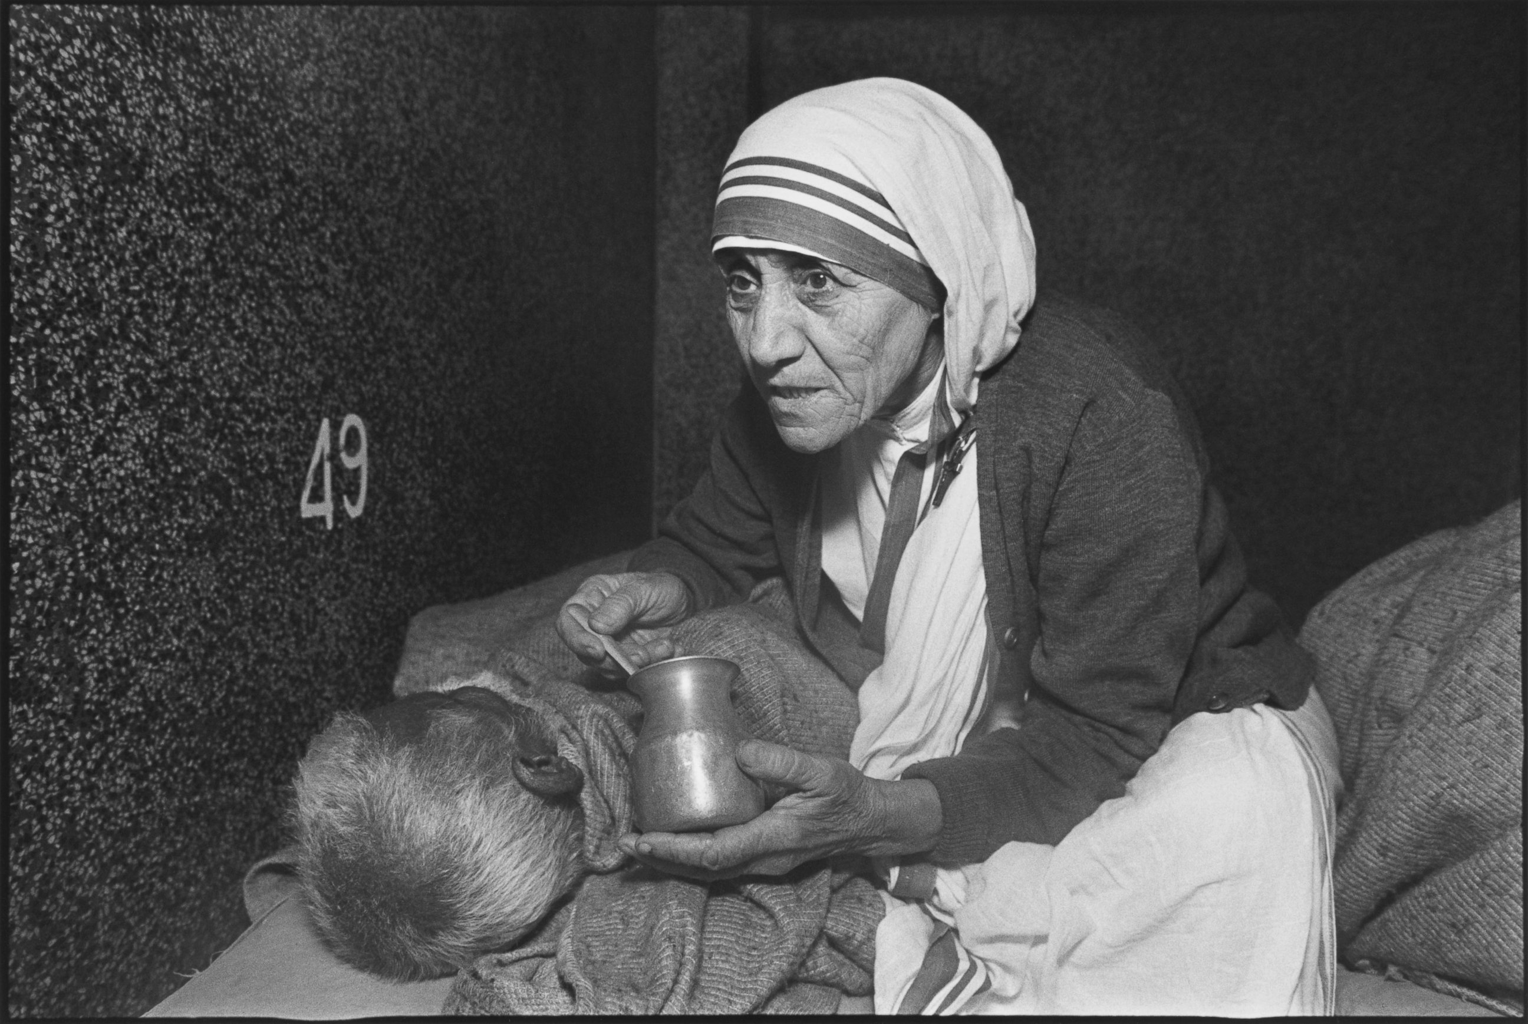
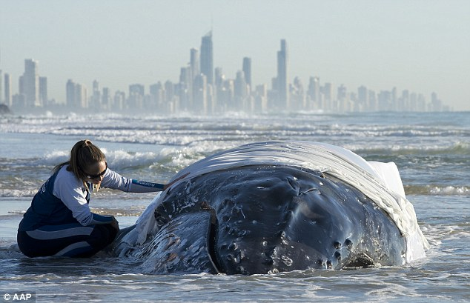
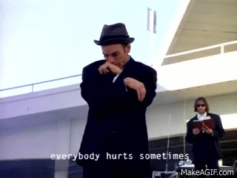
Center for Excellence in Disabilities
Positive Behavior Support
16
Notes:
Following Figley’s brief description of CF vulnerability, this slide shows many first responders and caregivers who may routinely be subjected to secondary trauma. The beached whale picture also addresses the fact that secondary trauma can come from working with animals as well as people, and witnessing that suffering.

Slide 17
You have been given a workbook with several sections that cover various areas of your helping profession, family life, or other caregiving.
We will complete portions of this workbook together, and others you can complete later on your own.
ACTIVITY:
WORKBOOK
Rewards/
Challenges
of
Caregiving

Slide 18
Effects of CF on the Individual
Excessive blaming
Bottled up emotions
Isolation from others
Receives unusual amount of complaints from others
Voices excessive complaints about administrative functions
Substance abuse used to mask feelings
Compulsive behaviors (such as overspending, overeating, gambling, sexual addictions)
Compassion Fatigue Project
Center for Excellence in Disabilities
Positive Behavior Support

Slide 19
Effects of CF on the Individual (continued)
Poor self-care (i.e., hygiene, appearance)
Legal problems, indebtedness
Reoccurrence of nightmares and flashbacks to traumatic event
Chronic physical ailments such as gastrointestinal problems and recurrent colds
Apathy, sadness, loss of pleasure
Difficulty concentrating
Compassion Fatigue Project
Center for Excellence in Disabilities
Positive Behavior Support

Slide 20
Effects of CF on the Individual (continued)
Mentally and physically tired
Preoccupied
In denial about problems
Compassion Fatigue Project
Center for Excellence in Disabilities
Positive Behavior Support

Slide 21
Center for Excellence in Disabilities
Positive Behavior Support
Notes:
The many detrimental effects of CF create an ever-worsening state of isolation and “go it alone”-edness for the person experiencing them.

Slide 22
Effects of CF on the Workplace
High absenteeism
Constant changes in co-workers relationships
Inability for teams to work well together
Desire among staff members to break company rules
Outbreaks of aggressive behaviors among staff
Inability of staff to complete assignments and tasks
Compassion Fatigue Project
Center for Excellence in Disabilities
Positive Behavior Support
Notes:
Impact the broader workplace not just the individual.

Slide 23
Effects of CF on the Workplace (continued)
Inability of staff to respect and meet deadlines
Lack of flexibility among staff members
Negativism towards management
Strong reluctance toward change
Inability of staff to believe improvement is possible
Lack of a vision for the future
Compassion Fatigue Project
Center for Excellence in Disabilities
Positive Behavior Support

Slide 24
Warning Signs
Flat/blunted affect
Numbness
Change of world view, including statements of:
Helplessness
Hopelessness
Worthlessness
Center for Excellence in Disabilities
Positive Behavior Support

Slide 25
Self-Assessment: Circles of Support
Consists of four levels of social support:
Circle of Intimacy – Those you couldn’t imagine living without
Circle of Friendship – Key people who just missed the First Circle
Circle of Participation – People who’s main relationship to you is due to sharing a common interest or activity
Circle of Exchange – People involved in your life because they are paid to be there
Center for Excellence in Disabilities
Positive Behavior Support
Notes:
Those dealing with CF may well be experiencing a limited support system. Additionally, a reluctance to ask for help can create barriers to healthy outcomes.

Slide 26
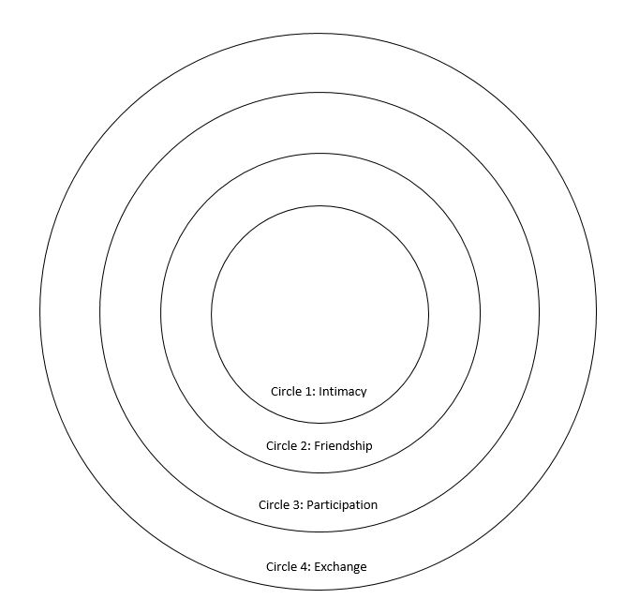
ACTIVITY:
Circles of Support
Center for Excellence in Disabilities
Positive Behavior Support
Notes:
Have participants complete these Circles for themselves. Stress that they should think of who they can rely upon for support at the various levels.

Slide 27
Discussion: Self-Care Skills
What are you currently doing to cope with caregiving-related stress in your life?
What has been working and/or not working?
Center for Excellence in Disabilities
Positive Behavior Support

Slide 28
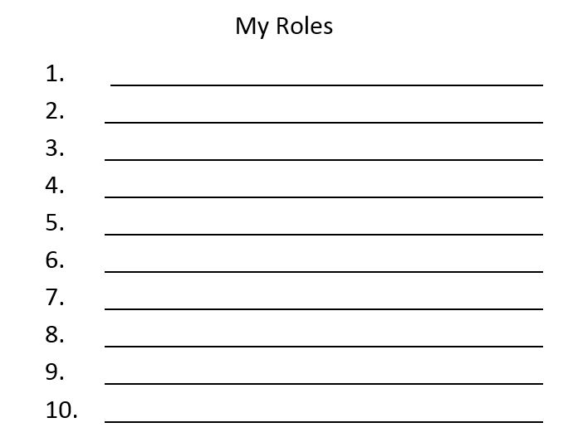
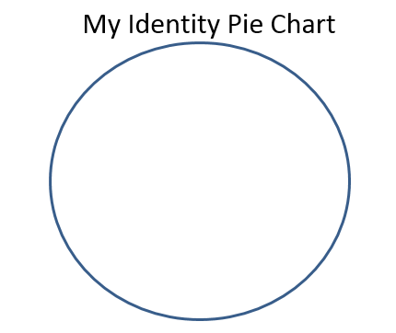
ACTIVITY:
My Roles
&
Identity Pie
Center for Excellence in Disabilities
Positive Behavior Support

Slide 29
Dreams, Themes, and Intervention Schemes
Dream | Theme | Example Intervention
Become a doctor | Wants to have prestige and work with medicine | Get a white coat Make sure office/ house nurse has supplies (e.g., alcohol wipes, bandages)
Be Batman | Wants to be a detective, help others | Volunteer Help run “Lost & Found”
Go to the Bahamas | Wants to be in a tropical environment | Go swimming at a local lake by a sand beach Have a luau party
Go to college | Wants to learn something new | Have a daily word/online research topic
Notes:
This slide is a nod back to PBS, but can be used for discussion about how even someone in a high-involvement caregiving capacity can find small ways to have daily contact with their dreams or other things most personally important to them.

Slide 30
Hogewey Village (Netherlands)
Center for Excellence in Disabilities
Positive Behavior Support
Notes:
Hogewey Village is a care facility for individuals with Alzheimer’s and other progressive dementia. The care staff appear as fellow community members, and the environment is structured in a way that is far more conducive to more natural interactions where individuals can demonstrate their remaining strengths (and thus, lessening some of the effects of potential exposure to helplessness). I think of this as a large-scale example we can aspire to, if never quite reach.
This slide can also be an opportunity to discuss workplace/home changes that might make caregivers feel less overwhelmed by their responsibilities.

Slide 31
10 Ways to be Happier Today
Exercise – 7 minutes might be enough
Sleep more – you’ll be less sensitive to negative emotions
A shorter commute
Spend time with friends and family
Go outside – happiness maximized at 57 degrees (F)
Help others – 100 hours/year is the magical number
Practice smiling
Plan a trip – even if you don’t take one
Meditate – rewire your brain for happiness (mindfulness)
Practice gratitude
Cooper, B., 2013
Notes:
On the other hand, these slides review very simple and immediate strategies for enhancing personal well-being and happiness. I always like to use these slides for discussion.

Slide 32
Other Happiness-Boosting Ideas
Laughter
Pet a pet
Eat yourself happy
Omega 3s and Vitamin B
Nature
Try aromatherapy
Bergamot, Geranium, Neroli and Jasmine
Take a risk
Talk it out
Schedule in regular treats
Set yourself a goal
Green Tea
Positive Attributes List
Own and love your uniqueness
Live in the moment
Healthy Active Living
Center for Excellence in Disabilities
Positive Behavior Support
Notes:
DISCUSSION ADDITION: LET IT GO, RECOGNIZE WHAT THEY CAN and CAN’T CONTROL [See back of workbook].

Slide 33
Thinking Outside the Box
Empowering yourself and support system
No bad ideas – use anything to build
Challenge the status quo
Work to energize and challenging yourself to action
Conduct brainstorming sessions with your co-workers, family, and individuals you serve
Figuring out barriers…
…so you can overcome them
Try new things
Center for Excellence in Disabilities
Positive Behavior Support
Notes:
This slide just reiterates values important to person-centeredness and self-care. Can review the Working/Not Working handout as well to give them a resource to use when they’re in the course of their jobs/caregiving.

Slide 34
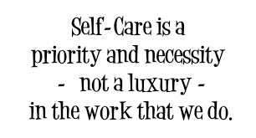
Center for Excellence in Disabilities
Positive Behavior Support

Slide 35
Compassion Fatigue References:
American Institute of Stress (2015) http://www.stress.org/military/for-practitionersleaders/compassion-fatigue/
Compassion Fatigue Awareness Project (2013) http://www.compassionfatigue.org/
Figley, C. R. (Ed.) (1995). Compassion fatigue: Coping with secondary traumatic stress disorder in those who treat the traumatized. NY: Brunner/Mazel.
Center for Excellence in Disabilities
Positive Behavior Support

Slide 36
Person-Centered Planning/Quality of Life References:
Falvey, M.; Forest, M.; Pearpoint, J.; Rosenberg, R. (1997) All My Life’s a Circle Using the Tools: Circles, MAPS & PATHS. Inclusion Press.
Inclusion Press. http://www.inclusion.com/
World Health Organization (1997) WHOQOL: Measuring Quality of Life http://www.who.int/mental_health/media/68.pdf
Cooper, B. (2013) 10 Simple Things you can do today to make you happier, backer by science. Buffersocial. https://blog.bufferapp.com/10-scientifically-proven-ways-to-make-yourself-happier
10 Ways to Boost your Happiness. Realbuzz.com. Healthy Active Living.
http://www.realbuzz.com/articles/10-ways-to-boost-your-happiness/#pagination-top
Center for Excellence in Disabilities
Positive Behavior Support

Slide 37
THANK YOU! For more Information: 1-855-558-4296 pbs.cedwvu.org
Center for Excellence in Disabilities
Positive Behavior Support
Notes:
Key Talking Points:
How to contact the program, Center, make a referral, etc.

