Slide 1
The Role of the Speech-Language Pathologist in the Assessment & Treatment of TBI
Cassaundra N. Miller, MS, CCC/SLP
West Virginia University Center for Excellence in Disabilities

Slide 2
According to the CDC…..
1.7 million people sustain a TBI every year
TBI is a factor in 30% of injury-related deaths
Medical costs for TBI total $76 billion a year

Slide 3
Children and TBI
Half a million ED visits yearly for ages birth-14 years
Children under 4 year at highest risk
Limited insight into impact on adult milestones
History of childhood TBI results in lower educational attainment & higher incarceration rates
Difficulty accessing appropriate services

Slide 4
Closed-Head & Penetrating Injuries
Closed-Head Injury
Penetrating Head Injury
Skull remains intact
Often diffuse damage
Includes:
Concussions
Coup/Contrecoup
Diffuse axonal injuries
Contusions
Hematomas
Insult to skull and/or dura
More focal damage
Occurs from:
High velocity projectiles
Skull fracture fragments

Slide 5
According to The American Speech Language Hearing Association’s (ASHA) Evidence Map for Pediatric Brain Injury…
“SLPs and medical specialists are essential for the management of speech, language, and swallowing disorders, and should be referred during the acute stage.”

Slide 6
Roles and Responsibilities of the SLP
Screenings
Comprehensive evaluations
Development & implementation of treatment
Counseling regarding SLP specific impairments
Collaboration with interdisciplinary team
Knowledgeable on recent research
Advocating
Risk management & quality control

Slide 7
TBI Severity Measurements
Loss of Consciousness
Glasgow Coma Scale
Post-Traumatic Amnesia
Rancho Los Amigos Scale

Slide 8
Loss of Consciousness (LOC)
TBI Classification | Coma Duration
Mild | < 20 minutes
Moderate | < 6 hours
Severe | > 6 hours after admission

Slide 9
Glasgow Coma Scale (GSC)
“Cornerstone of physical examination”
Consistent, numeric way to describe TBI
Guides initial treatment
Monitors responsiveness
Modified Pediatric Glasgow Coma Scale for children under age 5
Glasgow Coma Scale-Pupils Score developed in 2018 and includes Pupil Reactivity Score

Slide 10
Glasgow Coma Scale Scoring
Eye Opening Response |  | Verbal Response |  | Motor Response
Spontaneous | 4 pts | Oriented | 5 pts | Obeys commands | 6 pts
To verbal stim | 3 pts | Confused, but answers questions | 4 pts | Purposeful movement in response to pain | 5 pts
To pain only | 2 pts | Inappropriate words | 3 pts | Withdraws from pain | 4 pts
No response | 1 pt | Incomprehensible | 2 pts | Flexion in response to pain | 3 pts
 |  | No response | 1 pt | Extension in response to pain | 2 pts
 |  |  |  | No response | 1 pt

Slide 11
Glasgow Coma Scale Severity Ratings
Glasgow Score | Severity Rating
13 to 15 | Mild
9 to 12 | Moderate
8 or less | Severe

Slide 12
Post-Traumatic Amnesia
Impaired recall of events surrounding TBI
Time surrounding a TBI that patient is confused
Assessed by orientation
Longer period of confusion associated with worse immediate outcomes & slower recovery

Slide 13
RANCHO LOS AMIGOS Scale of Cognitive Functioning
Measures & identifies recovery patterns of TBI
No specific training
Administered multiple times throughout recovery
Insight into executive functioning, behavior, and safety awareness
Impacts treatment and discharge planning

Slide 14
Rancho Level | Behavior Description
I | No response
II | Generalized response, non-purposeful
III | Localized Response, purposeful
IV | Confused, agitated, aggressive
V | Confused, inappropriate, highly distractible
VI | Confused, appropriate, severe memory difficulties
VII | Automatic, appropriate, lacking insight
VIII | Purposeful, oriented, decreased premorbid reasoning

Slide 15
Dysphagia & TBI

Slide 16
Dysphagia & TBI
Dysphagia occurs in 33% of patients with TBI
60% of patients with severe TBI have dysphagia
Relationship between…
Length of coma
Tracheostomy tube/ ventilator
Severity of dysphagia

Slide 17
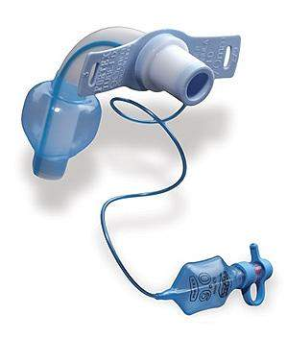
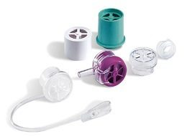
Tracheostomy Tube
Tube inserted into stoma in neck
Assists with breathing
Can be used with or without ventilator
Speaking valve allows talking
Eating can occur

Slide 18
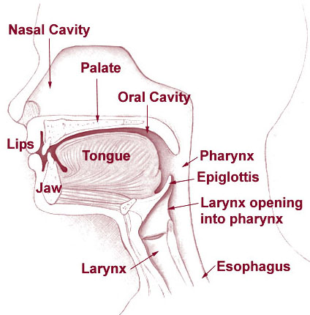
Dysphagia Assessment Measures
Oral Peripheral Exam
Bedside Swallow Evaluation
Functional Feeding Assessment
Instrumental Measures

Slide 19
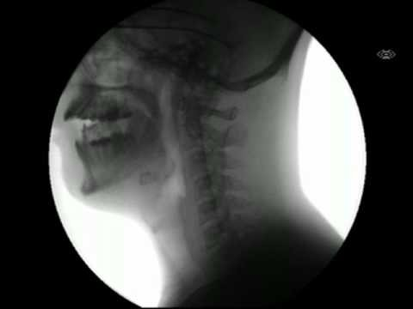
Modified Barium Swallow Study
Video x-ray study
Barium added to food
Monitor for safety
Helps determine diet
Some patient limitations
Notes:
.

Slide 20
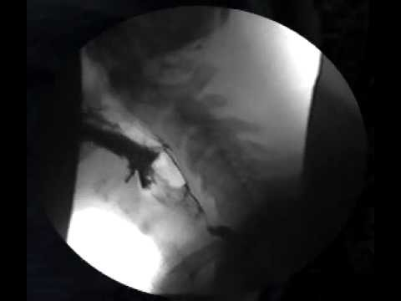
Aspiration During MBS

Slide 21
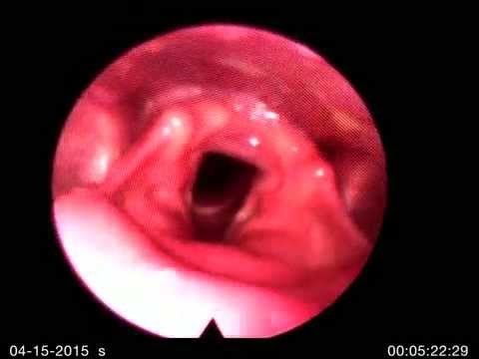
Fiberoptic Endoscopic Evaluation of Swallow
Flexible scope passed through the nose
Camera with light attached to the scope
Can be performed most patients
Short whiteout period

Slide 22
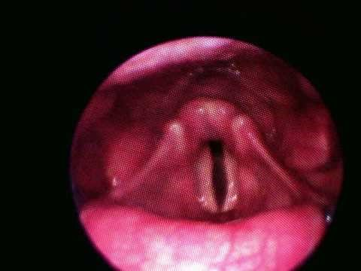
Aspiration during FEES

Slide 23
Dysphagia Treatment Modalities
Compensatory Strategies
Therapeutic Feeds
Positioning
Equipment
Electrical stimulation

Slide 24
Diet Modifications
Solids and liquids are modified for safety
Helps to decrease fatigue
Reduces aspiration risk
Previously based on National Dysphagia Diet
Moving towards IDDSI

Slide 25
Alternative Nutrition
Not all patients can tolerate food by mouth
Very impaired swallow
Decreased arousal level
On ventilator
Alternative Nutrition Methods
TPN
NG tube
G tube
Mixed

Slide 26
Assessment Procedures for
Cognition & Communication
After TBI

Slide 27
Cognitive-Communication Testing Considerations
Formalized testing MUST be normed for patients with TBI
Many factors affect testing reliability
Arousal
Depression
Agitation
Motor deficits
Sensory impairments

Slide 28
Cognitive-Communication Testing
Monitoring of Glasgow & Rancho Levels
Cognitive-Linguistic Quick Test
Includes Clock Drawing
SCATBI
ASHA-FACS
FAVRES

Slide 29
Pediatric Specific Testing
Pediatric Test of Brain Injury
Only standardized pediatric assessment for brain injury
FAVRES
Adolescent specific portion
CELF-5
Includes metalinguistic component

Slide 30
Cognitive-Communication
Impairments in TBI

Slide 31
Speech & Language Deficits in Patients with TBI
Expressive Language
Receptive Language
Reading & Writing
Pragmatics/Social Language

Slide 32
Discourse Analysis & Conversational Speech
Discourse deficits are a hallmark of TBI
Socially isolating
Discourse analysis best evidence based practice
Intervention should be based on cognitive deficits

Slide 33
Cognitive Deficits in Patients with TBI
Memory
Attention
Executive functioning
Insight

Slide 34
Treatment for Cognitive-Communication Deficits
Functional patient-centered goals
Collaborative team approach
High therapy frequency
Group & individual intervention
Evidence Based Practice

Slide 35
Compensatory Strategies
Support success and independence
by utilizing intact skills to
overcome challenges

Slide 36
Errorless Learning
Correct Practice
Patient feels successful
Small steps
Provide multiple models
Fade out prompts

Slide 37
Metacognitive Skill Training
Patients “think” about “thinking”
Increases problem-solving skills
Tasks are broken down into small steps
Setting Goals
Self-monitoring of performance
Evaluation

Slide 38
Augmentative & Alternative Communication
Supplements communication
Changes throughout treatment
No-tech, low-tech or high-tech
Decreases agitation or frustration
Increases independence
Can support speech development

Slide 39
Motor Speech Intervention
Increase speech & speech intelligibility
Targets apraxia & dysarthria
Tactile, visual, auditory cues
Modalities such as massage

Slide 40
Caregiver Stressors
Time off work
Decreased income
Caregiver burden
Concern for loved one
Increased anxiety & depression
Parental distress increases child behaviors

Slide 41
Questions?
Thank you!

Slide 42
References
ASHA www.asha.org
- AAC Practice Portal
- Pediatric Brain Injury Evidence Map
- Pediatric Brain Injury Practice Portal
- Adult Traumatic Brain Injury Practice Portal
Centers for Disease Control www.cdc.gov
- Traumatic Brain Injury & Concussion
- Report to Congress. The Management of Traumatic Brain Injury in
Children: Opportunities for Action
- Mass Trauma Resources Glasgow Coma Scale

Slide 43
References
Glasgow Structured Approach to Assessment of the Glasgow Coma Scale www.glasgowcomascale.org
Narad, M.; Yeates, K.; Taylor, H.; Stancin, T.; Wade, S. (2016) “Maternal and Paternal Distress and Coping Over Time Following Pediatric Traumatic Brain Injury”
Le, K.; Mozeiko, J.; Coelho, C. (2011). “Discourse Analyses: Characterizing Cognitive-Communication Disorders following TBI”
Ness, B. & Sohlberg, M. (2009). “Implementing Metacognitive Strategies Targeting Self-Regulation for Adolescents in Resource Settings”
Patterson, F.; Fleming, J.; Doig, E. (2016) “Group-based Delivery of Interventions in Traumatic Brain Injury Rehabilitation: A Scoping Review”

Slide 44
References
YouTube
“My X Ray Swallows”
“Intra Swallow Aspiration”
“Fiberoptic Endoscopic Evaluation of Swallowing”
“Aspiration Before the Swallow with Thin Liquids by Cup”
“IDDSI Flow Test”
Zollman, Felise S. (2011). Manual of Traumatic Brain Injury Management

